Slide 1
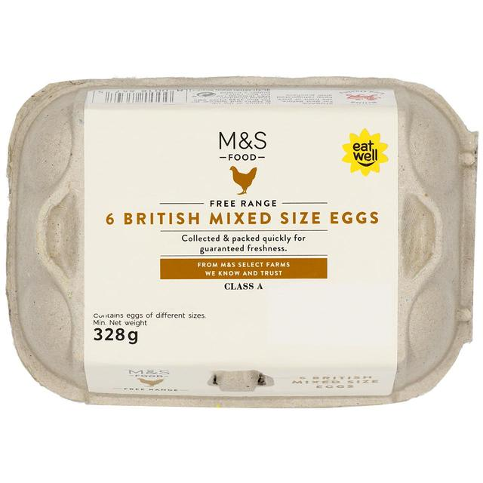
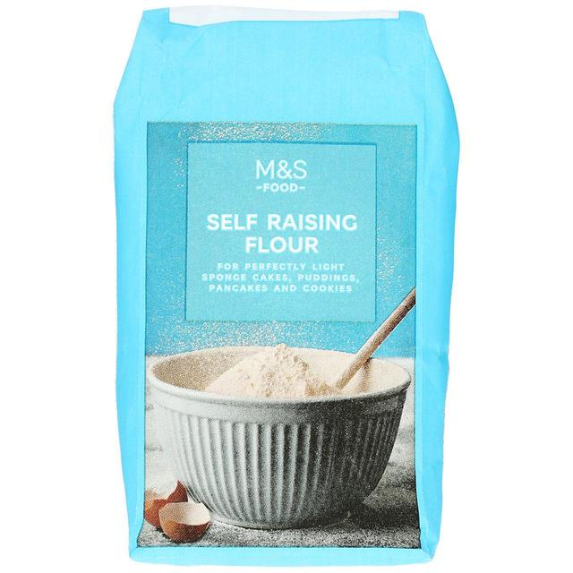
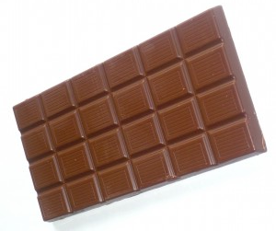
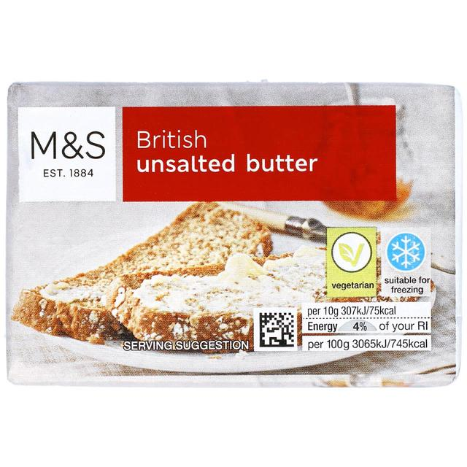

Slide 2
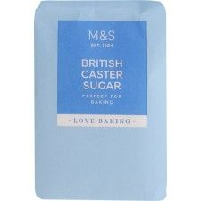
When you whisk this ingredient it traps air in bubbles, helping the pudding to be light and fluffy. It is liquid when raw, and solid when cooked.
Clue: You have to crack it first
This ingredient is mostly fat. It helps to keep the pudding moist and gives the sponge a smooth texture.
Clue: We spread it on bread
When you eat this ingredient it melts in your mouth, changing from solid to liquid. It contains fat, sugar and caffeine.
Clue: You can get milk, dark and white types of it.

Slide 3
This ingredient helps the pudding to rise and hold its shape. It contains gluten.
Clue: It’s a white powder that you would use to make bread.
This is the sweetest ingredient. It helps to keep moisture in the pudding by forming a hard crust when it’s baked.
Clue: It’s the main ingredient in sweets.

