Slide 1

Lesson 1

Slide 2
What do you know about M&S food?
Mind map everything you know, think and feel about M&S food.

Slide 3
Did you know?
1884 Our Penny Bazaar market stalls sold some basic food items like flour, spices and confectionery.
1935 Cafe Bars opened in a selection of stores.
1948 Nathan Goldenberg is appointed as Technical Executive and
Chief Chemist, his Food Technology Department improves quality control, hygiene and safety standards.
1960 M&S invents the cold chain in order to provide fresh, chilled chicken (not frozen). It’s an immediate success with customers.
1972 We introduce ‘sell-by’ dates, which later become a legal requirement.
1992 Percy Pigs are launched.
2019 We launch food ranges for specific preferences including Plant Kitchen for vegans, Halal and Kosher ranges.

Slide 4

What is an archive?
Why would a business like M&S have and value an archive?

Slide 5

Introduction
Watch the Promoting the Pudding film
Q: Why do you think the ‘This is not just food…’ TV advert was so successful?

Slide 6
Creating the Pudding
Q: Why do you think it took so long to get the pudding right?

Slide 7
Creating the Pudding
Watch the Perfect Pudding? film
How does the pudding go wrong and why?

Slide 8
Creating the Pudding
Q: How would you describe a failed pudding?
Think about what it would look, smell and taste like and why.

Slide 9
Creating the Pudding
Q: How would you describe a successful pudding?
Think about what it would look, smell and taste like and why.

Slide 10
Lesson 1 Plenary
Q: Why do you think M&S chose to invest so much time into developing this product?
List the pros and cons of long product development times.

Slide 11

Lesson 2

Slide 12
Ingredients
Q: What were the five key ingredients used to make the pudding in the Perfect Pudding? film.

Slide 13
Ingredients
Sort the cards in your pack
Match each ingredient with a description and a molecular structure

Slide 14
Ingredients
Which ingredient
  Helps the pudding to coagulate?
  Flavours by sweetening and colours by caramelising when heated?
  Moistens a baked mixture such as the sponge whilst extending shelf life?
  Helps the pudding keep its structure?

Slide 15
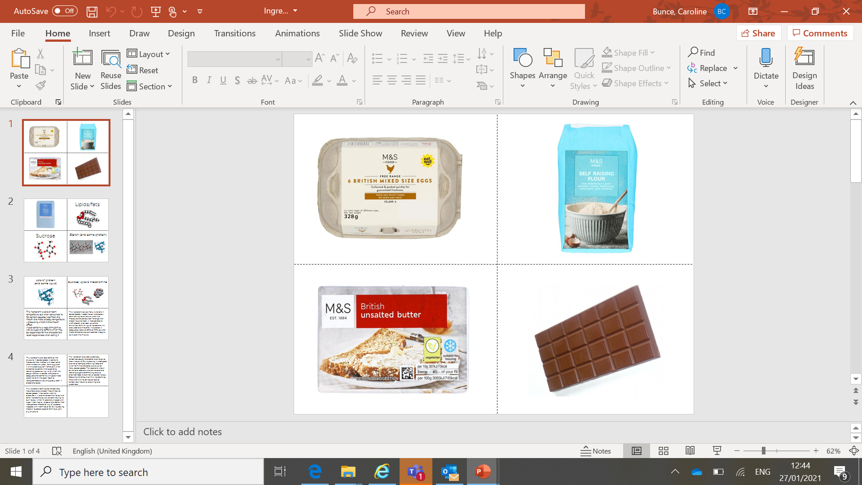
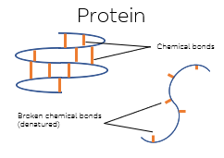
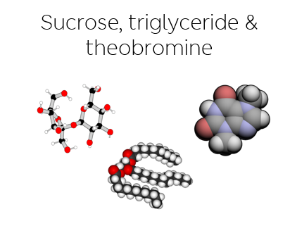
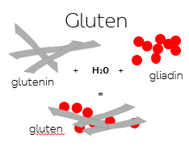
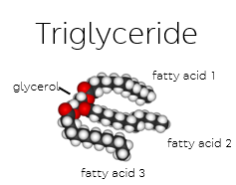
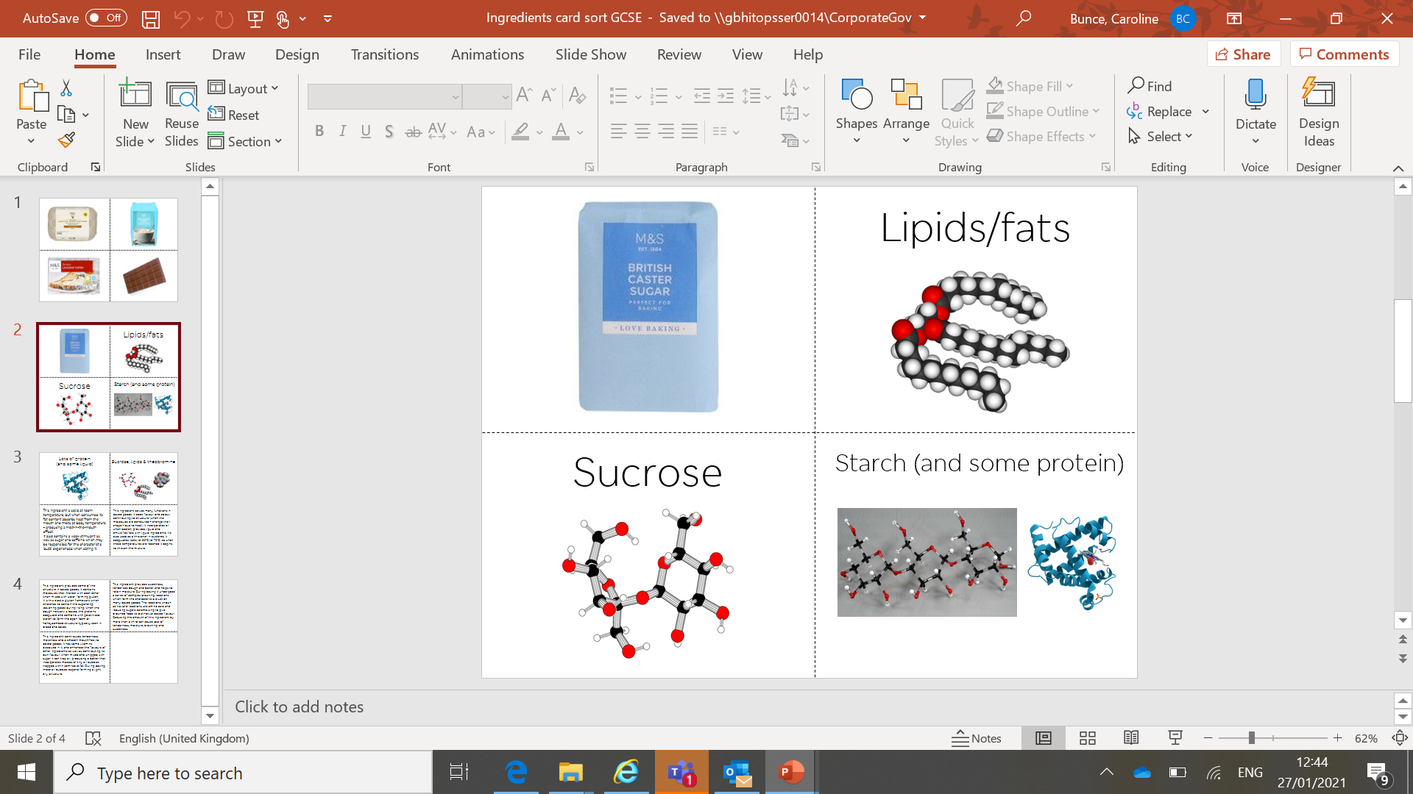
Ingredients – the answers
This ingredient serves many functions in baked goods. It adds flavour and colour, contributing to structure (when the molecules are denatured – change their shape – due to heat). It incorporates air when beaten, provides liquid and emulsifies fats with liquid ingredients. It’s also used as a thickener in custards. It coagulates (sets) at 60°C to 70°C, so when these temperatures are reached it begins to thicken the mixture.
This ingredient is solid at room temperature, but when consumed its fat content absorbs heat from the mouth and melts at body temperature – producing a melt-in-the-mouth effect. It also contains a weak stimulant as well as sugar and caffeine which may be responsible for the characteristic ‘buzz’ experienced when eating it.
This ingredient provides some of the structure in baked goods. It contains glutenin and gliadin that when mixed with water, form gluten. It is this elastic gluten framework which stretches to contain the expanding leavening gases during rising. When the dough network is baked, the proteins coagulate and combine with gelatinised starch to form the open foam or honeycombed structure typically seen in bread and cakes.
This triglyceride is a mixture of glycerol and three fatty acids. It contributes tenderness, moistness and a smooth mouth-feel to baked goods. It is a source of vitamins A, D, E, B12, and K2 and enhances the flavours of other ingredients as well as contributing its own flavour. It can trap air bubbles when beaten and whipped with sugar it has plasticity. During baking, these air bubbles expand forming a light, airy structure.
This ingredient provides sweetness, tenderizes dough and batter and helps to retain moisture. During baking it undergoes a series of complex browning reactions which form the characteristic crust on many baked goods. The reactions, known as Maillard reactions, are amino acid and reducing sugars caramelising to give browned food its distinctive ‘baked’ flavour. Reducing the amount of this ingredient by more than a third can cause loss of tenderness, moisture, browning and sweetness.

Slide 16
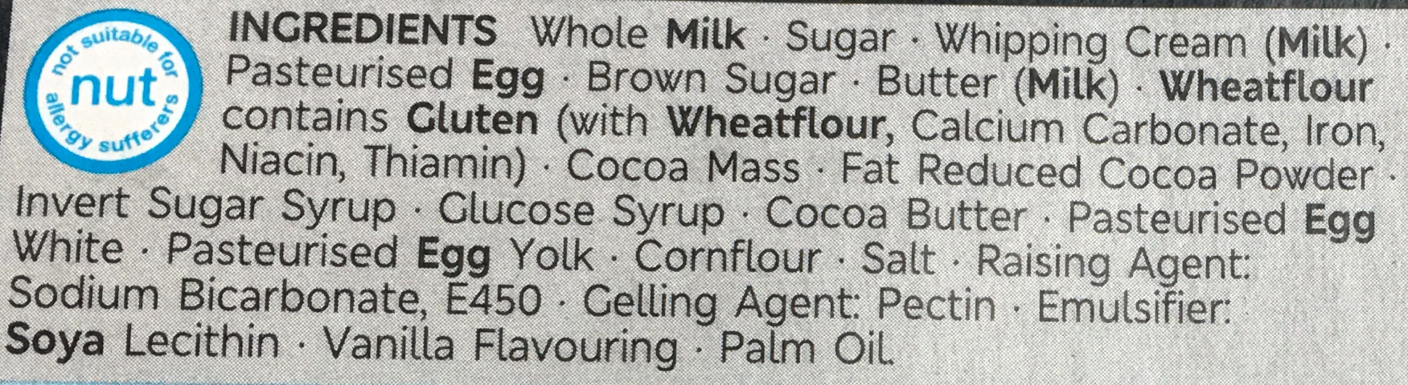
Helpful Additions
Q: Why are there more ingredients in the M&S pudding than in a homemade pudding?

Slide 17
Helpful Additions
Watch the Emulsifiers film
Q: What function do emulsifiers perform?
Q: Why is that an important function in chocolate products?

Slide 18
Modify the Pudding
Brief 1: Create a Chocolate Melt in the Middle Pudding that is suitable for a customer who follows a vegan diet.
Brief 2: Create a Chocolate Melt in the Middle Pudding that is suitable for a customer who has coeliac disease.
Brief 3: Create a Chocolate Melt in the Middle Pudding that is suitable for a customer who has to follow a low-sugar diet.

Slide 19
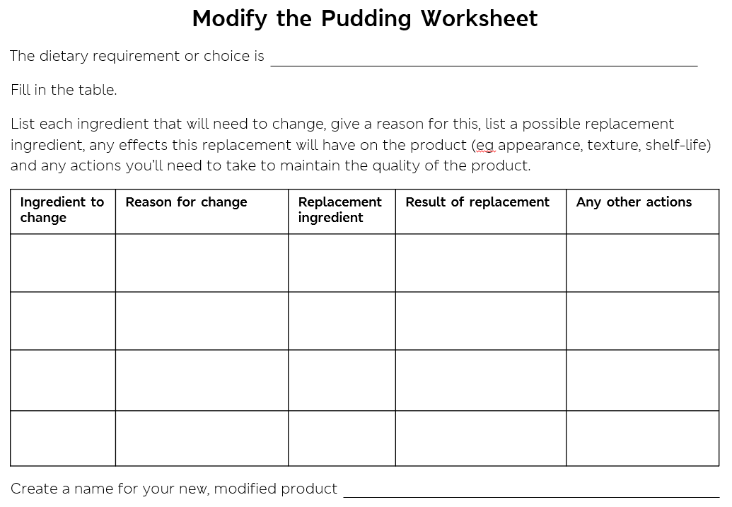

Slide 20
Lesson 2 Plenary
Peer Review - Share your work

Slide 21
Lesson 3

Slide 22
Ice Cream in a Bag
Watch the Ice Cream film.
Follow the instructions to make your ice cream.

Slide 23
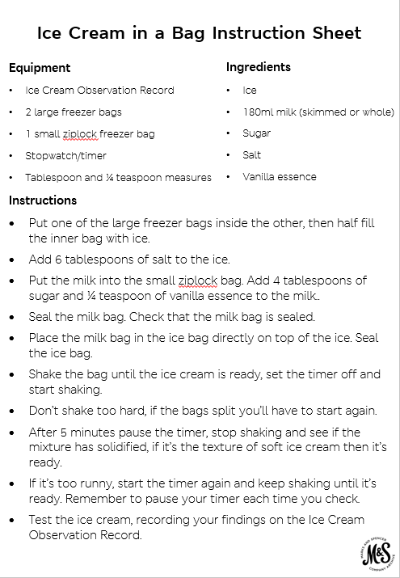
MAKING ICE CREAM TOP TIPS
Aprons and gloves are recommended, this can be a messy activity.
Keep one hand on the bottom of the bag when shaking to help prevent the bag splitting.
The ice bags get cold! Working in groups means you can share the shaking and
avoid your hands getting too cold.
Try to keep the milk bag upright in the ice bag.

Slide 24
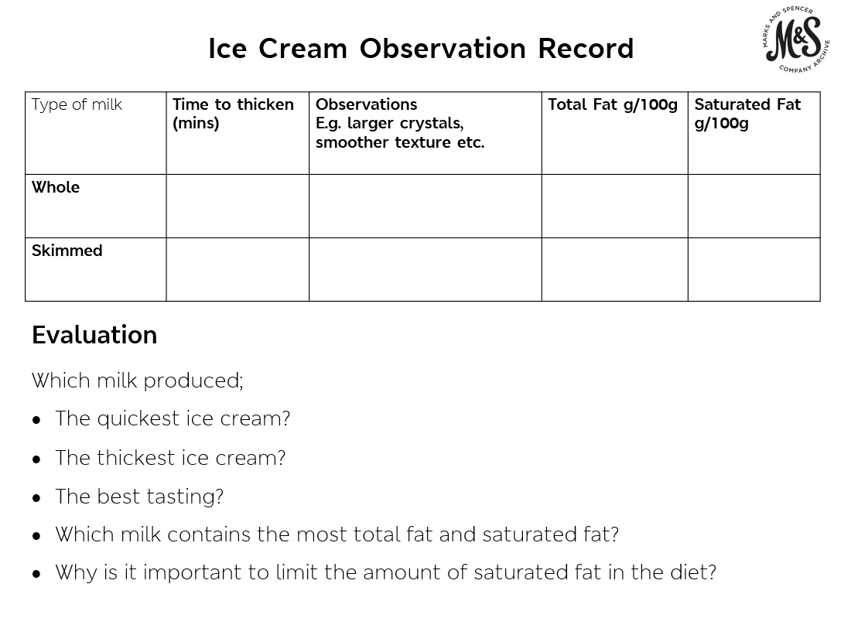

Slide 25
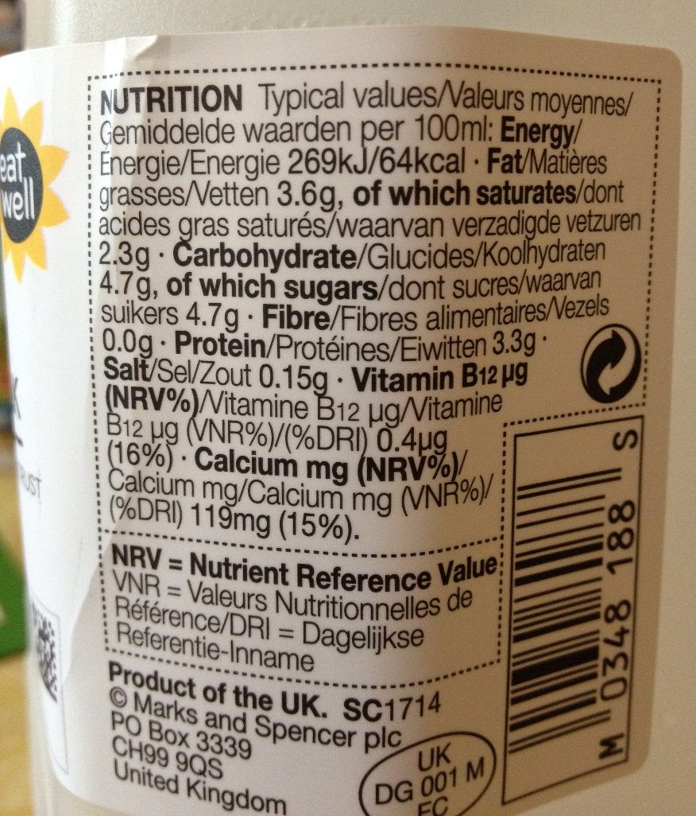
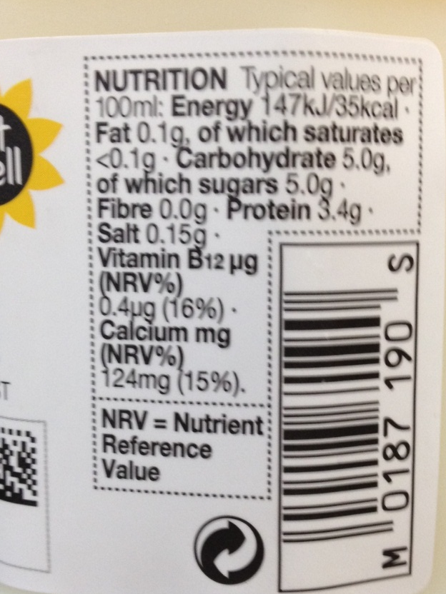
Ice Cream in a Bag
Whole Milk
Skimmed Milk

Slide 26
Ice Cream in a Bag
Q: What can you conclude about the effect of fat content on the qualities of ice cream?
Fats are important because they trap air, giving a silky, rich texture to ice cream.
When skimmed milk is used, it will lack the creamy texture and won’t be as light because the air isn’t incorporated into it as effectively.

Slide 27
Sensory Evaluation
Q: What is sensory evaluation and why is it important?

Slide 28

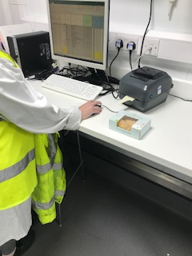
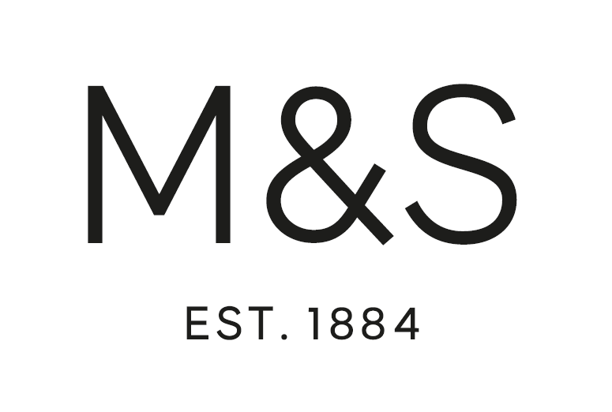


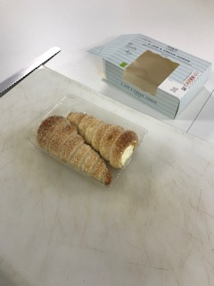
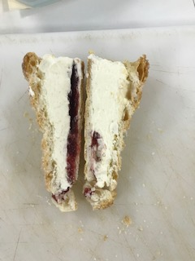
Sensory Evaluation at M&S
Quality Contract

Slide 29


Slide 30
Plenary
Q: Can you name any other iconic food products?
Q: What do you think makes a food product iconic?
Mind map all the factors that have contributed
to the success of the Chocolate Melt in the Middle Pudding.

