Slide 1


Slide 2
What is a pudding?

Slide 3
What’s your favourite pudding?
Why do you like it?

Slide 4
Introduction
Watch the Promoting the Pudding film
Q: Why do you think so many people bought puddings after seeing the ‘This is not just food…’ TV advert?

Slide 5
Creating the Pudding
Q: Why do you think it took so long to get the pudding right?

Slide 6
Creating the Pudding
Watch the Perfect Pudding? film
Watch for all the ways the pudding goes wrong!

Slide 7
Creating the Pudding
Q: How would you describe a failed pudding?
Think about what it would look, smell and taste like.

Slide 8
Creating the Pudding
Q: How would you describe a successful pudding?
Think about what it would look, smell and taste like.

Slide 9
Ingredients
Q: What were the five key ingredients used to make the pudding in the Perfect Pudding? film.

Slide 10
Ingredients
Sort the cards in your pack
Match each ingredient with a description

Slide 11
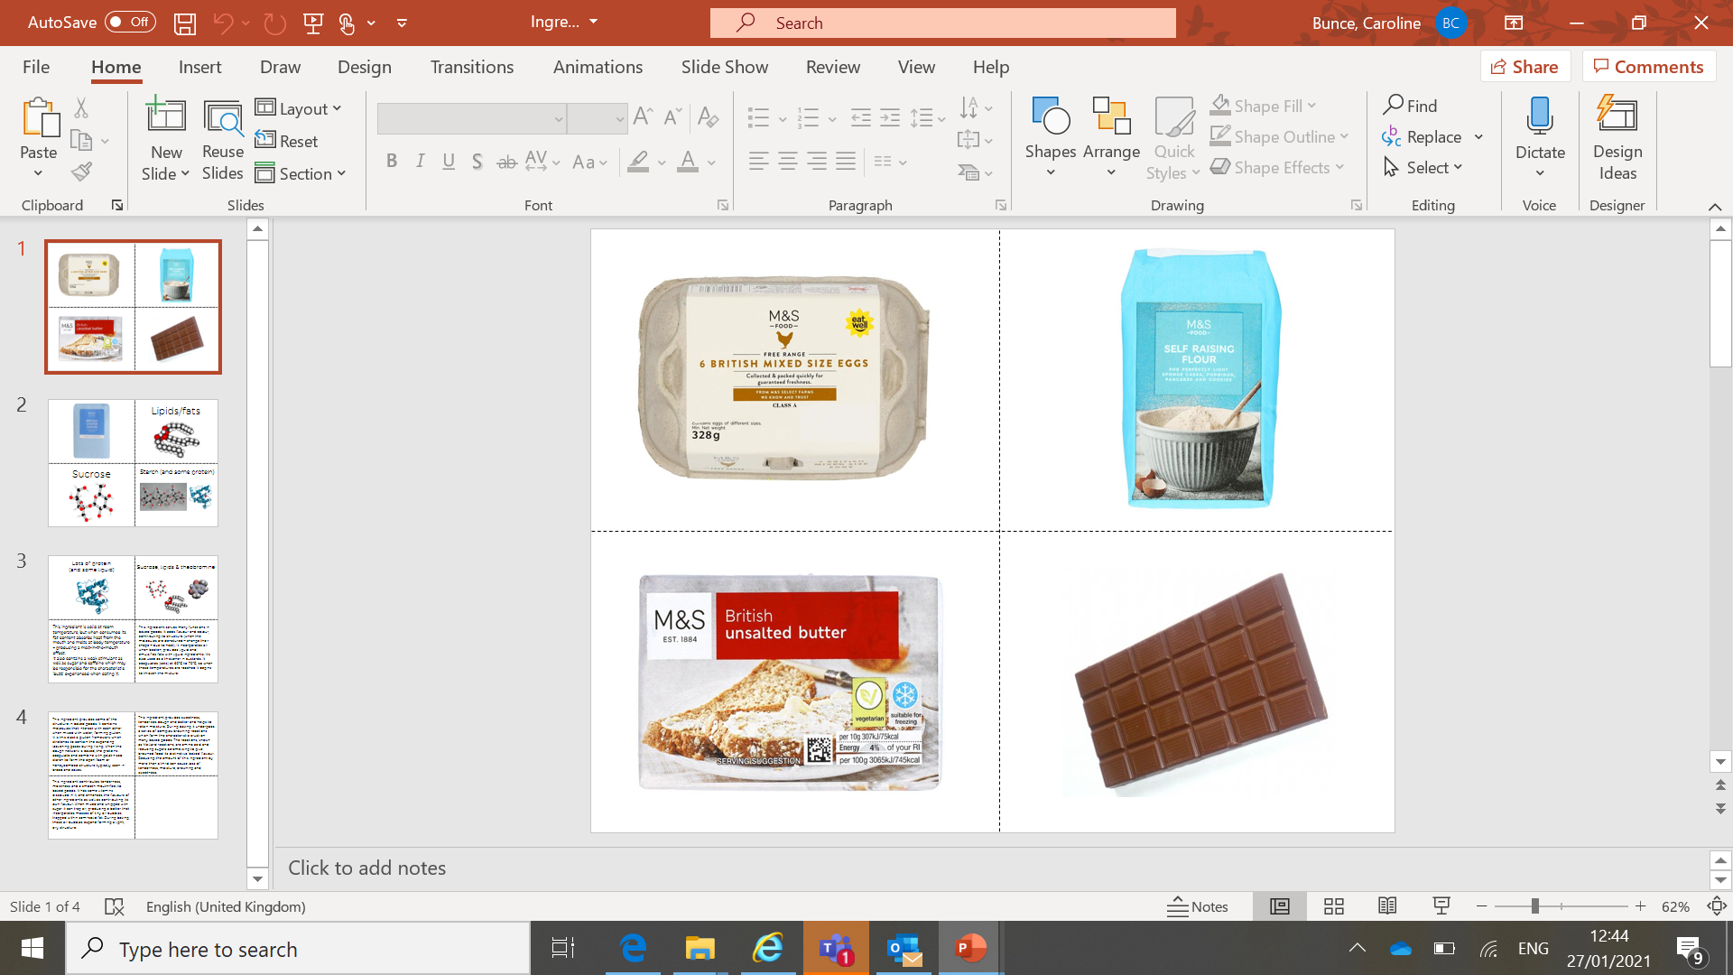
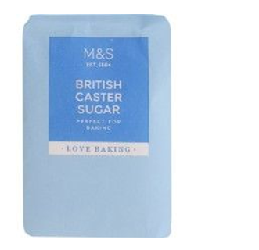
Ingredients – the answers
Changes from a liquid to a solid when heated.
Holds the structure of the sponge and traps air bubbles.
Solid at room temperature, melts at body temperature.
Contains sugar and caffeine.
Creates gluten when mixed with water.
Helps the sponge to hold hot air bubbles as it rises.
Contains vitamins and enhances other flavours.
Keeps the pudding moist and gives the sponge a smooth texture.
Provides sweetness and helps to keep moisture in the pudding mix.

Slide 12
Why do we like chocolate?
Q: Who likes chocolate?
Q: Why do you think people like it so much?
Caffeine
Theobromine

Slide 13
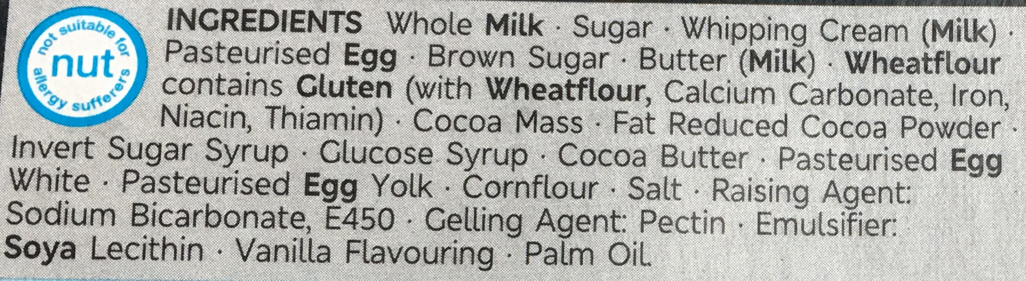
Helpful Additions
There are a lot more ingredients in the M&S pudding than in a homemade pudding.
Q: Why do you think that is?

Slide 14
Helpful Additions
Watch the Emulsifiers film
Q: What do emulsifiers do?
Q: Why are they important for making chocolate?

Slide 15
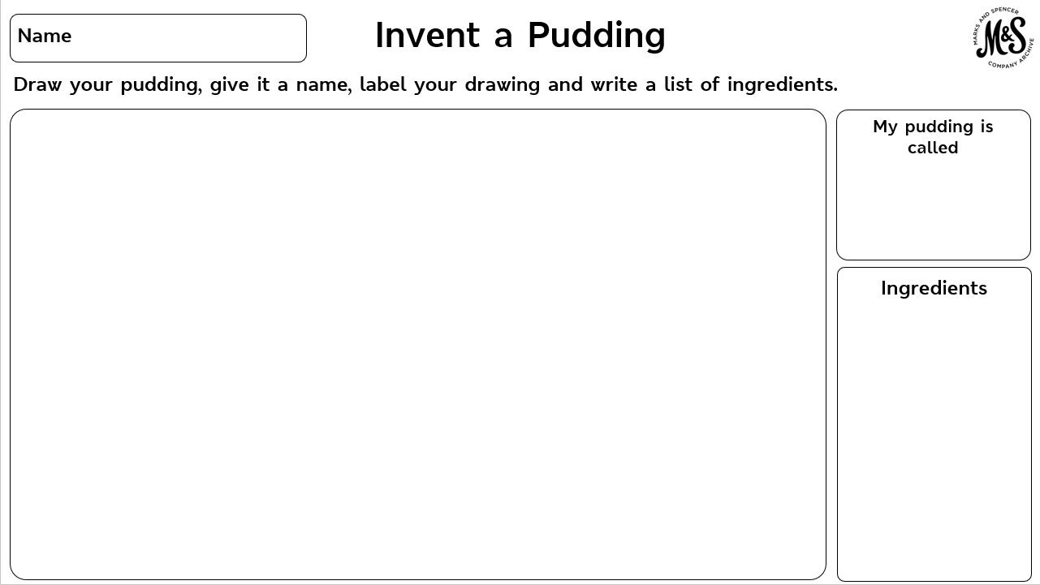
INVENTING TIP Coming up with a new idea can be tricky! Think about your top two favourite puddings and combine the best bits to make something totally new!

Slide 16
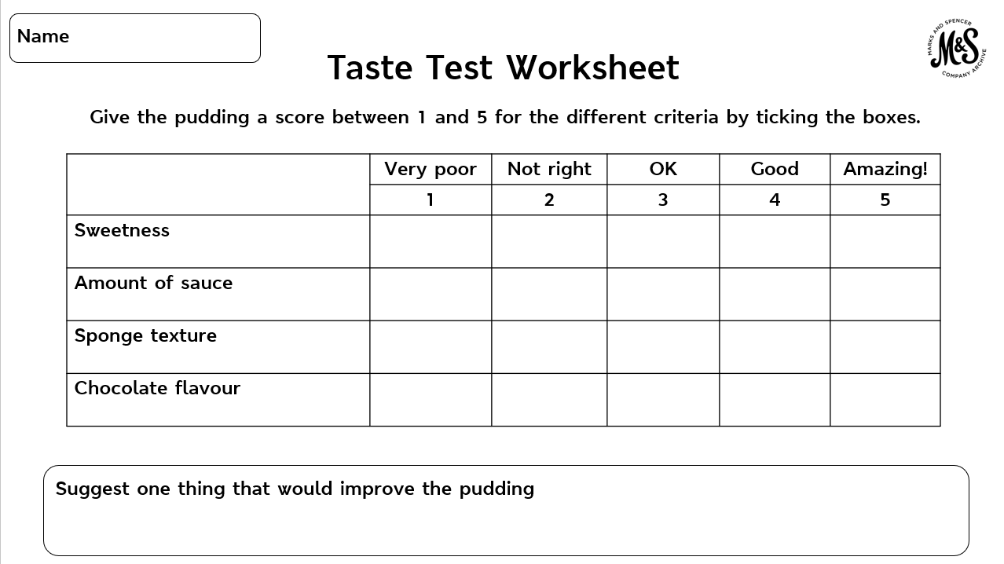

Slide 17

Taste Test
Q: Which feature did you give the lowest score and why?
Q: Which one did you give the highest score and why?
Q: Suggest one thing that would improve the pudding.

Slide 18
Plenary
Q: What made the M&S Chocolate Melt in the Middle Pudding such a success?

