Slide 1


Slide 2
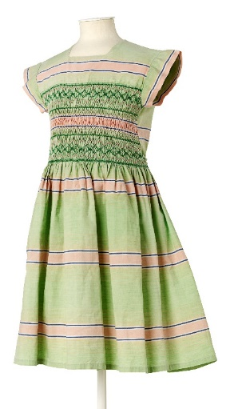
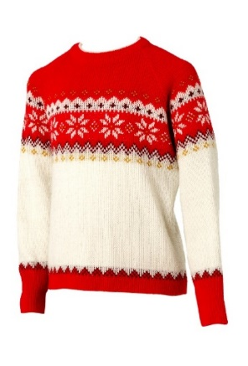
What are fabrics?
How many different fabrics can you name?

Slide 3
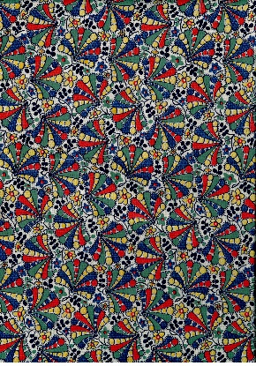
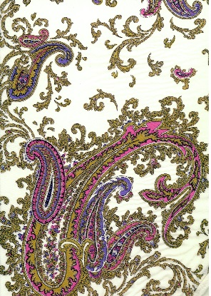
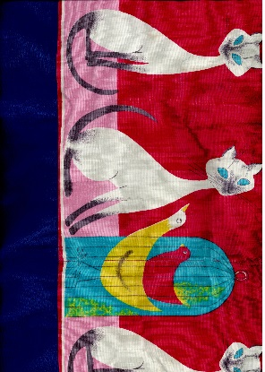
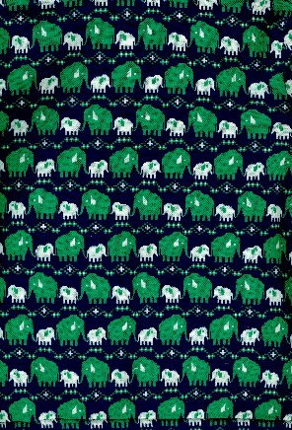
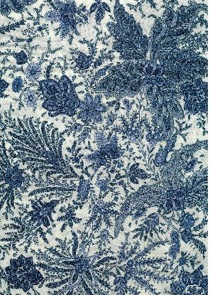
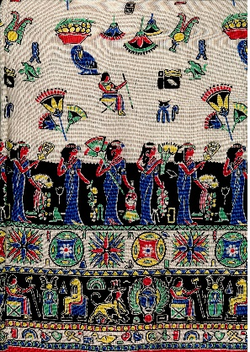
Investigating Fabrics
Use your senses to explore the fabrics

Slide 4
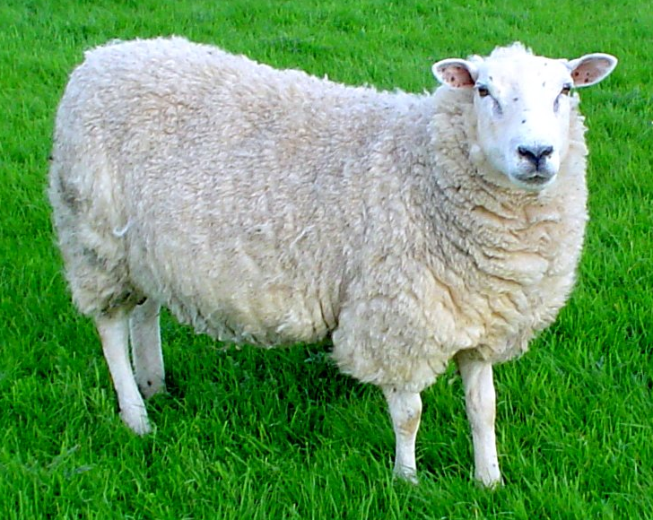

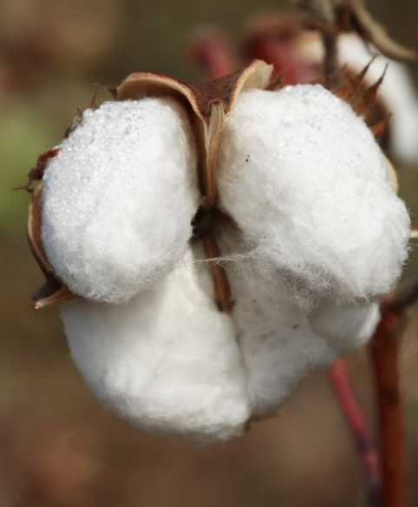
Making Fabrics
Is it natural or synthetic?

Slide 5
Play
Find the Fabric!

Slide 6
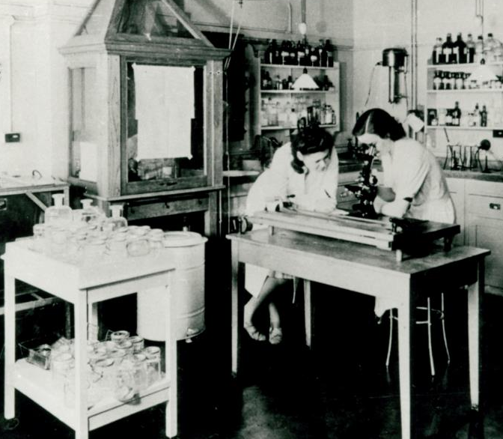
Testing Fabrics
Different fabrics have different properties
This is why we use certain fabrics to make types of clothing e.g. waterproofs
You are going to test some fabrics to find out about their properties
Watch the film

Slide 7
Investigation 1
Tree-climbing Trousers
You need to make some trousers especially for climbing trees.
Q: What properties will you need your tree-climbing trousers to have?
Q: How can you test the fabrics?
Q: How can you make sure your tests are fair?

Slide 8
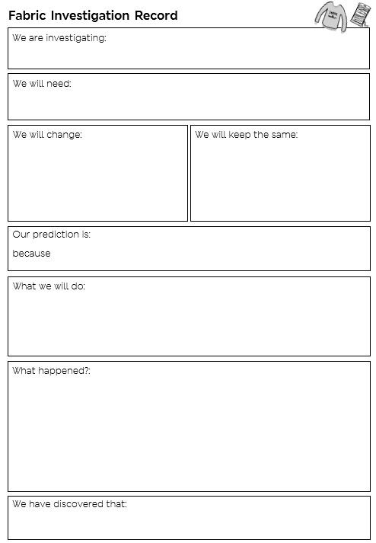

Slide 9
Investigation 2
Swimsuit
You need to find the best fabric for making a swimsuit.
Q: What properties will you need your swimsuit to have?
Q: How can you test the fabrics?
Q: How can you make sure your tests are fair?

Slide 11
Future Fashion
Do you know what the word innovation means?
Inventing something new, or a new way of doing something, that makes the process easier, or solves a problem.
Watch the film

Slide 12
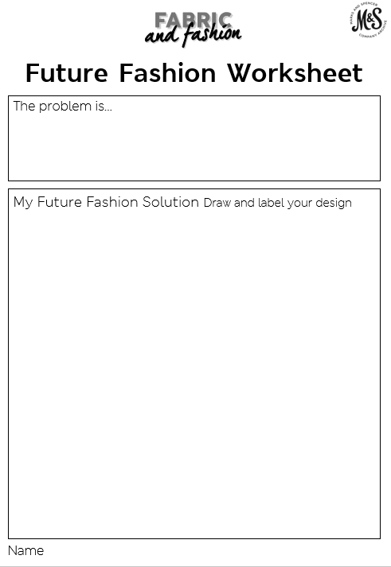
What’s the problem?
What’s the solution?

Slide 13

Future Fashion
Gallery

