Slide 1
What’s On My Plate? Historical Sources – Information for teachers
Period | No | Title | Description | Focus points
 | 1 | A Good Cook never spoils the broth | Article from The Marks & Spencer Magazine, 1932 | Can you read the names of the dishes?
 | 2 | Café Bar in Guildford store, 1941 | Photograph | Find the menu on the wall. What are the dishes?
 | 3 | Café Bar in Watford store, 1930s | Photograph | Find the menu on the wall. What are the dishes? Is there any other food and drink?
 | 4 | Leaflet on menu planning, 1950s | Company document | Are there any foods you don’t know? Use the Glossary to find out what they are.
 | 5 | Tinned food labels, 1950s-60s | Food packaging | What other food could you add to make a meal?
 | 6 | Fresh Fried Fillets, 1950s | Photograph | How long does it take to get this dish ready? What other food could you add to make a meal?
 | 7 | Sandwiches and rolls, Oxford 1951 | Photograph | What other sandwich fillings were there? Which would you choose?
 | 8 | Frozen Foods, 1971 | Advert | Choose a meal from the picture. What frozen vegetables could you add?
 | 9 | Chicken Tikka Masala, 1987 | Food packaging | Would you add anything to this food to make a meal?
 | 10 | Lamb recipes | From Microwave Cooking, Jenny Webb, 1983 | Can you match the names to the pictures? Choose one for your Meal from the Past.
1930s-40s
1950s-60s
1970s-80s

Slide 2
Source 1
Article from The Marks & Spencer Magazine, 1932
Can you read the names of the dishes?
Glossary
Bloater – a whole smoked herring fish, with the guts left inside

Slide 3
Source 2
Café Bar in Guildford store, 1941
Find the menu on the wall. What are the dishes?
Café Bar Menu
Cottage Pie with peas and mashed potatoes
Fruit Pie
Salmon Salad
Beans on toast
Trifle
Tea
Coffee

Slide 4
Source 3 Café Bar in Watford store, 1930s
Find the menu on the wall. What are the dishes? Can you see any food or drink on display?
Glossary
Savoury & Veg. Cutlet – vegetables and mashed potato mixed, coated in breadcrumbs and fried in a flat round shape
Bovril – a salty paste similar to Marmite, it can be made into a drink by adding hot water.

Slide 5
Source 4
Leaflet on menu planning, 1950s
Are there any foods you don’t know?
Use the Glossary to find out what they are.
Glossary
Carrots Vichy – carrots cooked in water with butter and sugar
Queen of Puddings – a dessert made from breadcrumbs with milk, sugar, butter and eggs, topped with jam and meringue

Slide 6
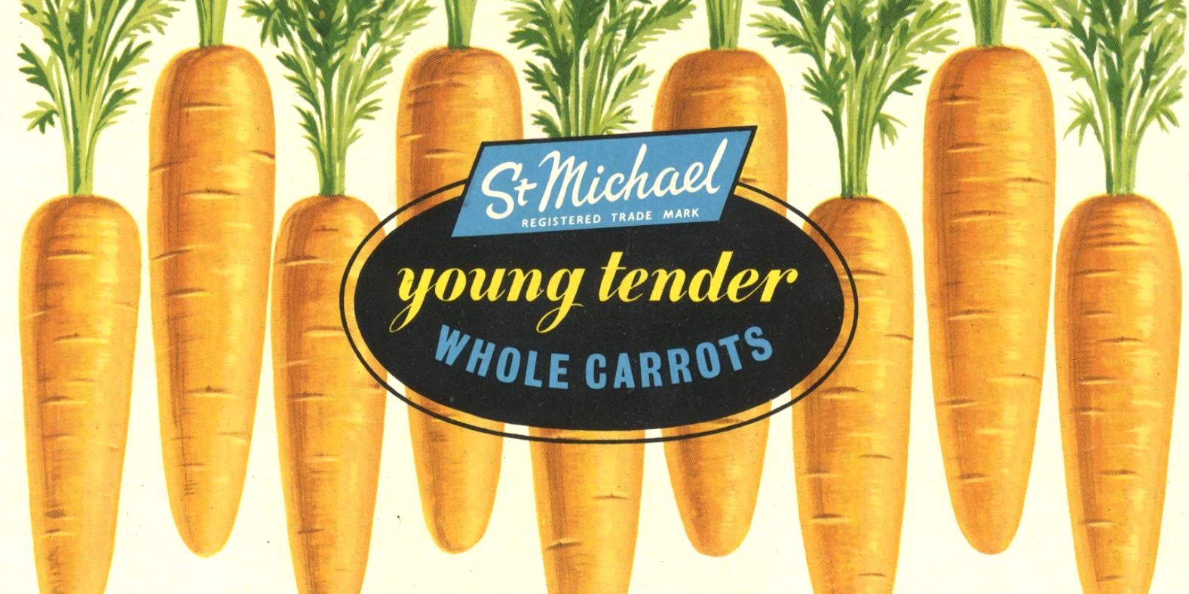
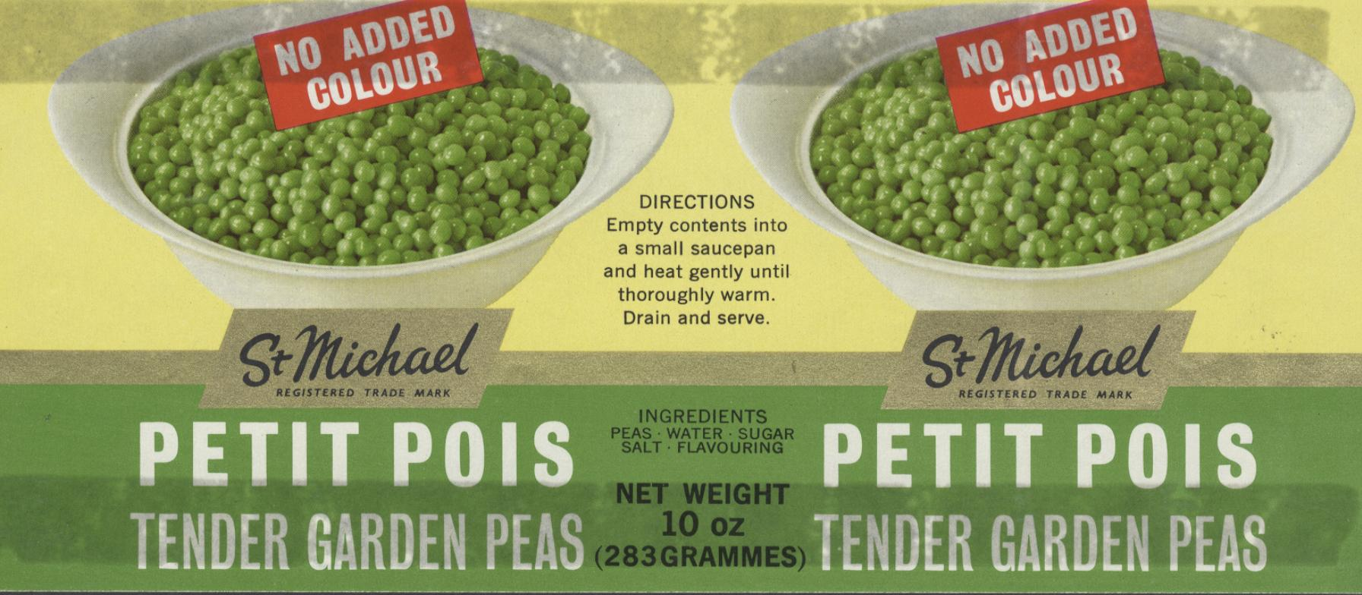
Source 5
Tinned food labels, 1950s-60s
What other food could you add to make a meal?

Slide 7
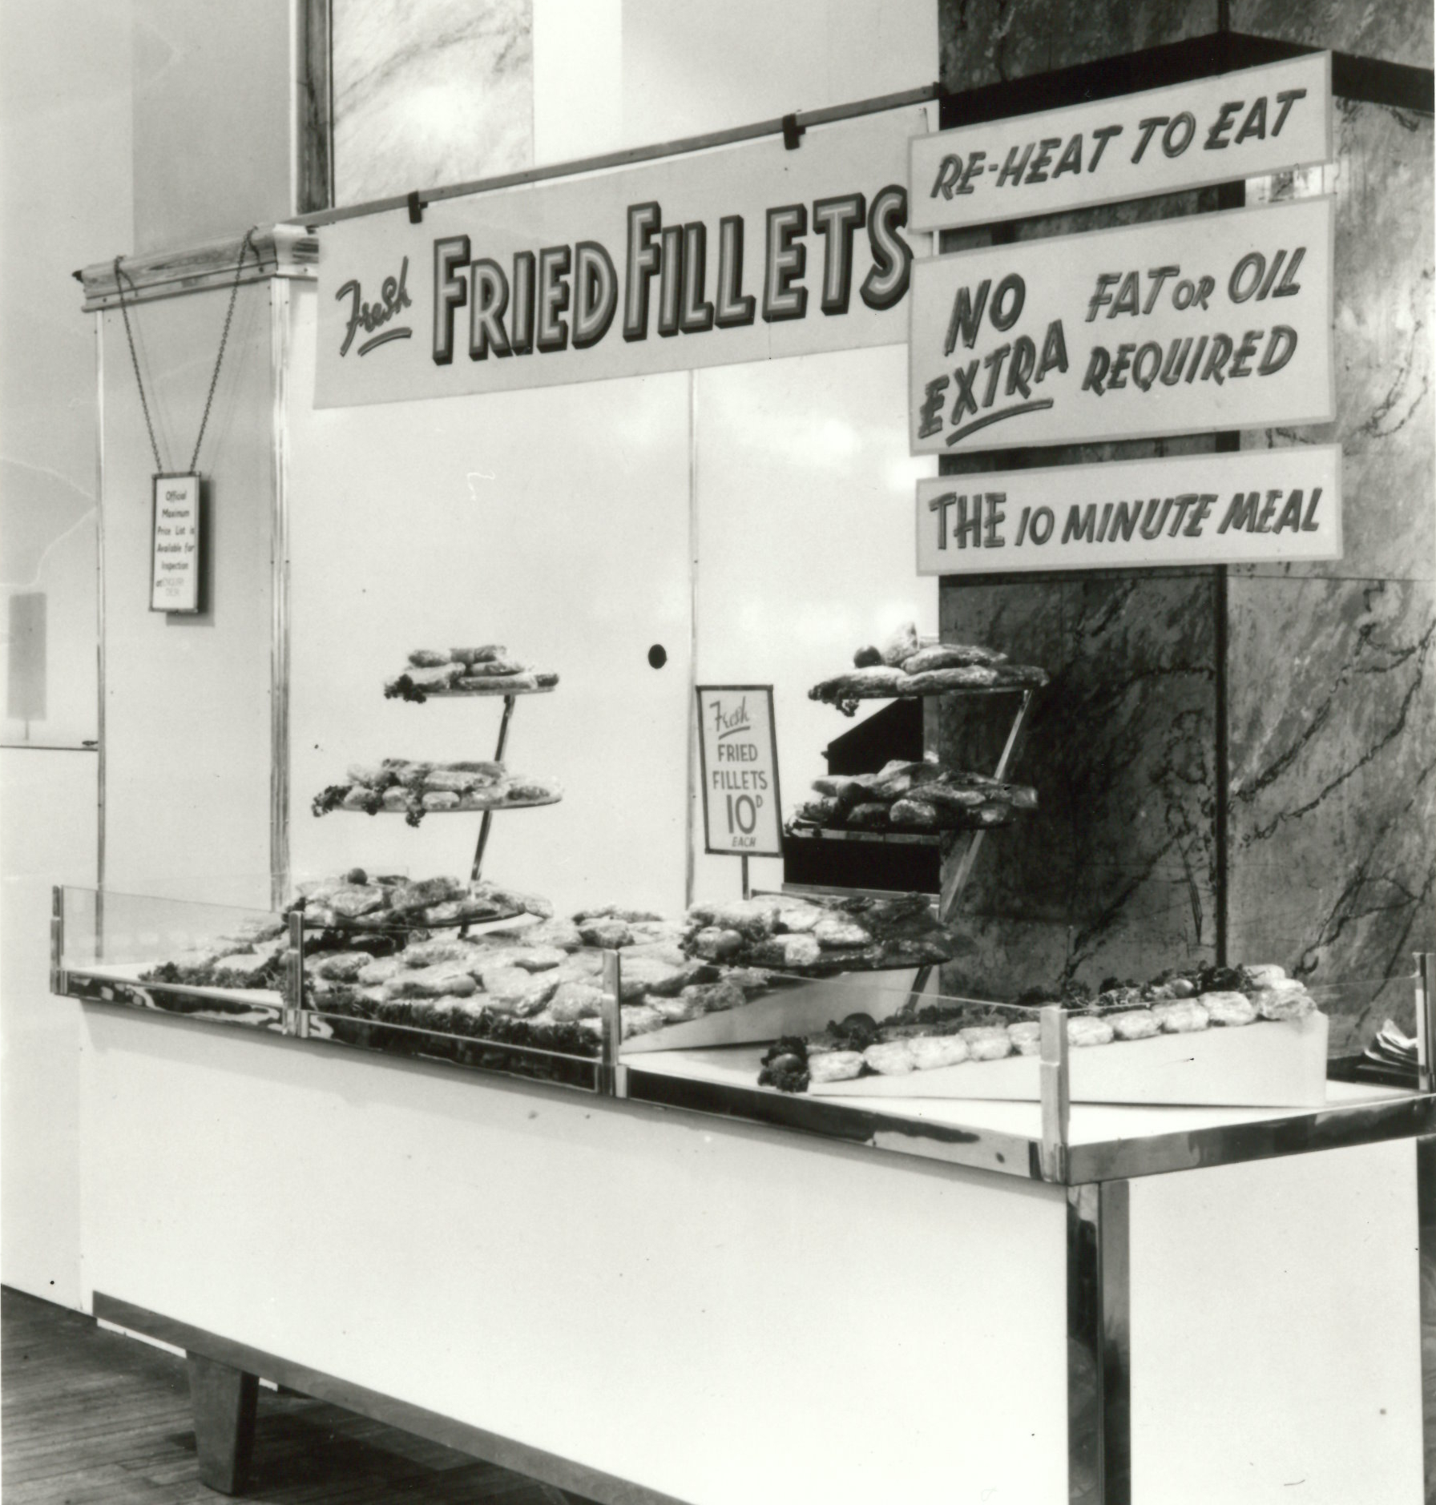
Source 6
Fresh Fried Fillets, 1950s
How long does it take to get this dish ready?
What other food could you add to make a meal?

Slide 8
Source 7 Sandwiches and rolls, Oxford 1951
What other sandwich fillings are there?
Which would you choose?
Glossary
Luncheon meat – a type of cooked meat usually sold in tins. Spam is a brand of luncheon meat.

Slide 9
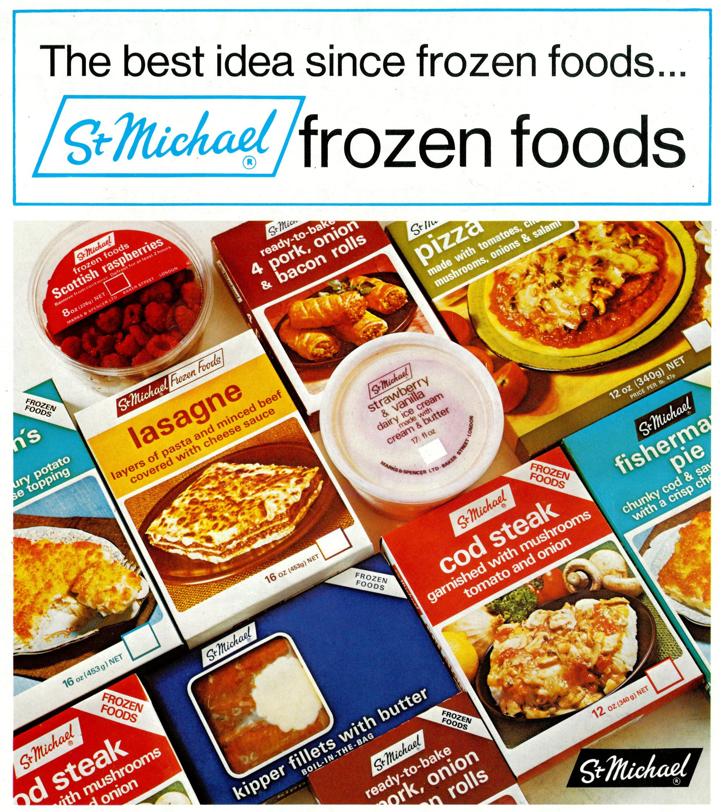
Source 8
Frozen Foods advert, 1971
Choose a meal from the picture.
What frozen vegetables could you add?
Glossary
Kipper – a whole herring fish, salted or pickled, and smoked that is a traditional breakfast dish

Slide 10
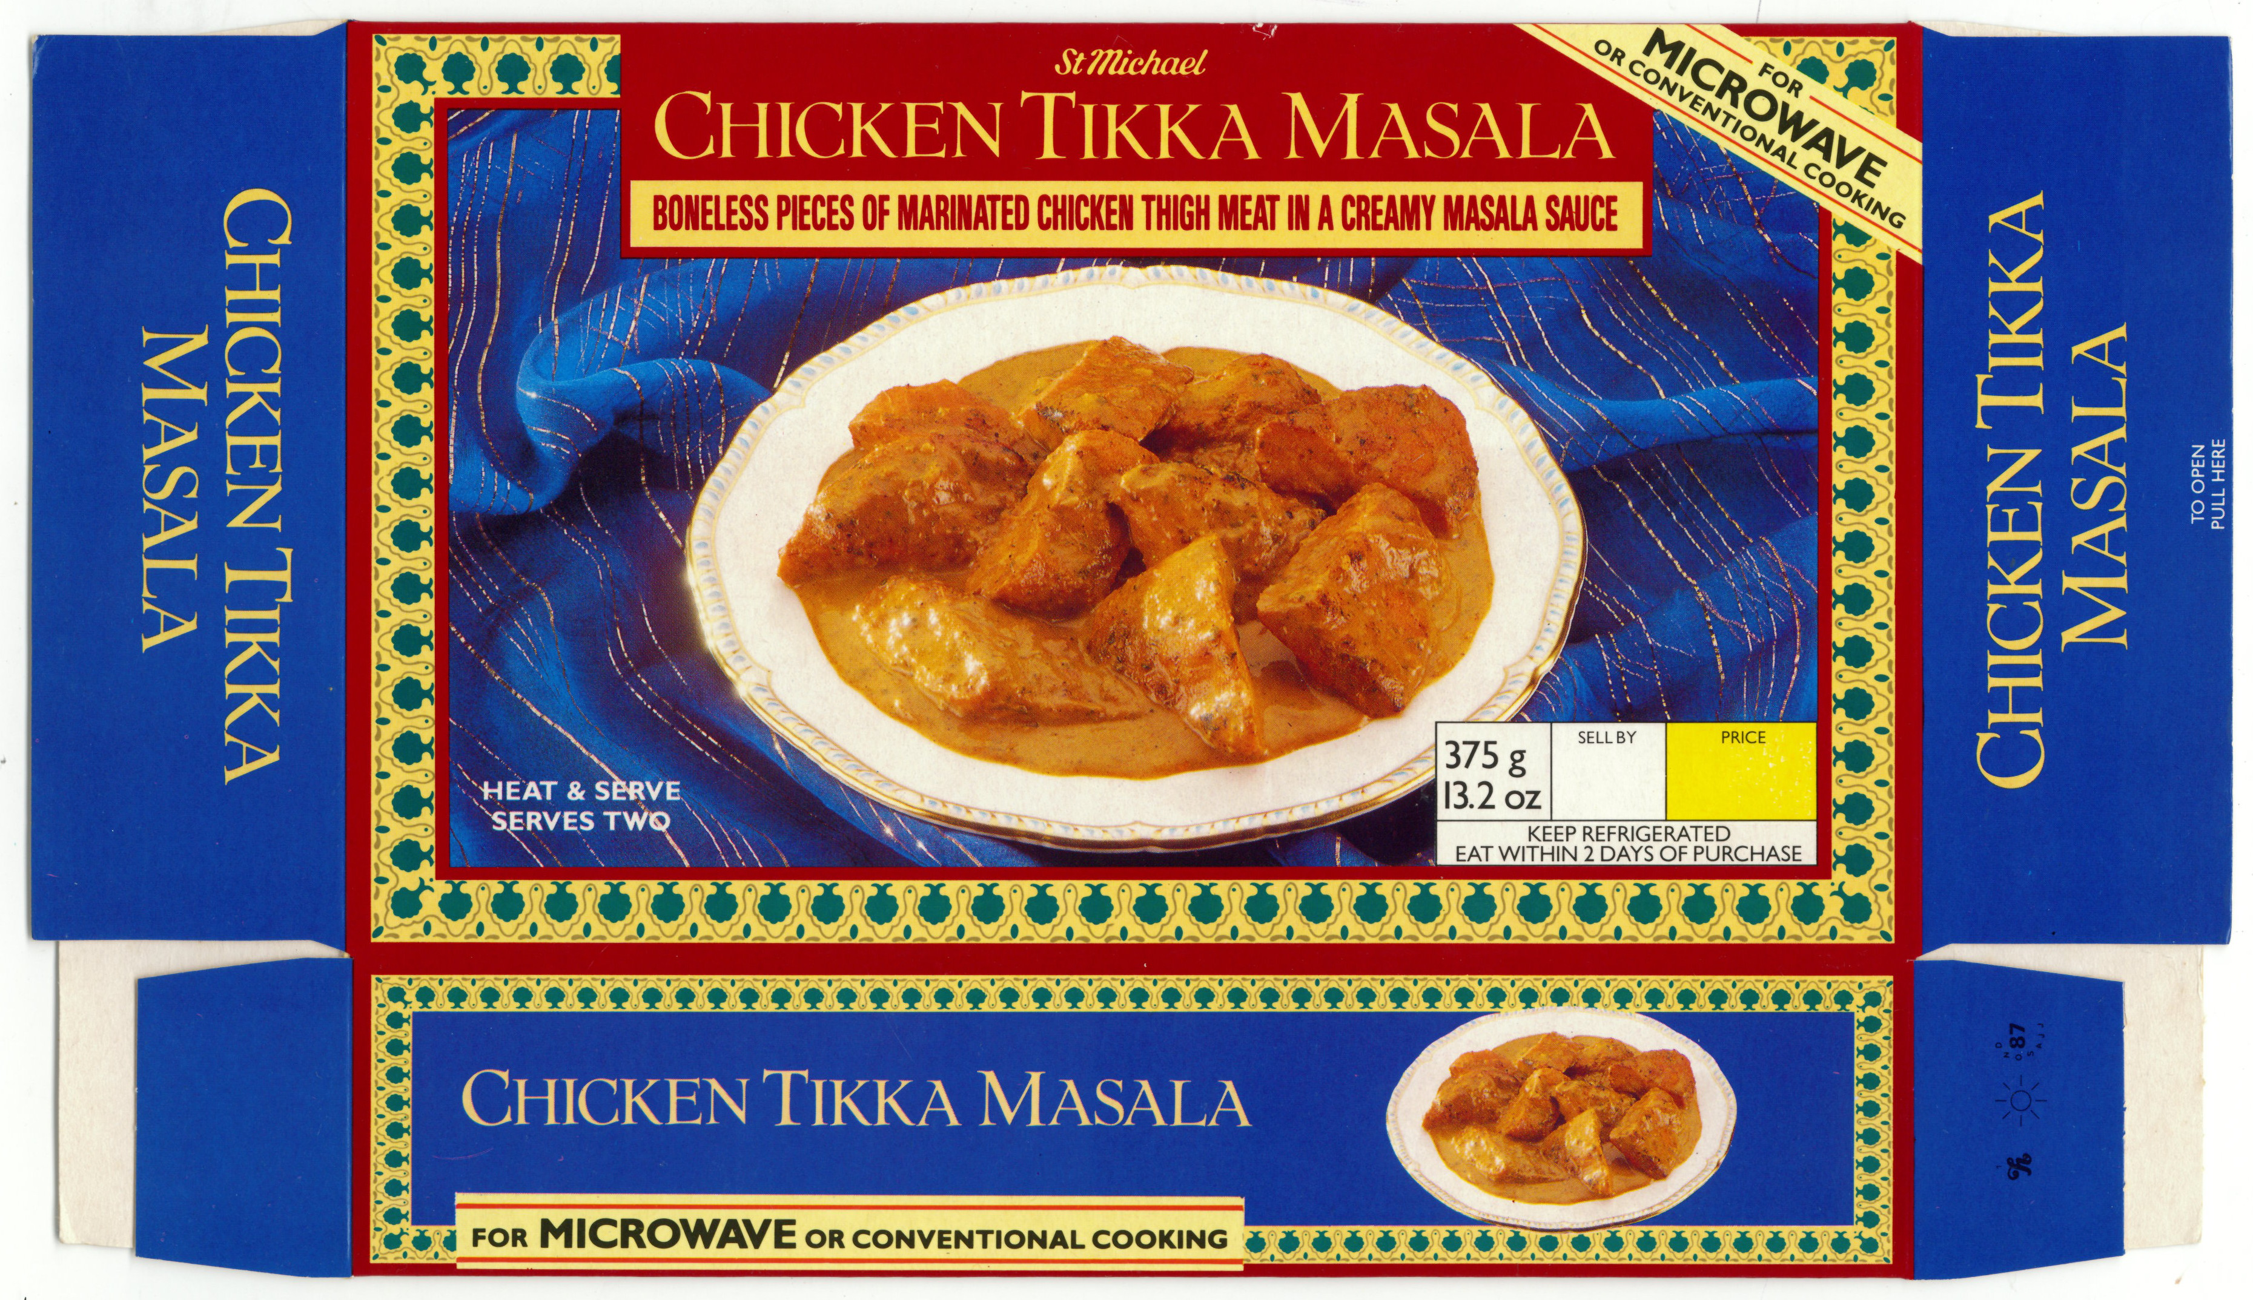
Source 9
Chicken Tikka Masala food packaging, 1987
Would you add anything to this food to make a meal?
Glossary
Marinated – Marinating is a process of soaking raw meat in a sauce before cooking
Masala - a spice mix used in South Asian cooking

Slide 11
Source 10
Can you match the names to the pictures?
Choose one for your Meal from the Past.
From Microwave Cooking, Jenny Webb, 1983

