Slide 1
Archive Biscuit Tin Images – information for teachers
Picture no. | Description | Date | Information
1 | Square green tin with illustrations | 1984 | M&S Centenary biscuit tin celebrating 100th anniversary of M&S.
2 | Asymmetric bookcase tin with tea cup | 2011 | Christmas biscuit tin designed using images from the archive collection (Sleeping Beauty book cover, 1930s, and Christmas Carols sheet music album, 1900s).
3 | Marks & Spencer Bazaar shopfront tin | 2006 | Christmas biscuit tin inspired by our Penny Bazaar shops (1900s-1920s).
4 | Vintage TV tin | 2010 | Christmas biscuit tin in the shape of a 1960s television.
5 | Red phone box tin | 2012 | Biscuit tin in the shape of a traditional red phone box.
6 | Hexagonal red tin | 2008 | Christmas biscuit tin designed using images from the archive collection (Advert for tree decorations, 1910s).

Slide 2
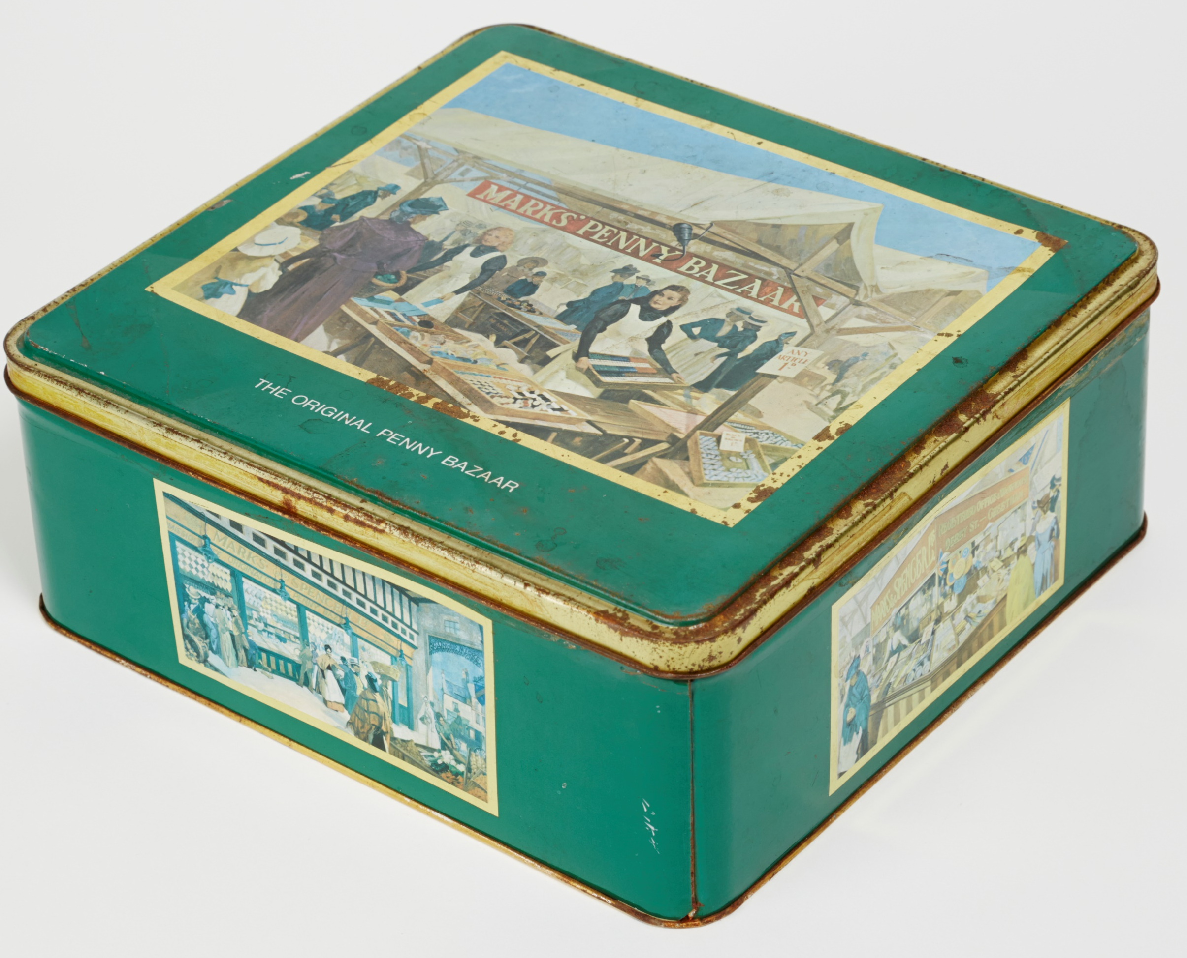
1

Slide 3
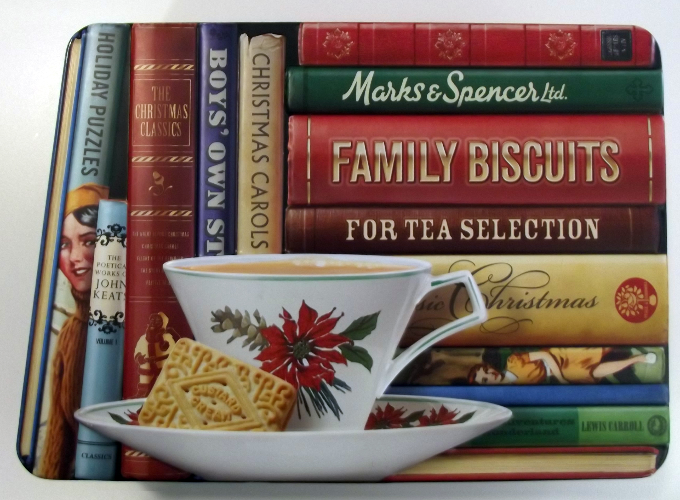
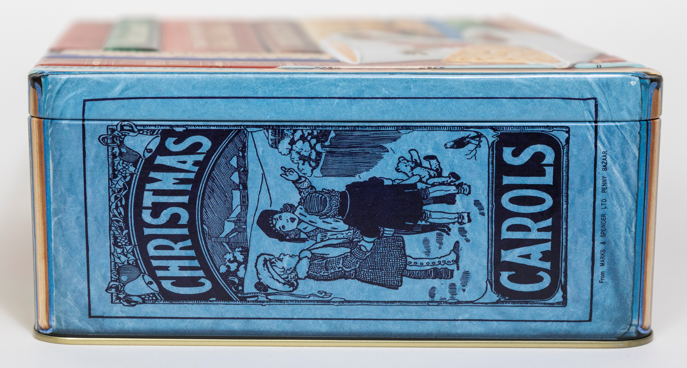
2

Slide 4
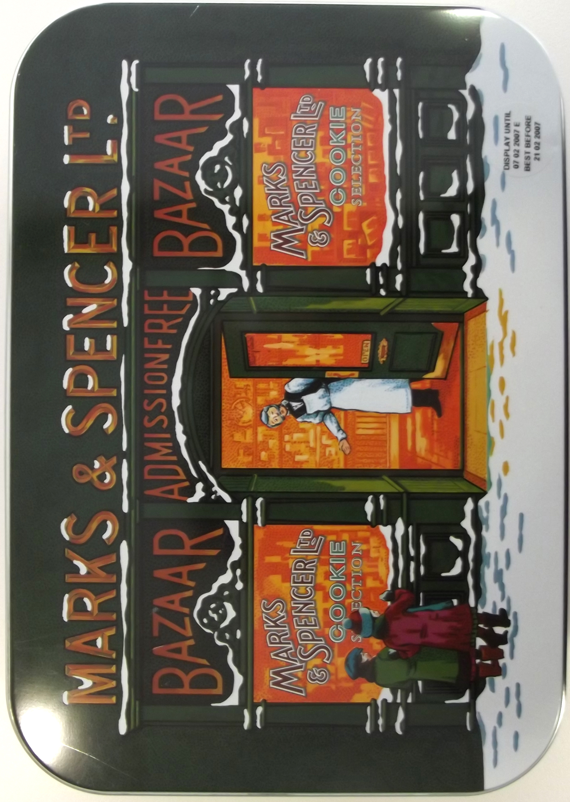
3

Slide 5
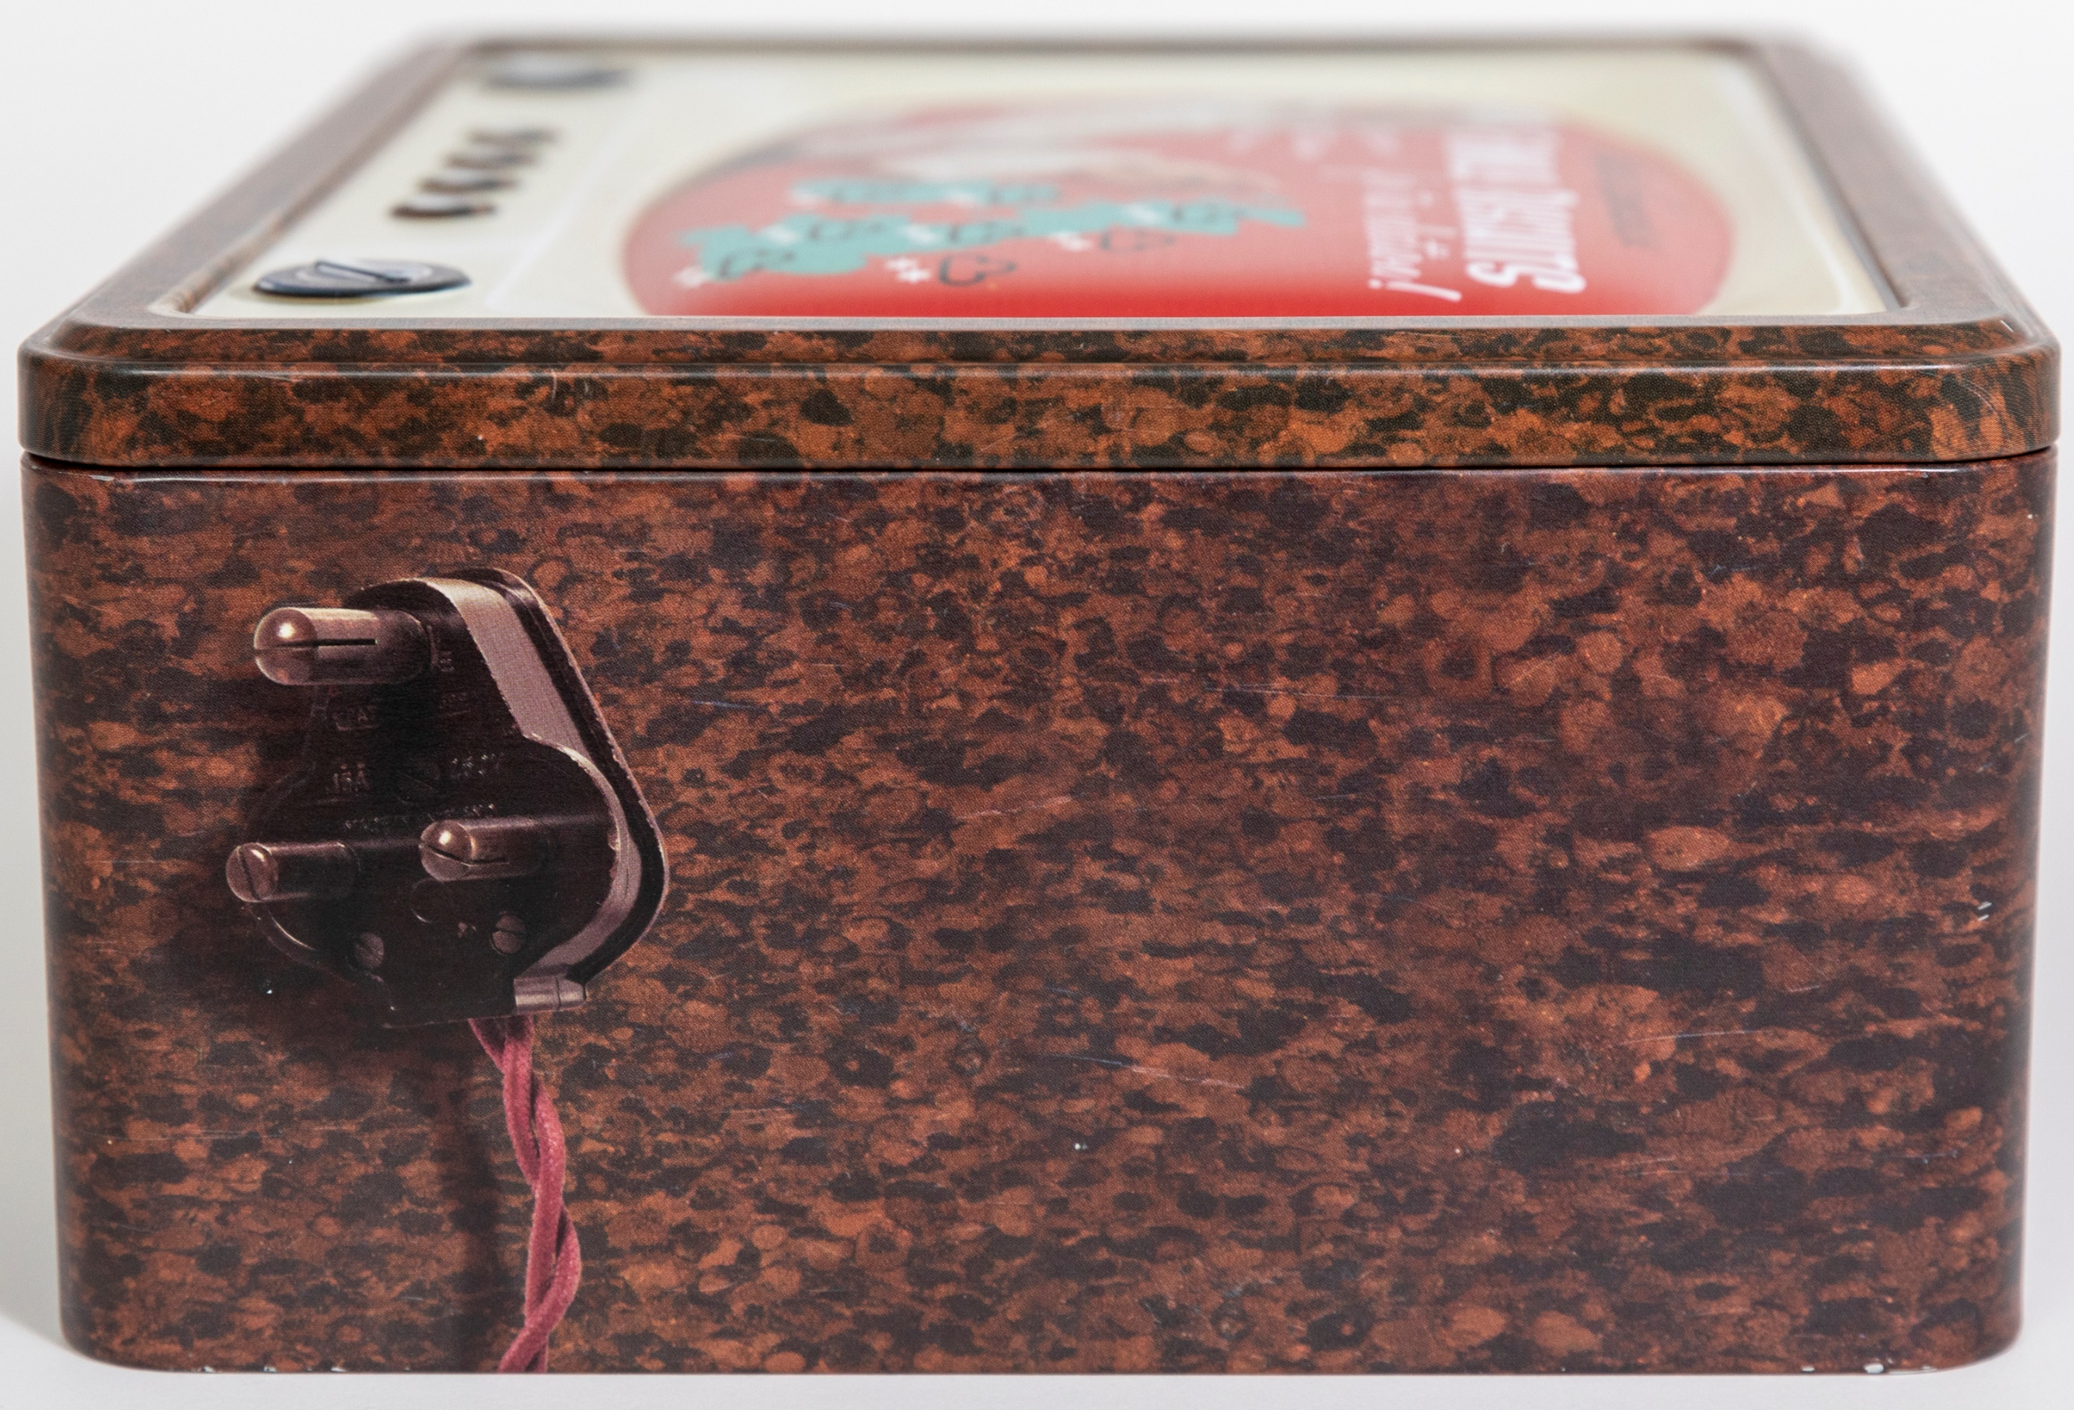
4

Slide 6
5

Slide 7
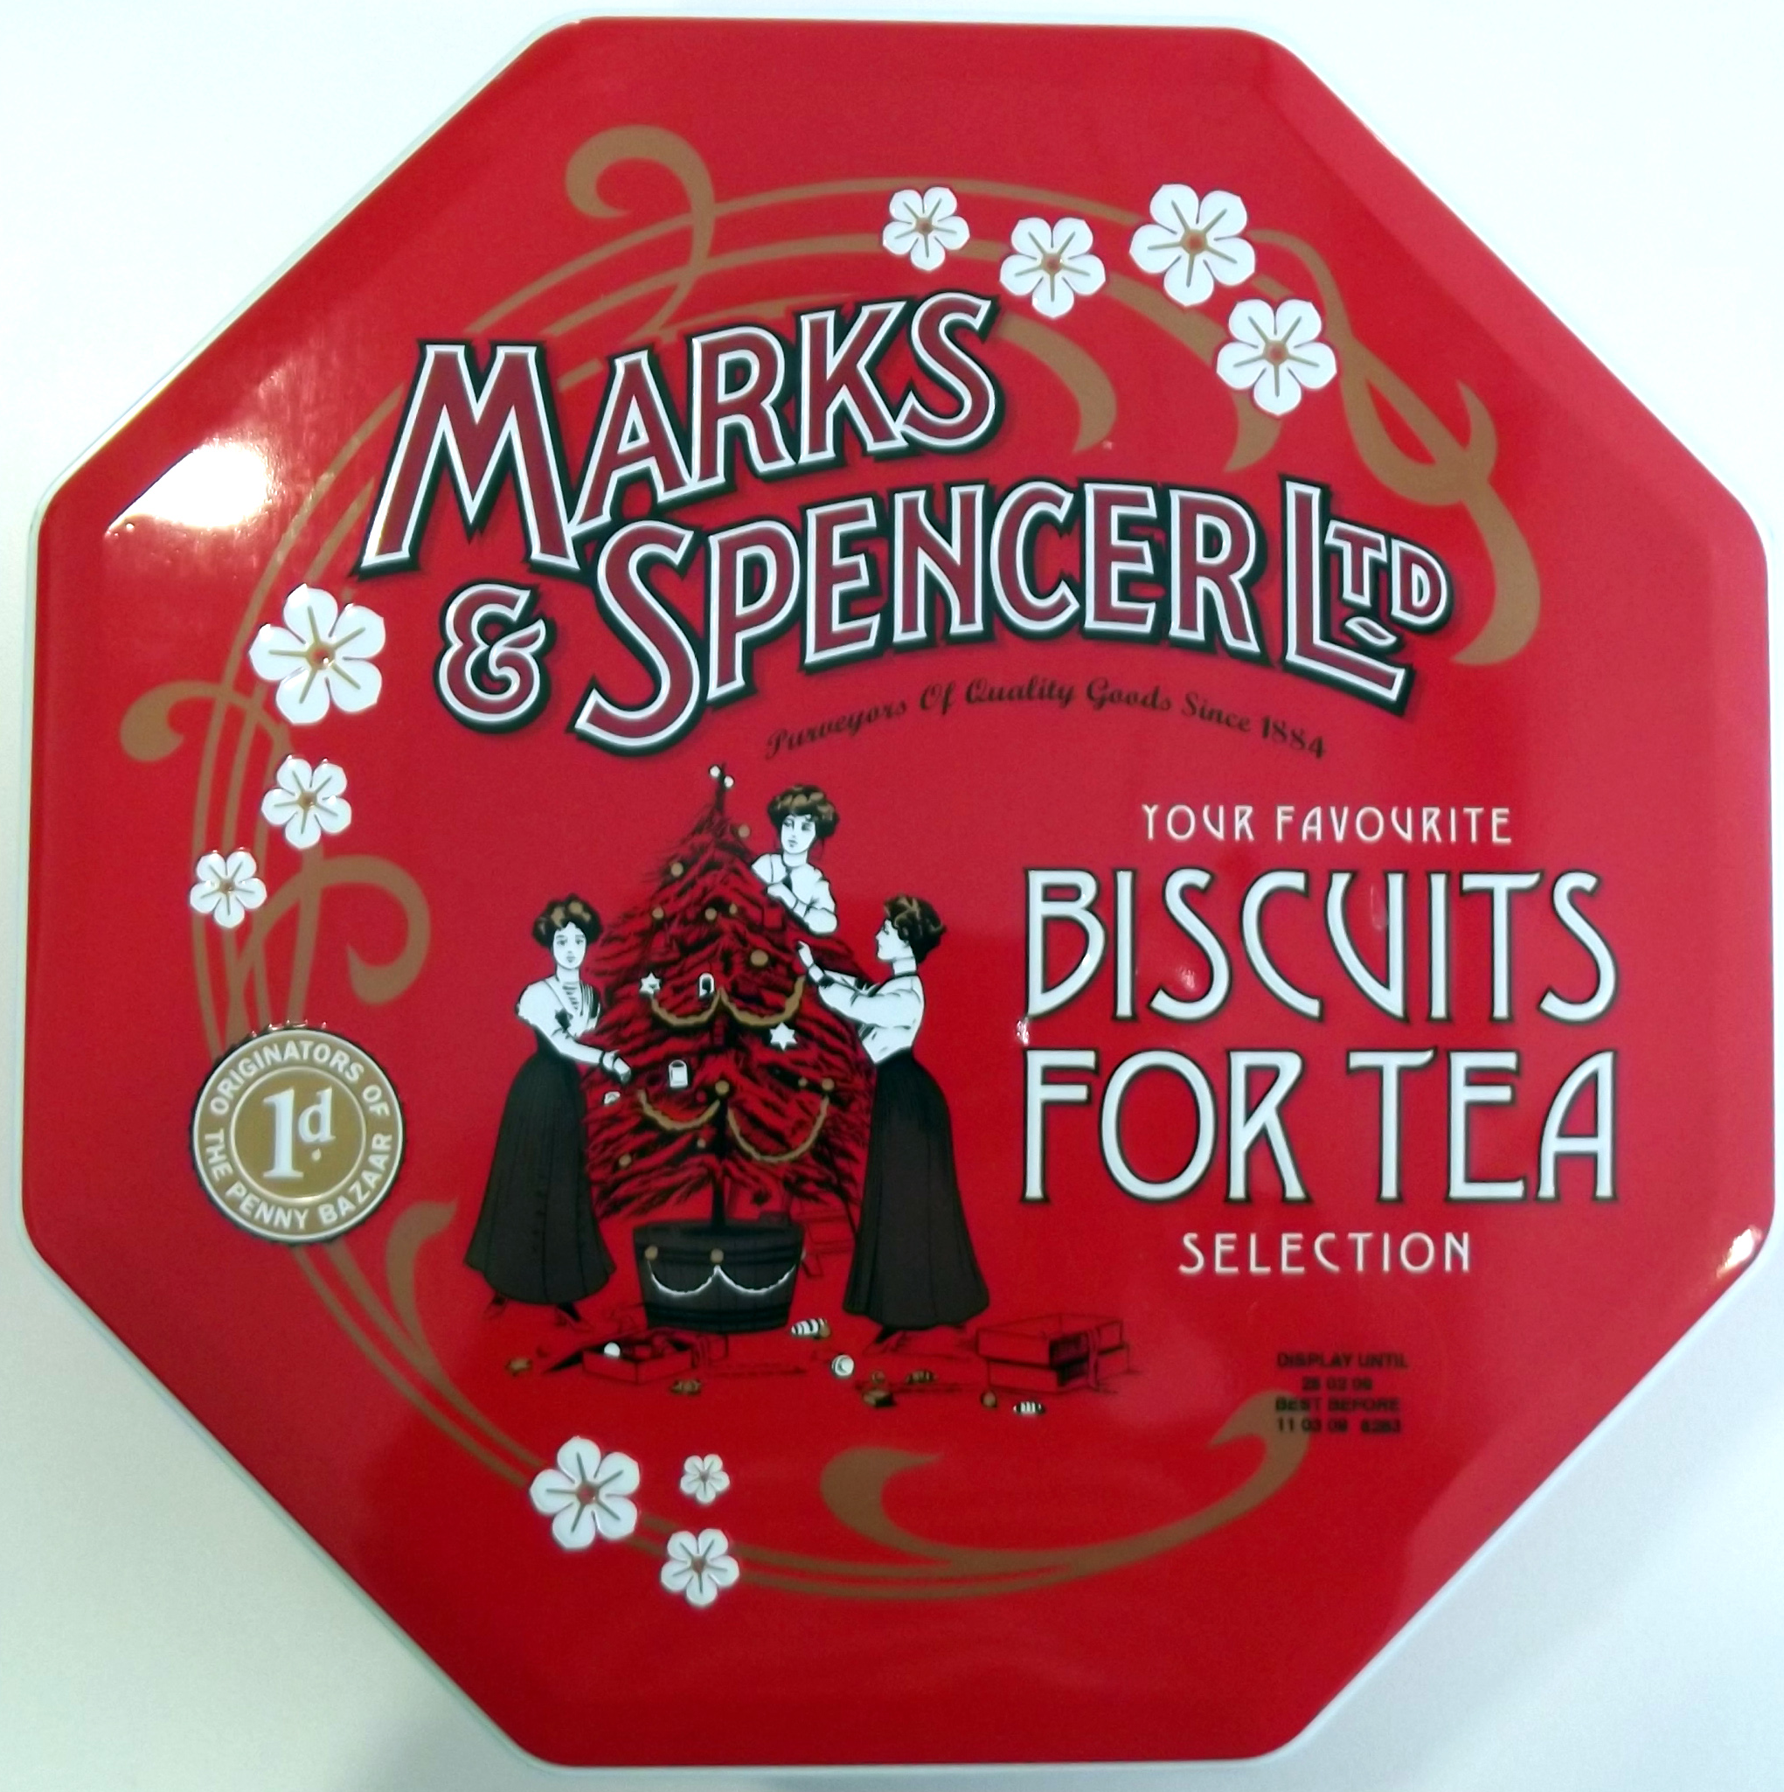
6

