Slide 1


Slide 2
Learning Objectives
Ask questions and find different ways to answer them Use equipment to do tests, watch closely to see what happens Record results and use your observations to answer questions
Investigate objects and think about what they are made of Describe the properties of everyday materials Compare and group everyday materials by their properties
Identify and compare how suitable everyday materials are for particular items of clothing

Slide 3
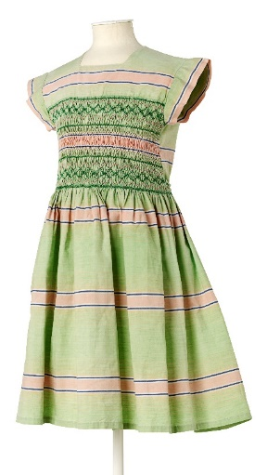
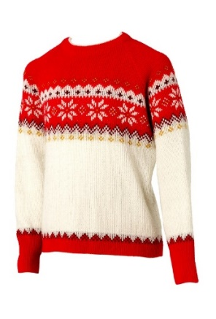
What are fabrics?
How many different fabrics can you name?

Slide 4
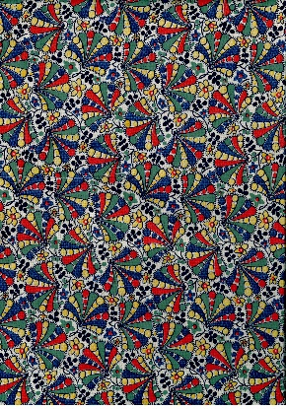
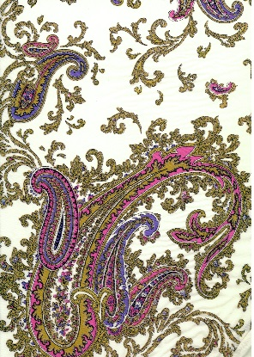
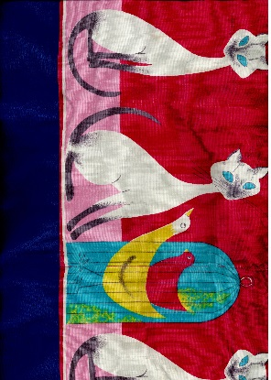
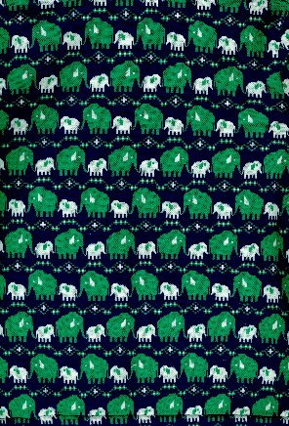
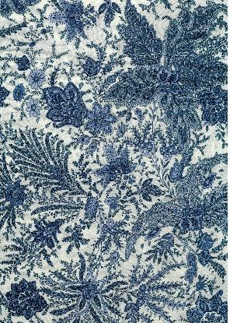
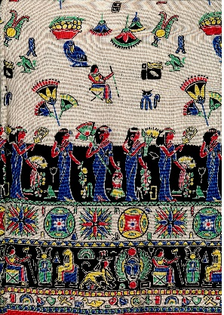
Investigating Fabrics
Use your senses to explore the fabrics

Slide 5
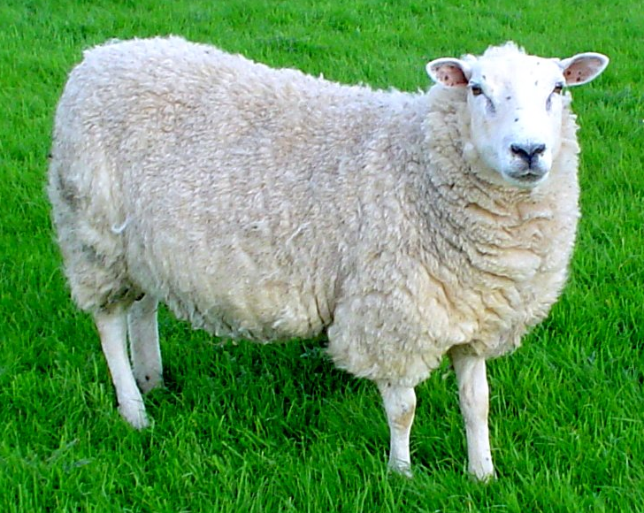

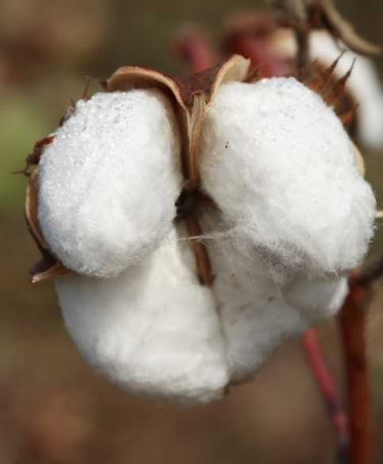
Making Fabrics
Is it natural or synthetic?

Slide 6
Play
Find the Fabric!

Slide 7
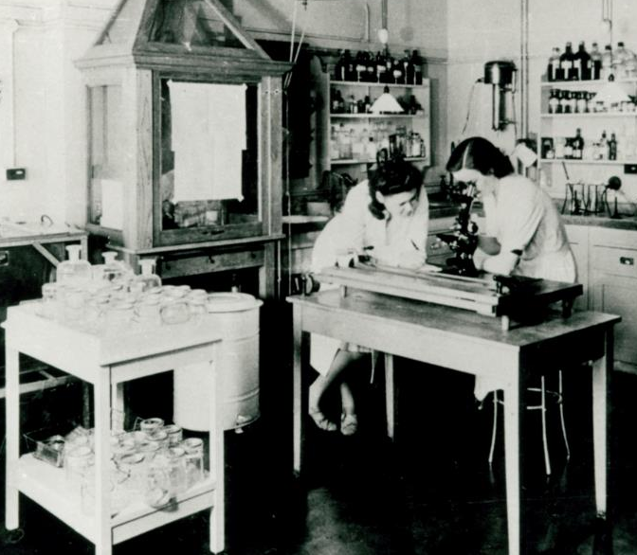
Testing Fabrics
Different fabrics have different properties
This is why we use certain fabrics to make types of clothing e.g. waterproofs
You are going to test some fabrics to find out about their properties
Watch the film

Slide 8
Investigation 1
Tree-climbing Trousers
What properties will they need to have?
Look at the fabrics. Predict which one will be best.
Feel the fabrics. Which would be most comfortable?
Try and tear the fabrics with your hands.
Rub the fabrics with the sandpaper. What happens?
Which fabric is the most suitable?
Were you right?
How did you make sure it was a fair test?

Slide 9
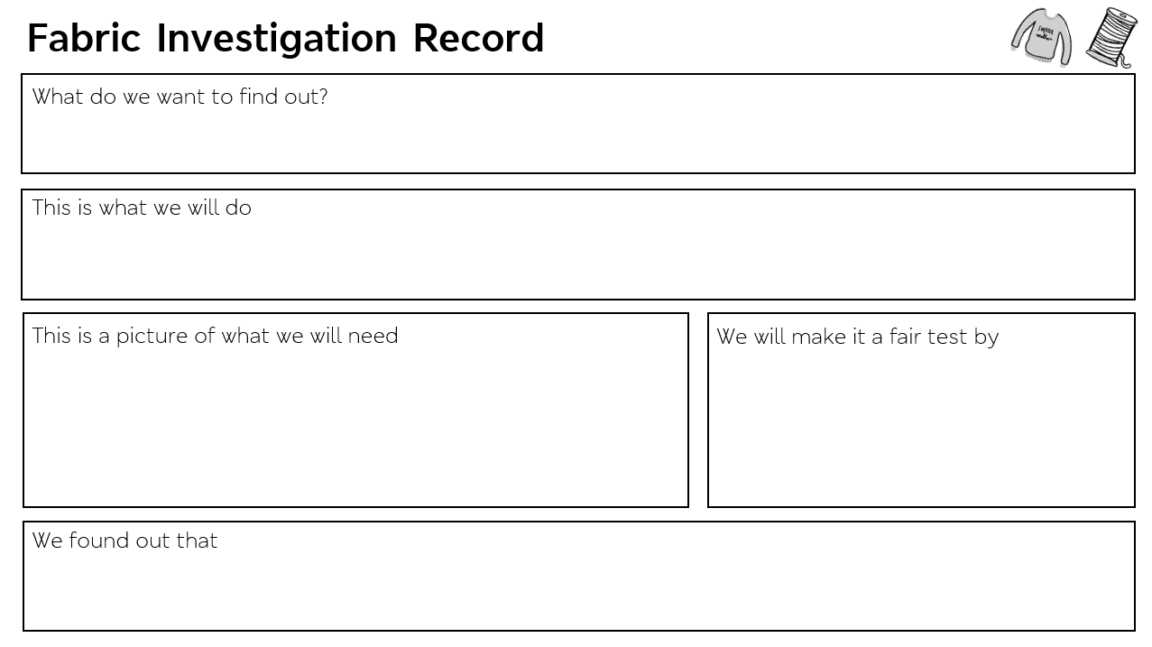

Slide 10

Investigation 2
Swimsuit
What properties will it need to have?
Look at the fabrics. Predict which one will be best.
Feel the fabrics. Which would be most comfortable?
Put one fabric into the bowl of water for 30 seconds.
Take it out and squeeze it over the measuring jug. How much water comes out?
Which fabric is the most suitable?
Were you right?
How did you make sure it was a fair test?

Slide 12
Future Fashion
Do you know what the word innovation means?
Inventing something new, or a new way of doing something, that makes the process easier, or solves a problem.
Watch the film

Slide 13
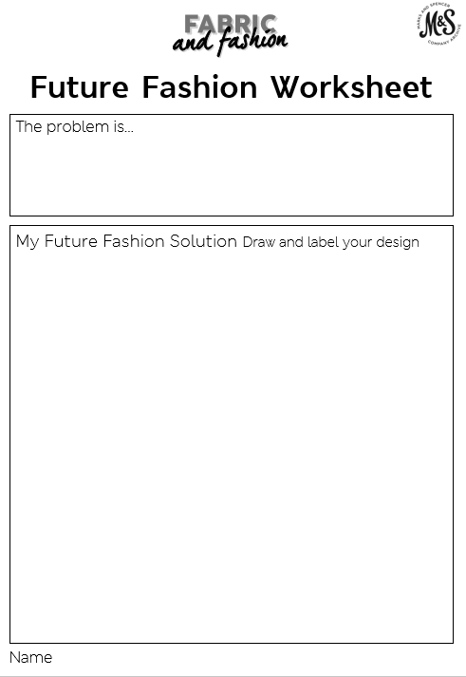
What’s the problem?
What’s the solution?

Slide 14
Future Fashion
Gallery

