Slide 1
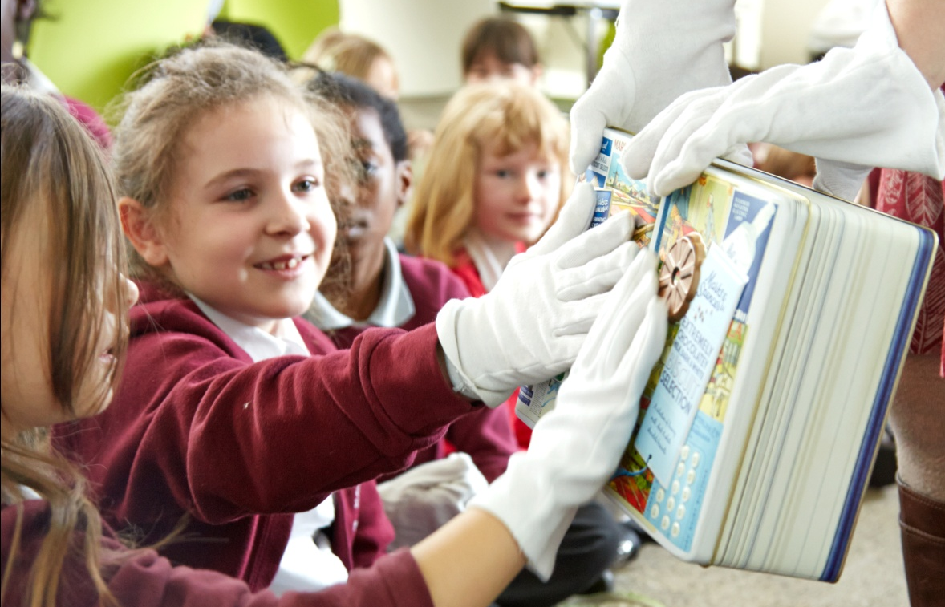


Slide 2
Learning Objectives
Design - Design purposeful, functional, appealing products based on design criteria
Make - Select from and use a range of materials according to their characteristics
Evaluate - Explore and evaluate a range of existing products
- Evaluate ideas and products and participate in
peer evaluation

Slide 3
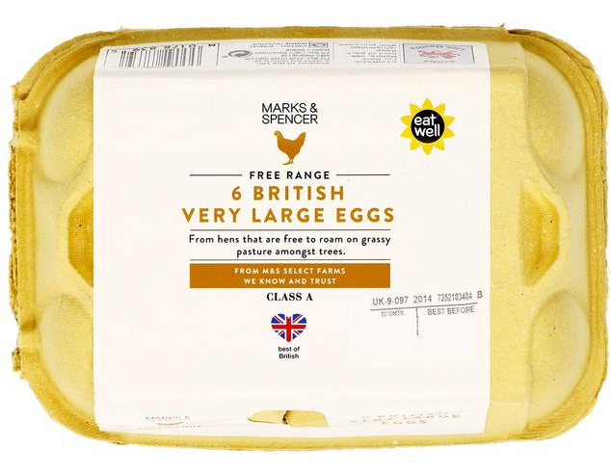
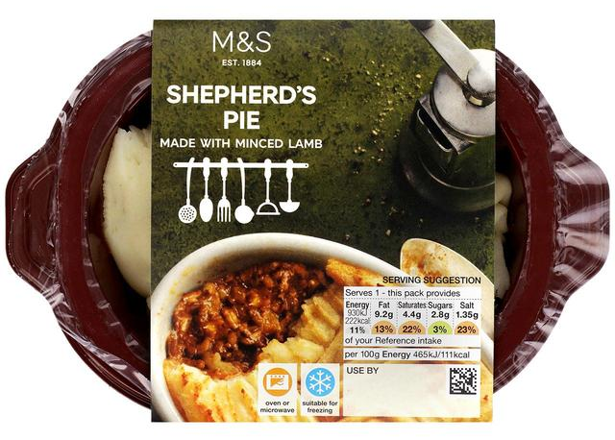
Food Packaging
Why do we put food in packaging?
What different types of food packaging can you think of?
We’re going to take a closer look at biscuit tins.

Slide 4
Let’s investigate!
What is the object?
How do you know what it is?
What colours and shapes can you see?
Does it have any textures?
Who is it for?
What information can you find?
Tip: Look for writing, symbols, pictures and numbers

Slide 5
You’re the designer!
Designers start with a brief, this tells them what their design needs to achieve
DESIGN BRIEF
Your design will;
be for a decorative biscuit tin
contain the name of the biscuit
use only 3 colours

Slide 6
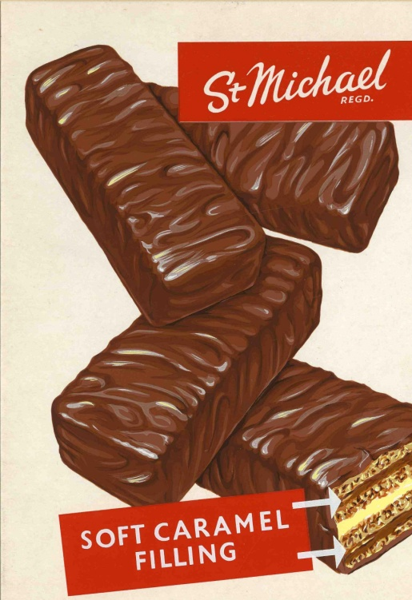
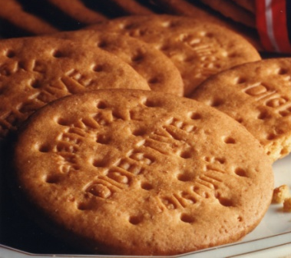
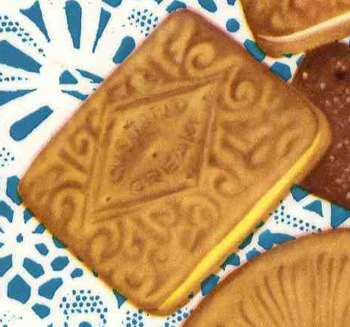
Name your biscuit!

Slide 7


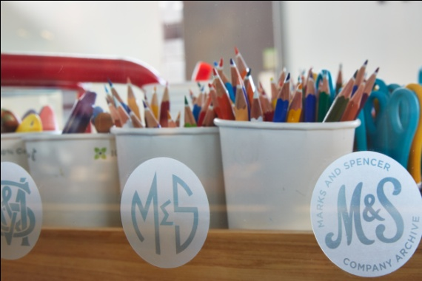
Design your biscuit tin

Slide 8
Your name
Design your Biscuit Tin

Slide 9
Evaluate!
What went well?
What would you do differently next time?
Share your work with your class –
which designs do you like best and why?

