Slide 1


Slide 2
Learning Objectives
Identify that our diet has changed over the last 100 years and recognise how this is linked to food origins and availability
Identify continuity and change in our lifestyles over a period of time
Understand some of the ways in which we find out about the past and identify different ways in which it is represented
Ask and answer questions using historical sources

Slide 3
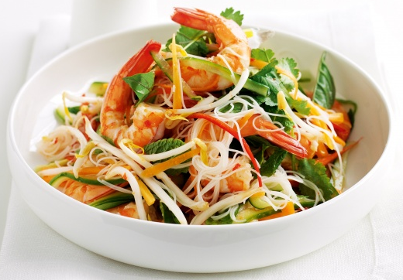
My Favourite Meal
Prawn and vegetable stir fry with noodles
Stir fry vegetables
Think of your favourite meal
Write down the name of your meal
Draw a picture of it on the plate
Label all the different ingredients
Prawns
Yellow peppers
Courgette
Noodles
Red peppers
Bean shoots

Slide 4
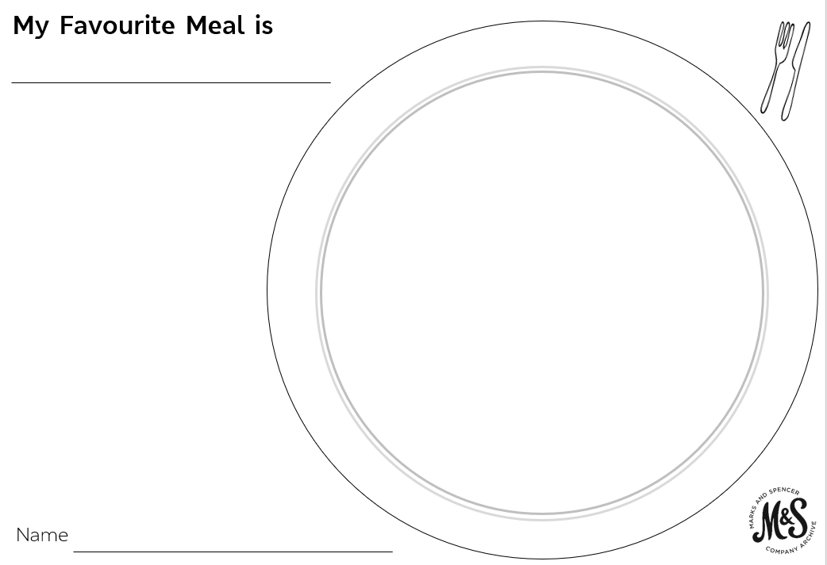

Slide 5
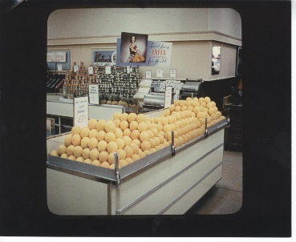
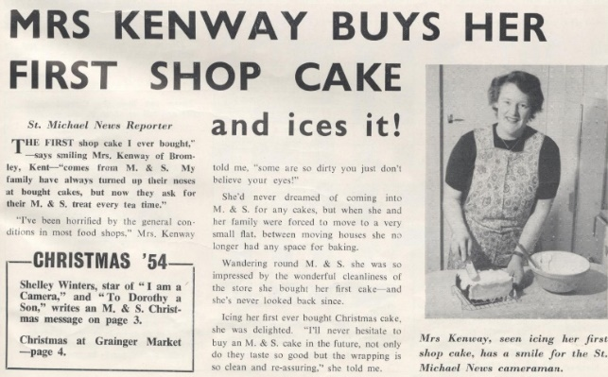
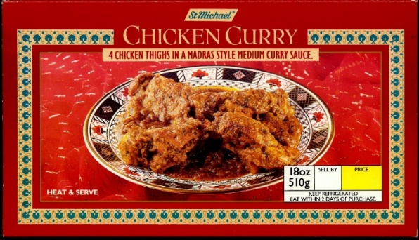
Food History Detectives
How could we find out about what people ate in the past?
Who could we ask?
Where could we look?
What could we look at?

Slide 6
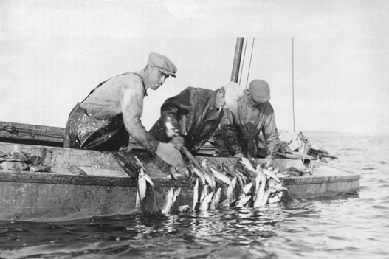
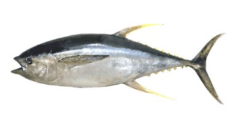
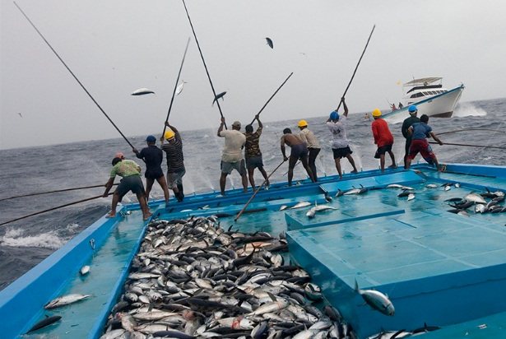
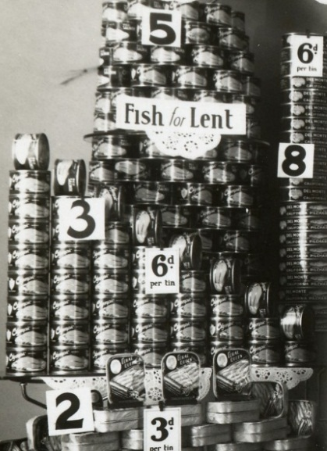
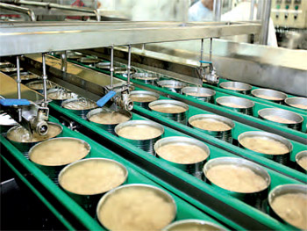
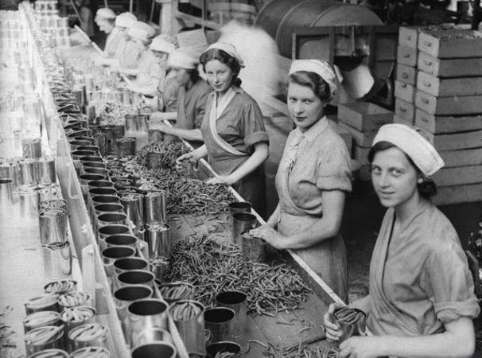
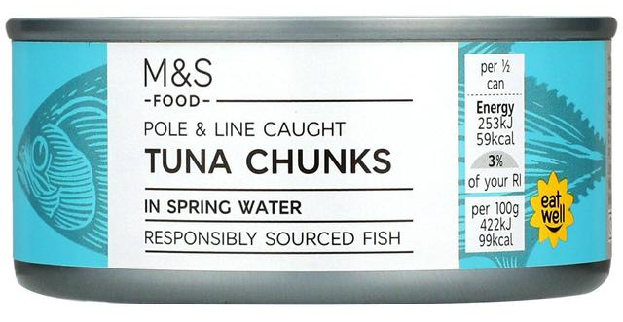
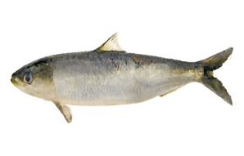
Food Journey Timeline
Sort the pictures into old and new

Slide 7
Food Journey Timeline
Old
New

Slide 8


What’s different?
What’s the same?

Slide 9
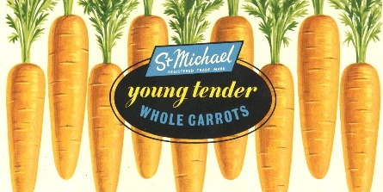
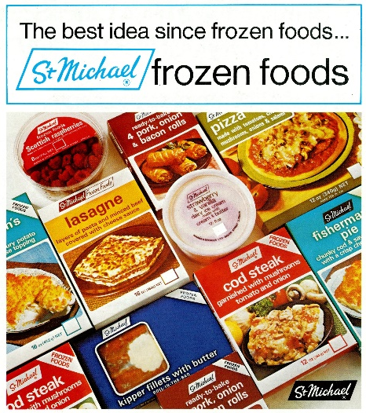
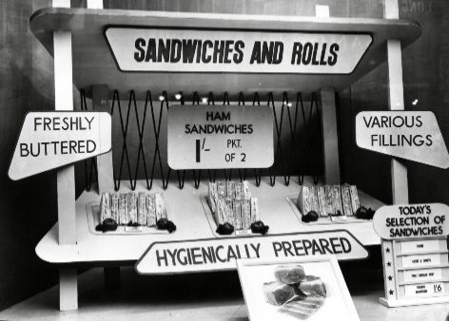
Meal from the Past
Watch the What’s On My Plate? film
Look carefully at your sources to find out about a meal from that time.
Write down the name of your meal.
Draw your meal on the plate.
Label all the different ingredients on your drawing.
What clues are there that this meal is from the past?
How is it similar to your favourite meal?
How is it different to your favourite meal?

Slide 10
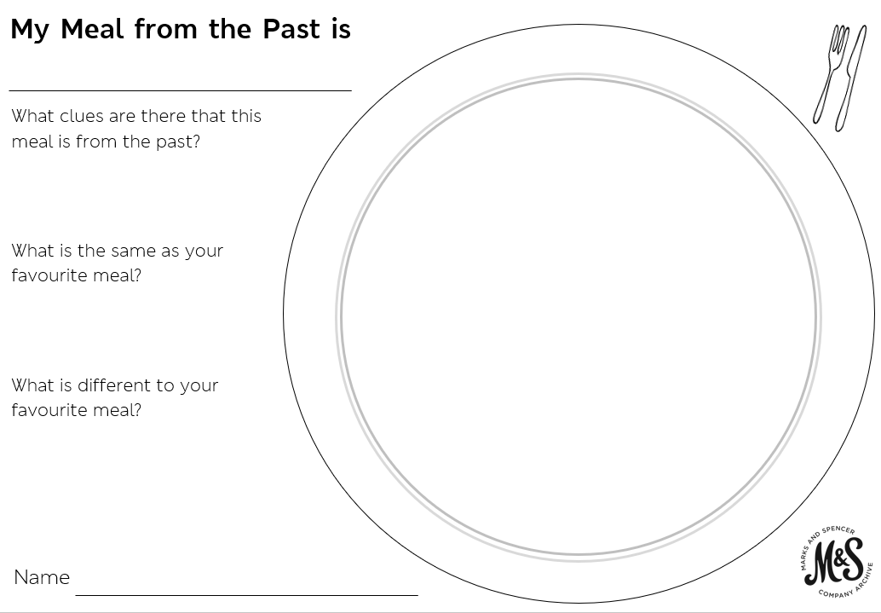

Slide 11
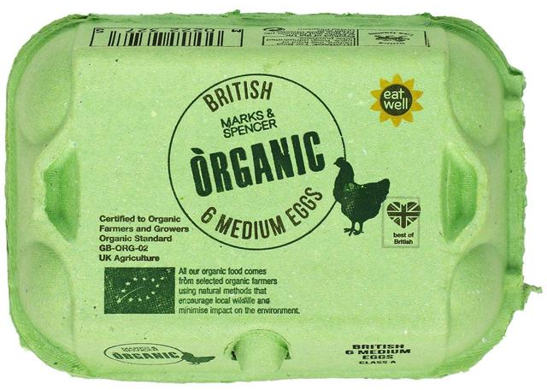
Can you see which country these foods have come from?

Slide 12
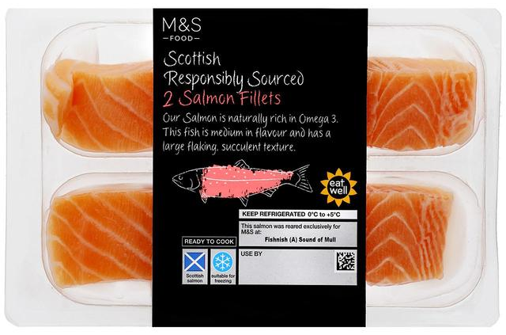

Slide 13
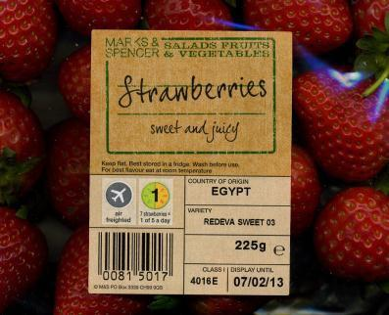

Slide 14


Share your Meal
or

