Slide 1
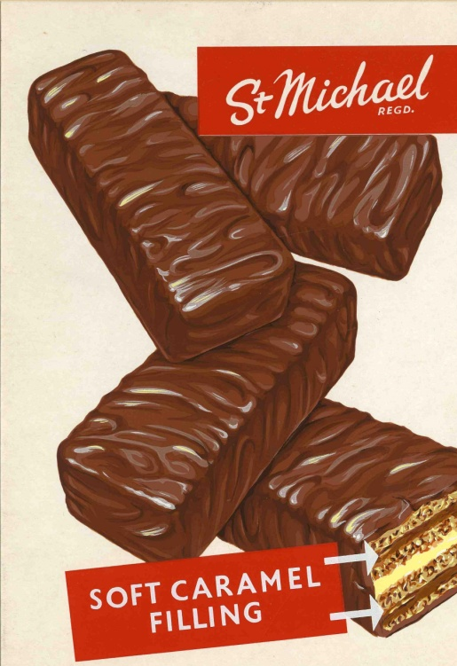
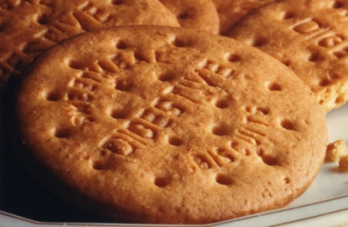
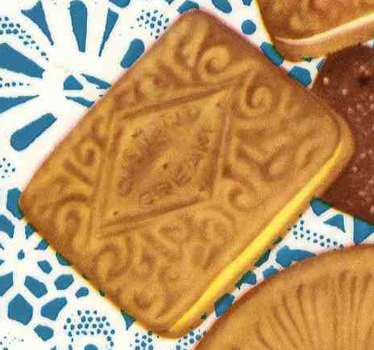

Describing Biscuits
How many adjectives can you think of to describe each biscuit?
Write your describing words under the pictures.
Digestive biscuit
Chocolate caramel wafer
Custard cream

