Slide 1


Slide 2
Learning Objectives
To learn about the science of the M&S Chocolate Melt in the Middle Pudding
To design a new pudding
To use scientific thinking to conduct a taste test

Slide 3
What’s your favourite pudding?
Why do you like it?

Slide 4
Introduction
Watch the Promoting the Pudding film
Q: Why do you think so many people bought puddings after seeing the ‘This is not just food…’ TV advert?

Slide 5
Creating the Pudding
Q: Why do you think it took so long to get the pudding right?

Slide 6
Creating the Pudding
Watch the Perfect Pudding? film
Watch for all the ways the pudding goes wrong!

Slide 7

Creating the Pudding
Q: How many ways can you think of that the pudding could go wrong?
Think about what it would look, smell and taste like.

Slide 8
Creating the Pudding
Q: How would you describe a perfect pudding?
Think about what it would look, smell and taste like.

Slide 9
Ingredients
Q: What were the five key ingredients used to make the pudding in the Perfect Pudding? film.

Slide 10
Ingredients
Sort the cards in your pack
Match each ingredient with a description

Slide 11
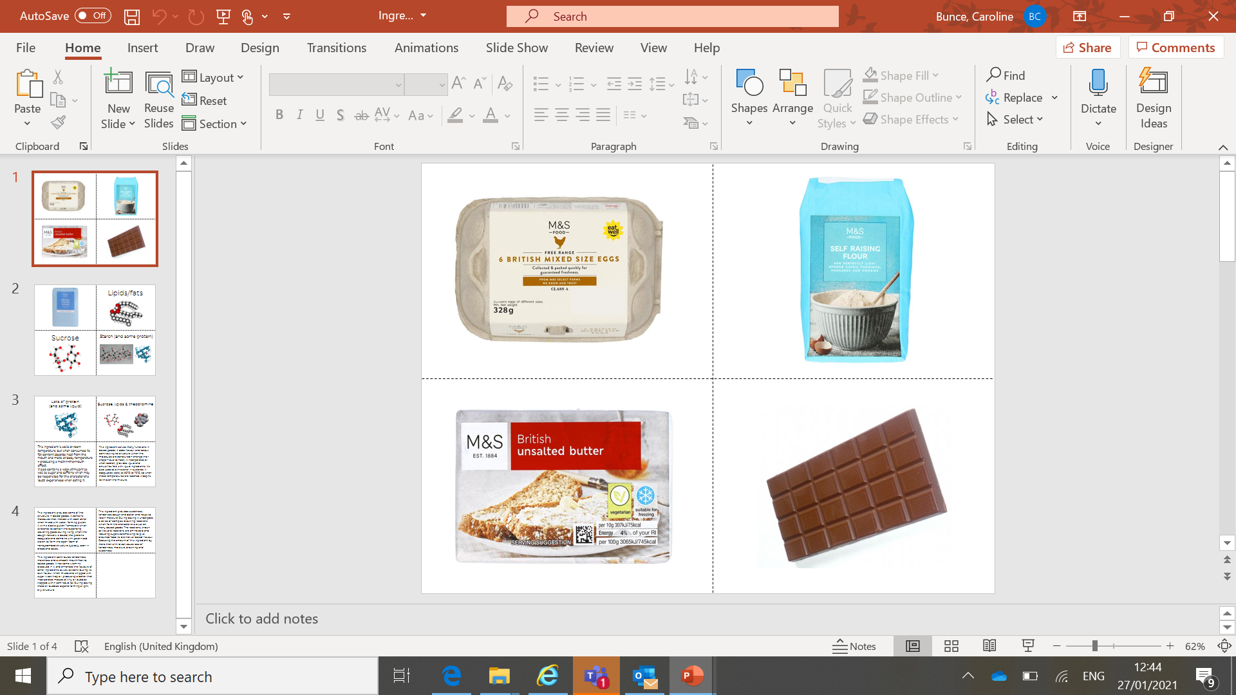
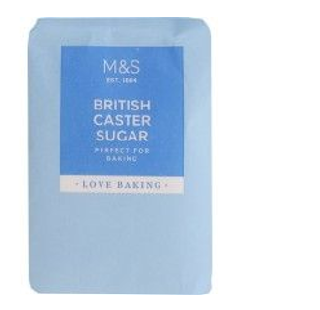
Ingredients – the answers
Traps air in bubbles, making the pudding light and fluffy.
Liquid when raw, and solid when cooked.
Clue: You have to crack it first.
It melts in your mouth, changing from solid to liquid.
It contains fat, sugar and caffeine.
Clue: You can get milk, dark and white types of it.
Helps the pudding to rise and hold its shape.
It contains gluten.
Clue: It’s a white powder that you would use to make bread.
It is mostly fat.
It helps to keep the pudding moist and gives it a smooth texture.
Clue: We spread it on bread.
The sweetest ingredient.
It helps to keep moisture in the pudding.
Clue: It’s the main ingredient in sweets.

Slide 12
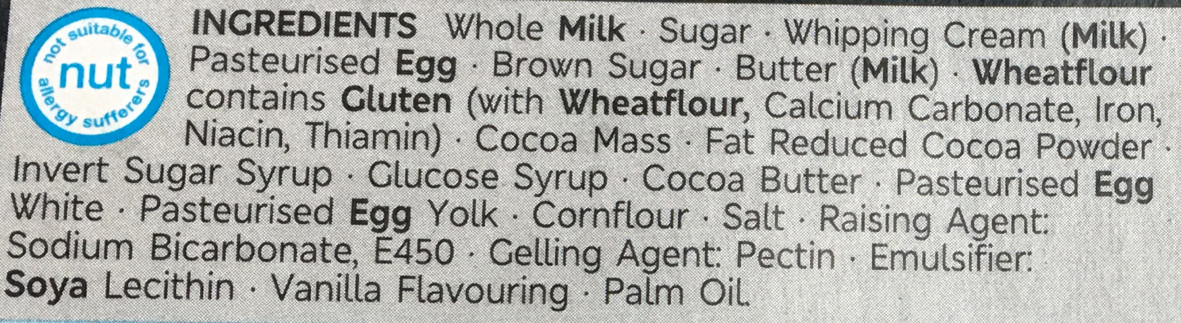
Helpful Additions
Q: Why do you think there are more ingredients in the M&S pudding than in a homemade pudding?

Slide 13
Helpful Additions
Watch the Emulsifiers film
Q: What do emulsifiers do?

Slide 14
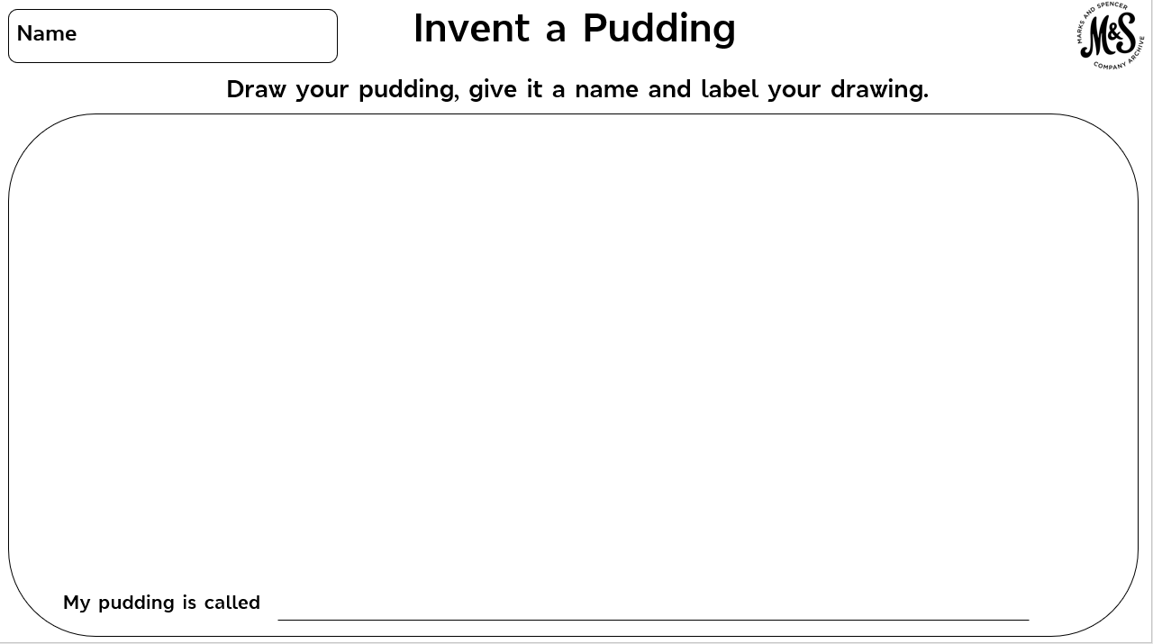
INVENTING TIP
Mix together the best bits of your two favourite puddings to make something totally new!

Slide 15
Invent a pudding
Design brief
Your invention will
Be a pudding
Contain at least one fruit ingredient

Slide 16
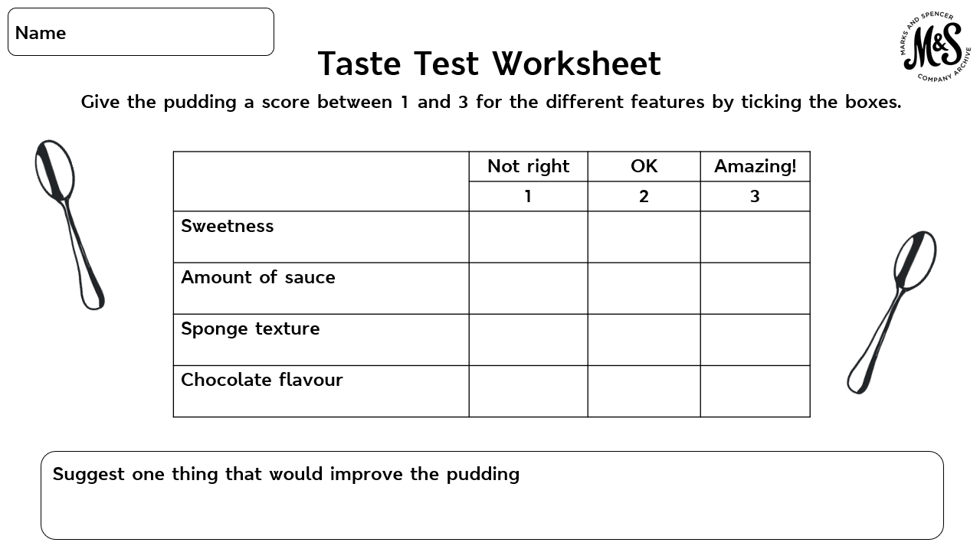

Slide 17
Taste Test
Q: Which feature did you give a low score and why?
Q: Which one did you give a high score and why?
Q: Suggest one thing that would improve the pudding.

Slide 18
Plenary
Q: What made the M&S Chocolate Melt in the Middle Pudding such a success?

