Slide 1
What’s On My Plate? Historical Sources – Information for teachers
Period | No | Title | Description | Focus points
 | 1 | A Good Cook never spoils the broth | Article from The Marks & Spencer Magazine, 1932 | Spot the names of the dishes under For Breakfast. Read the recipes to find out what they were like.
 | 2 | Café Bar in Guildford store, 1941 | Photograph | Find the menu on the wall. What are the dishes?
 | 3 | Café Bar in Watford store, 1930s | Photograph | Find the menu on the wall. What are the dishes? Is there any other food and drink?
 | 4 | Cafe Bar meal costs, 1941 | Company document | Are there any foods you don’t know? Use the Glossary to find out what they are.
 | 5 | Leaflet on menu planning, 1950s | Company document | Are there any foods you don’t know? Use the Glossary to find out what they are.
 | 6 | Tinned food labels, 1950s-60s | Food packaging | How are the foods described on the labels? Why? What other food might you add to make a meal?
 | 7 | Fresh Fried Fillets, 1950s | Photograph | How long does it take to get this dish ready? What other food might you add to make a meal?
 | 8 | Sandwiches and rolls, Oxford 1951 | Photograph | Can you spot the other sandwich fillings that were available? Which would you choose?
 | 9 | Frozen Foods, 1971 | Advert | Choose a meal from the packets you can see. What frozen vegetables could you add?
 | 10 | A New Experience | Article from St Michael News, Sep 1974 | Read the article to find the foods you could buy in this new range. Choose a meal from the dishes.
 | 11 | Chicken Tikka Masala, 1987 | Food packaging | Would you add anything to this food to make a meal?
 | 12 | Lamb recipes | From Microwave Cooking, Jenny Webb, 1983 | Choose one of these lamb dishes. Look at the bottom of the recipe page to find the matching picture.
1930s-40s
1950s-60s
1970s-80s

Slide 2
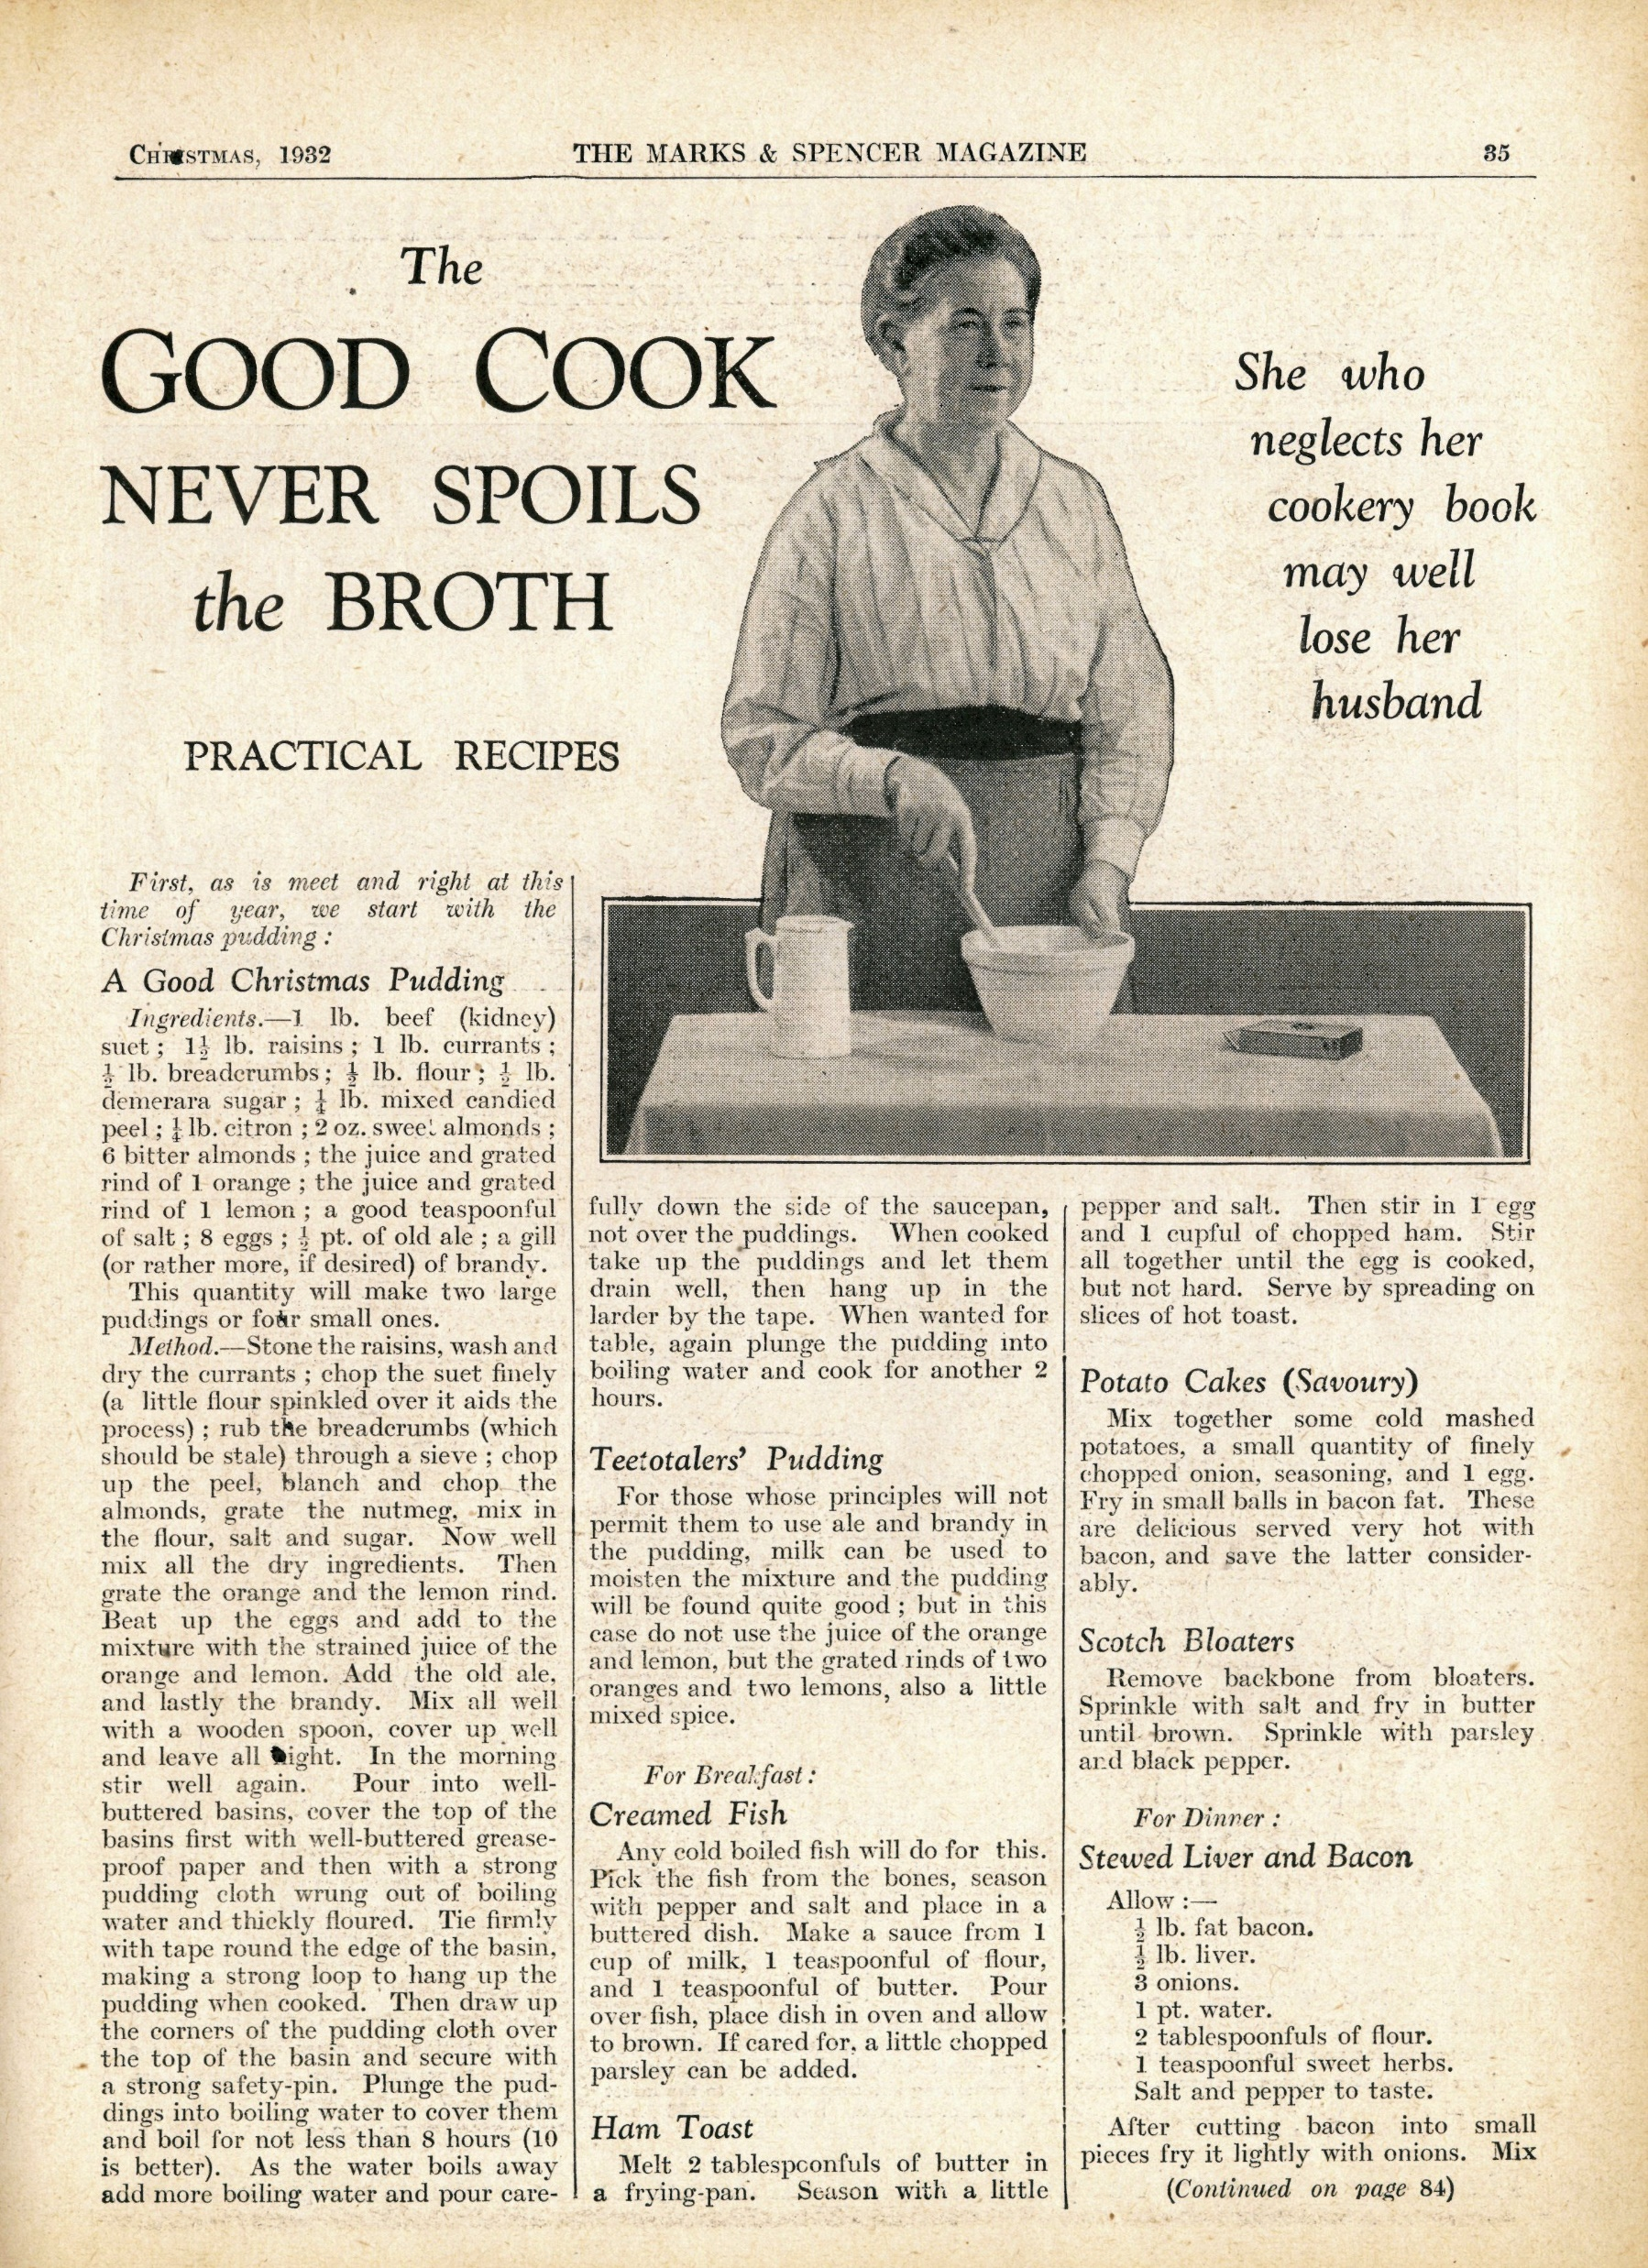
Source 1
Spot the names of the dishes under For Breakfast.
Read the recipes to find out what they were like.
Article from The Marks & Spencer Magazine, 1932
Glossary
Bloater – a whole smoked herring fish, with the guts left inside

Slide 3
Source 2
Find the menu on the wall. What are the dishes?
Café Bar in Guildford store, 1941
Café Bar Menu
Cottage Pie with peas and mashed potatoes
Fruit Pie
Salmon Salad
Beans on toast
Trifle
Tea
Coffee

Slide 4
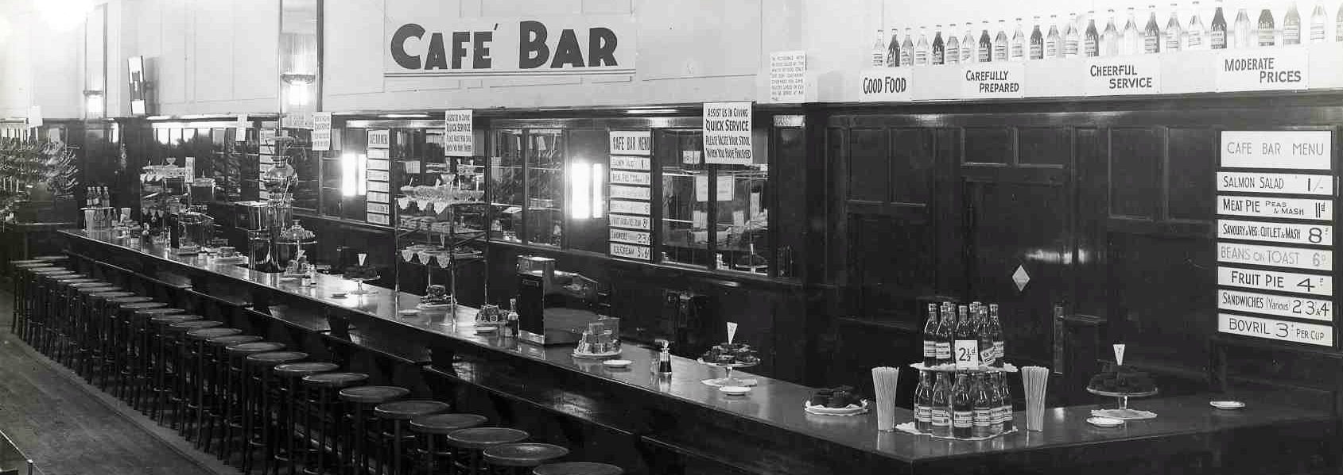
Source 3 Café Bar in Watford store, 1930s
Find the menu on the wall. What are the dishes? Is there any other food and drink on display?
Glossary
Savoury & Veg. Cutlet – vegetables and mashed potato mixed, coated in breadcrumbs and fried in a flat round shape
Bovril – a salty paste similar to Marmite, it can be made into a drink by adding hot water.

Slide 5
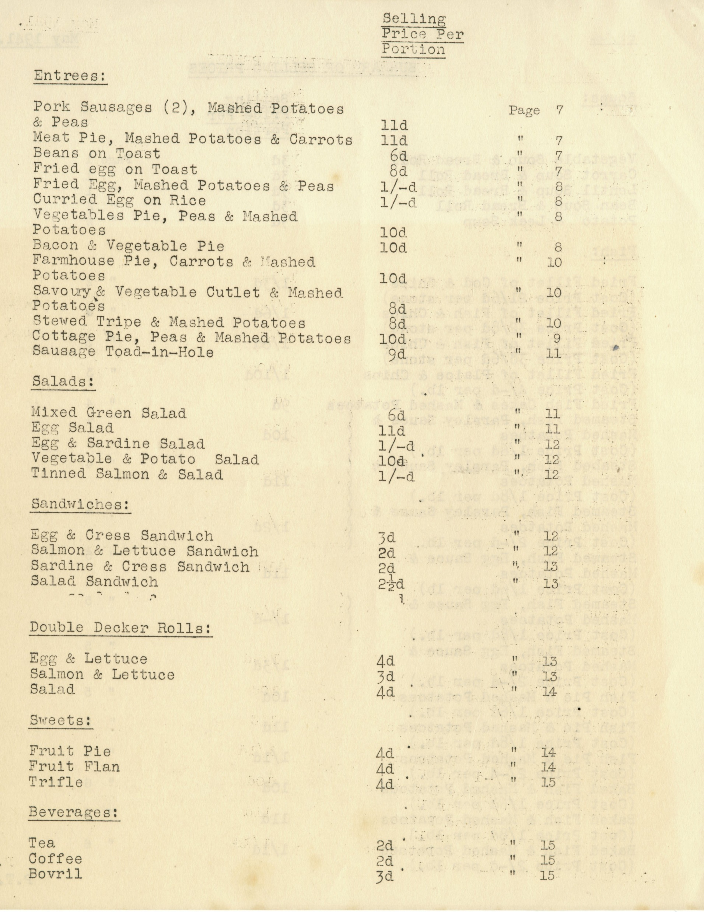
Source 4
Cafe Bar meal costs, 1941
Are there any foods you don’t know?
Use the Glossary to find out what they are.
Glossary
Tripe - edible lining from the stomach of cows, pigs, and sheep
Vegetable Cutlet - vegetables and mashed potato mixed, coated in breadcrumbs and fried in a flat round shape
Toad-in-hole – sausages cooked in Yorkshire pudding batter, usually served with gravy and vegetables
Bovril – a salty paste similar to Marmite, it can be made into a drink by adding hot water

Slide 6
Source 5
Leaflet on menu planning, 1950s
Are there any foods you don’t know?
Use the Glossary to find out what they are.
Glossary
Carrots Vichy – carrots cooked in water with butter and sugar
Queen of Puddings – a traditional British dessert made from breadcrumbs baked with milk, sugar, butter and eggs, spread with jam and topped with meringue

Slide 7
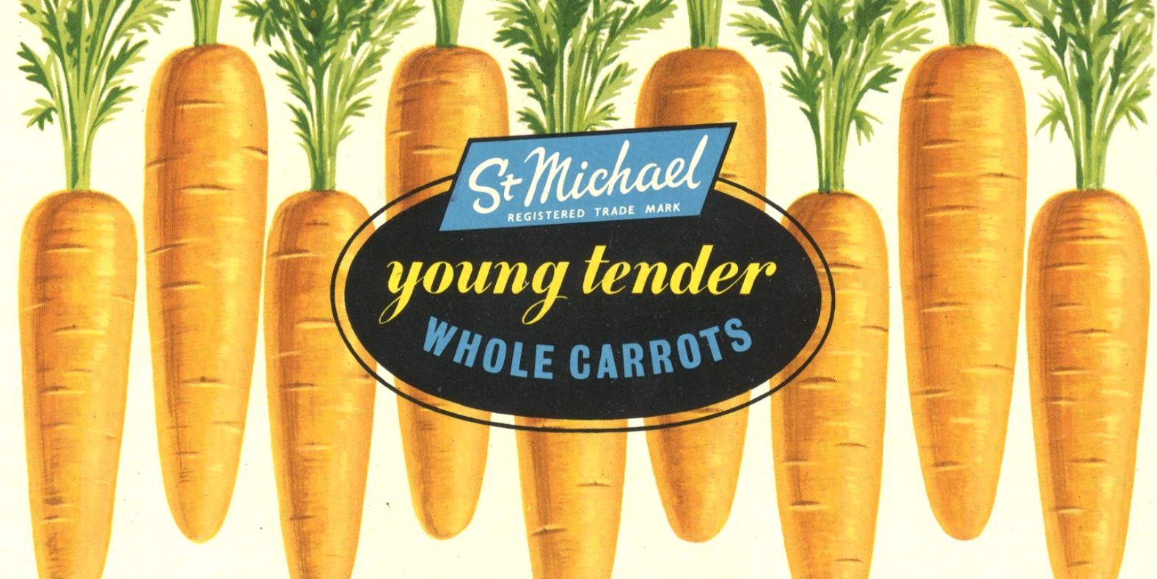
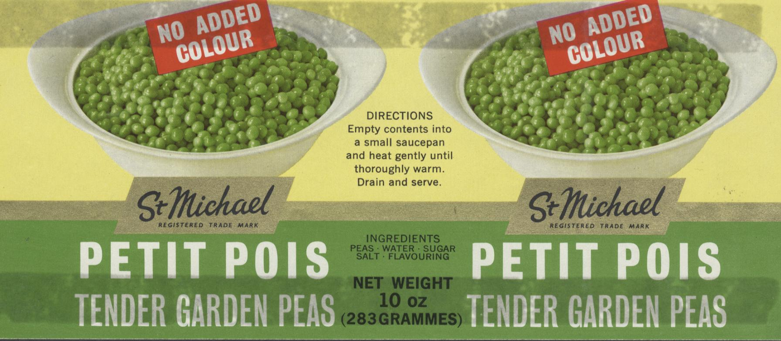
Source 6
Tinned food labels, 1950s-60s
How are the foods described on the labels? Why?
What other food might you add to make a meal?

Slide 8
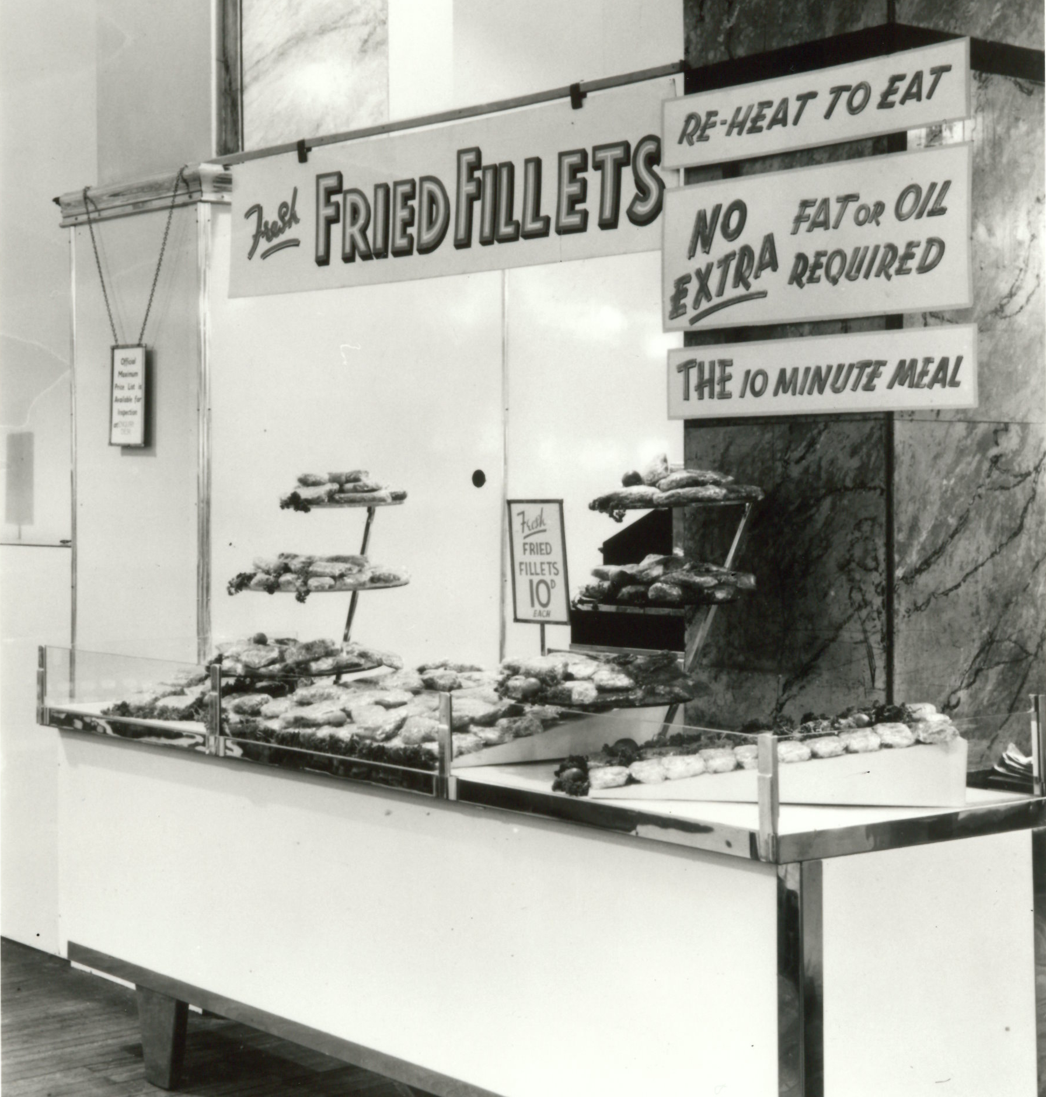
Source 7
Fresh Fried Fillets, 1950s
How long does it take to get this dish ready?
What other food might you add to make a meal?

Slide 9
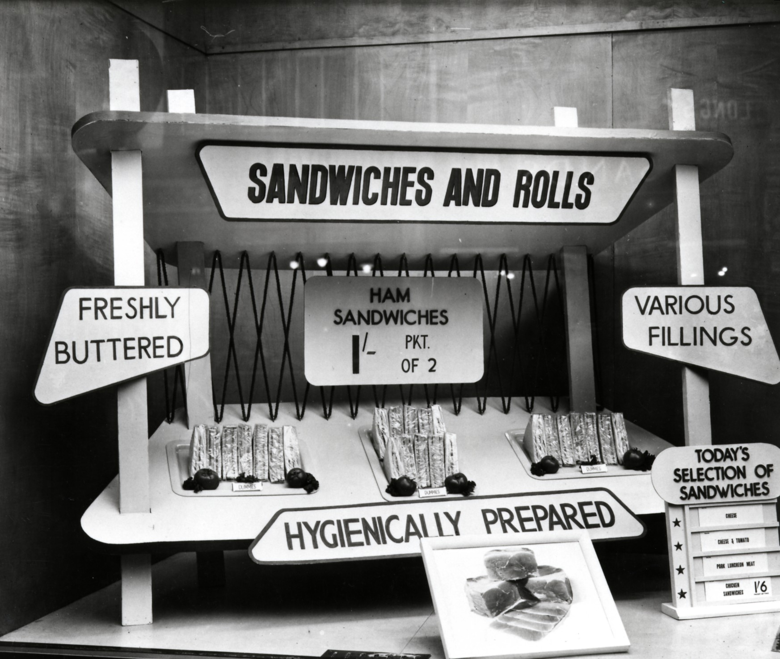
Source 8
Sandwiches and rolls, Oxford 1951
Can you spot the other sandwich fillings that were available?
Which would you choose?
Glossary
Luncheon meat – a type of cooked meat usually sold in tins. Spam is a brand of luncheon meat.

Slide 10
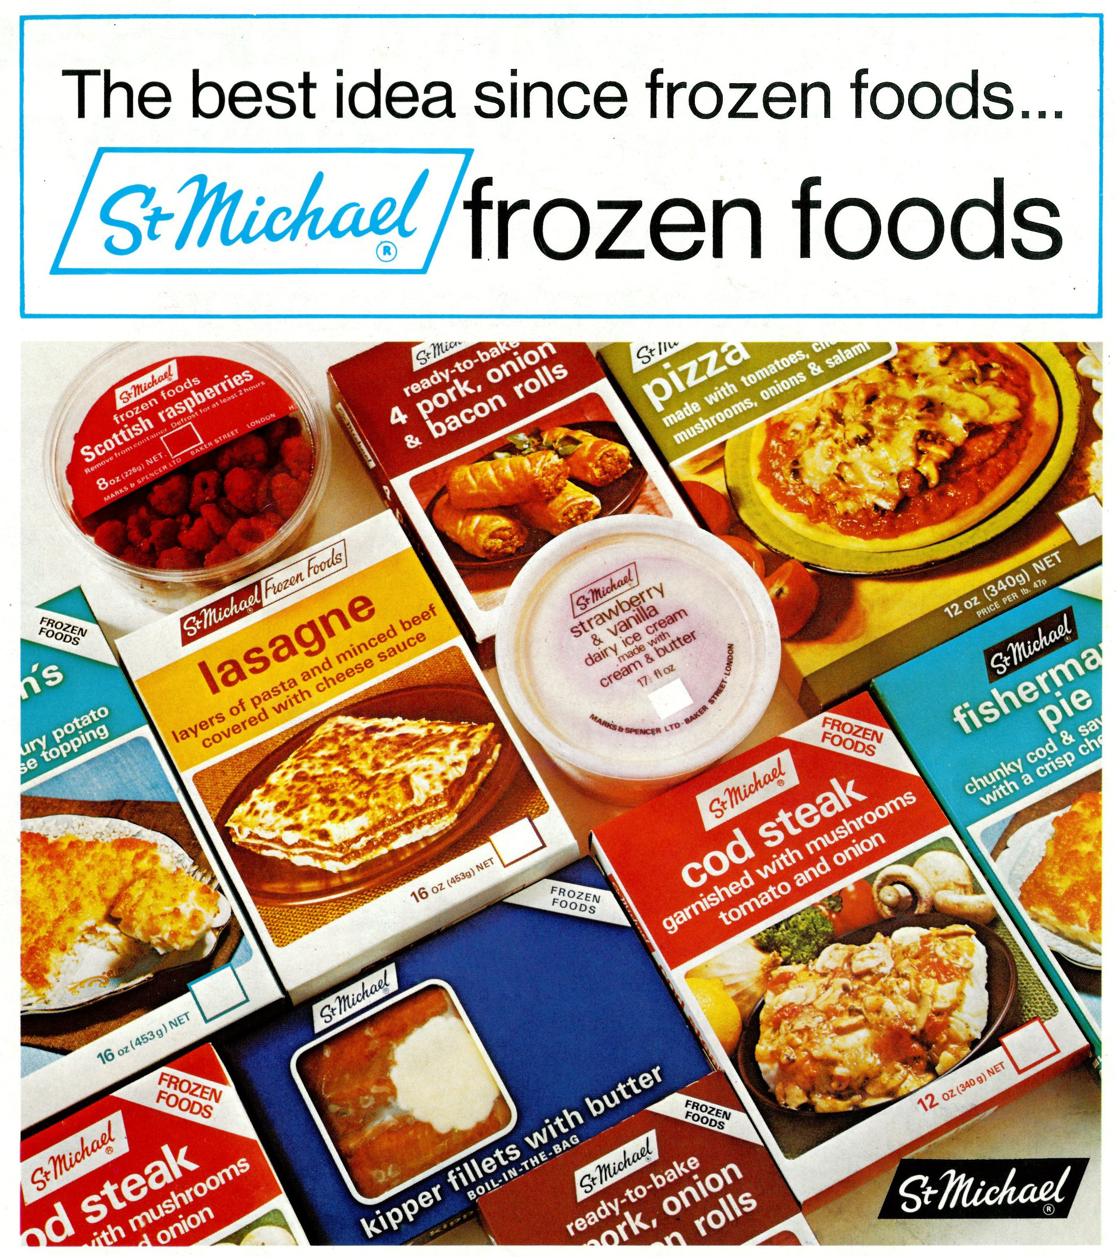
Source 9
Frozen Foods advert, 1971
Glossary
Kipper – a whole herring fish, salted or pickled, and smoked that is a traditional breakfast dish
Choose a meal from the packets you can see.
What frozen vegetables could you add?

Slide 11
Source 10
Article from St Michael News, Sep 1974
Read the article to find the foods you could buy in this new range. Choose a meal from the dishes.
Glossary
Beef stroganoff – beef cooked in a sauce made from butter and flour with mushrooms, onions, garlic, beef broth and sour cream.

Slide 12
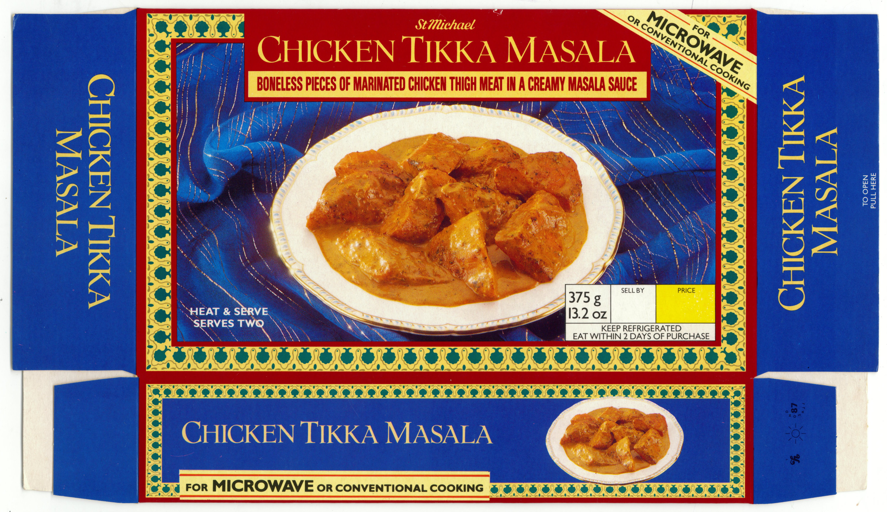
Source 11
Chicken Tikka Masala food packaging, 1987
Would you add anything to this food to make a meal?
Glossary
Marinated – Marinating is a process of soaking raw meat in a sauce before cooking
Masala - a spice mix used in South Asian cooking
Conventional cooking – cooking using an oven rather than a microwave

Slide 13
Source 12
From Microwave Cooking, Jenny Webb, 1983
Choose one of these lamb dishes. Look at the bottom of the recipe page to find the matching picture.

