Slide 1


Slide 2
Learning Objectives
Lower KS2: Working Scientifically Asking questions and using different types of scientific enquiries to answer them Setting up simple practical enquiries, comparative and fair tests Making careful observations and taking accurate measurements using standard units, using a range of equipment Recording findings using simple scientific language, drawings, labelled diagrams Reporting on findings through oral and written explanations or presentations of results and conclusions Using results to draw simple conclusions, make predictions for new values, suggest improvements and raise further questions Identifying differences, similarities or changes related to simple scientific ideas and processes Using straightforward scientific evidence to answer questions or to support findings

Slide 3
Learning Objectives
Upper KS2: Working Scientifically Planning different types of scientific enquiries to answer questions, including recognising and controlling variables where necessary Taking measurements, using a range of scientific equipment, with increasing accuracy and precision, taking repeat readings when appropriate Recording data and results of increasing complexity using scientific diagrams and labels, classification keys, tables, scatter graphs, bar and line graphs Using test results to make predictions to set up further comparative and fair tests Reporting and presenting findings from enquiries, including conclusions, causal relationships and explanations of and degree of trust in results, in oral and written forms such as displays and other presentations Identifying scientific evidence that has been used to support or refute ideas or arguments
Upper KS2: Properties and Changes of Materials Give reasons, based on evidence from comparative and fair tests, for the particular uses of everyday materials

Slide 4
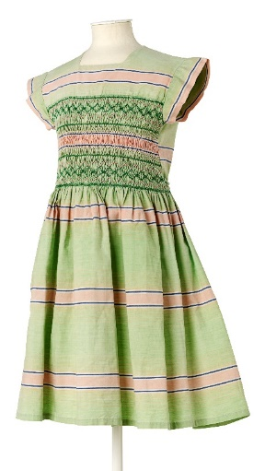
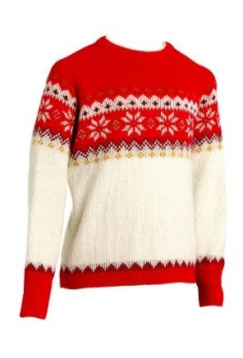
What are fabrics?
How many different fabrics can you name?

Slide 5
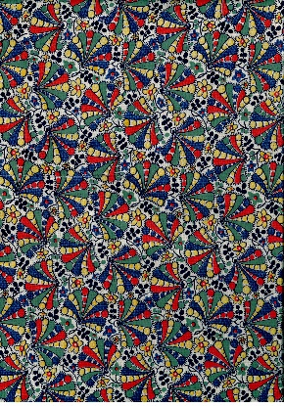
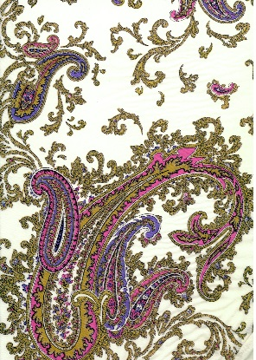
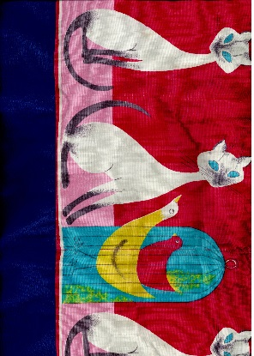
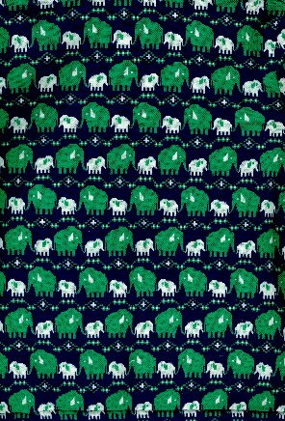
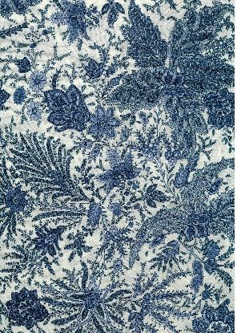
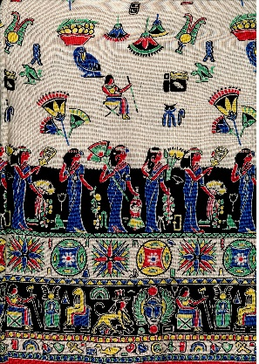
Investigating Fabrics
Use your senses to explore the fabrics

Slide 6
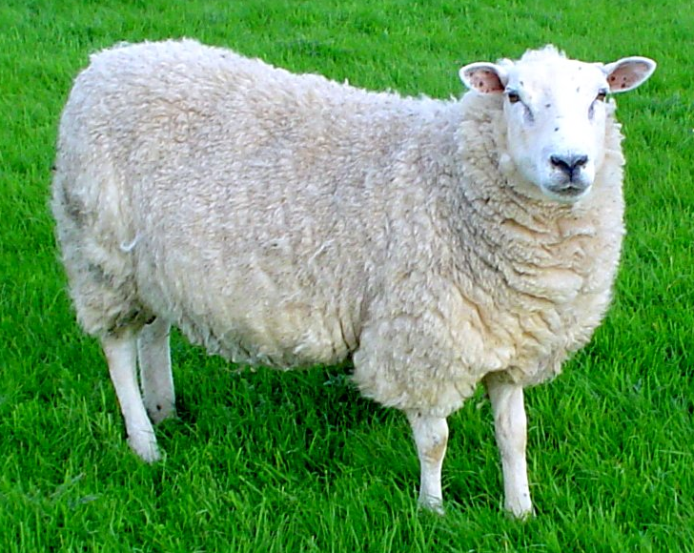

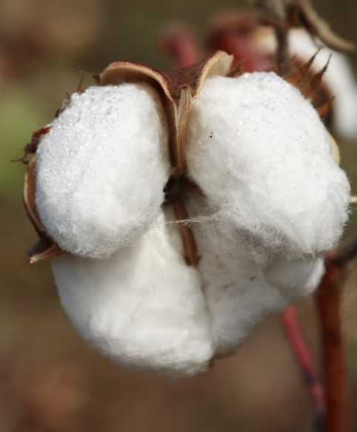
Making Fabrics
Is it natural or synthetic?

Slide 7
Play
Find the Fabric!

Slide 8
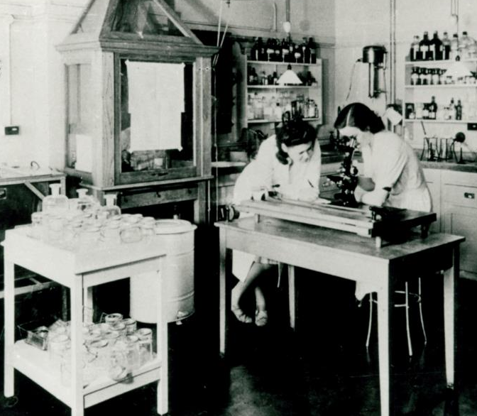
Testing Fabrics
Different fabrics have different properties
This is why we use certain fabrics to make types of clothing e.g. waterproofs
You are going to test some fabrics to find out about their properties
Watch the film

Slide 9
Investigation 1
Tree-climbing Trousers
You need to make some trousers especially for climbing trees.
Q: What properties will you need your tree-climbing trousers to have?
Q: How can you test the fabrics?
Q: How can you make sure your tests are fair?

Slide 10
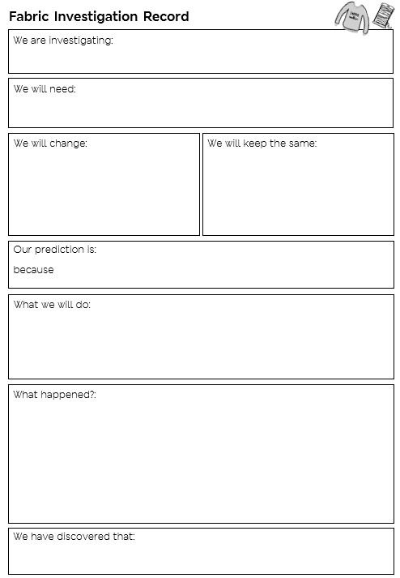

Slide 11
Investigation 2
Swimsuit
You need to find the best fabric for making a swimsuit.
Q: What properties will you need your swimsuit to have?
Q: How can you test the fabrics?
Q: How can you make sure your tests are fair?

Slide 13
Future Fashion
Do you know what the word innovation means?
Inventing something new, or a new way of doing something, that makes the process easier, or solves a problem.
Watch the film

Slide 14
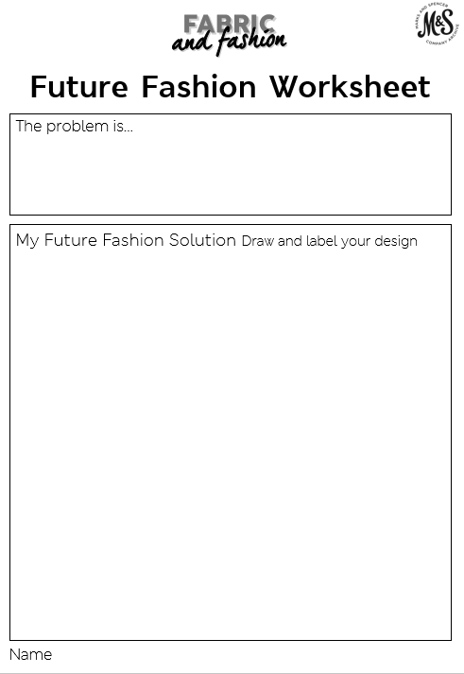
What’s the problem?
What’s the solution?

Slide 15
Future Fashion
Gallery

