Slide 1
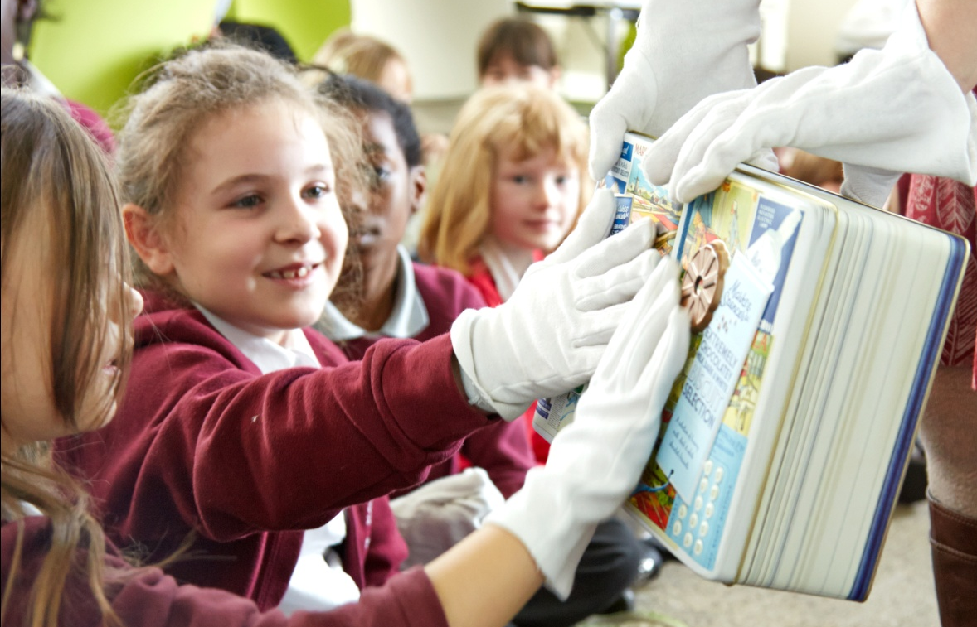


Slide 2
Learning Objectives
Design
Use, research and develop design criteria to inform the design of innovative, functional, appealing products that are fit for purpose, aimed at particular individuals or groups
generate, develop, model and communicate ideas
Make - use tools and equipment to perform practical tasks accurately
Evaluate
investigate and analyse a range of existing products
evaluate ideas and products against design criteria and consider the views of others to make improvements

Slide 3
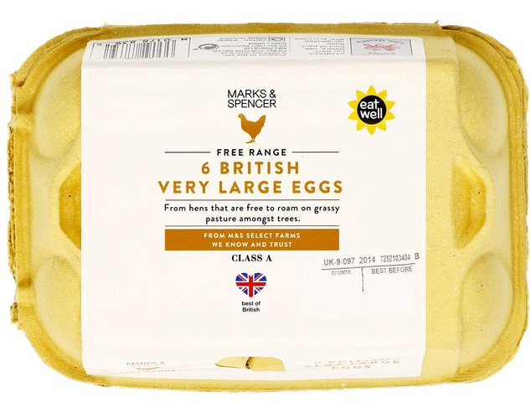
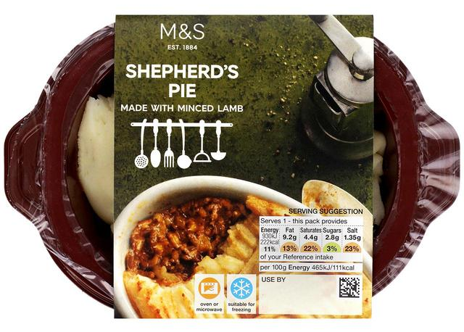
Food Packaging
Why do we put food in packaging?
What different types of food packaging can you think of?
We’re going to take a closer look…

Slide 4
Let’s investigate!
What is the object?
How do you know what it is?
What colours and shapes can you see?
Does it have any textures?
Who is it for?
What information can you find?
Tip: Look for writing, symbols, pictures and numbers

Slide 5
You’re the designer!
Designers start with a brief, this tells them what their design needs to achieve
DESIGN BRIEF
Your design will;
be for food packaging
contain the name of the biscuit
use only 3 colours
must appeal to children aged 7-11 years

Slide 6
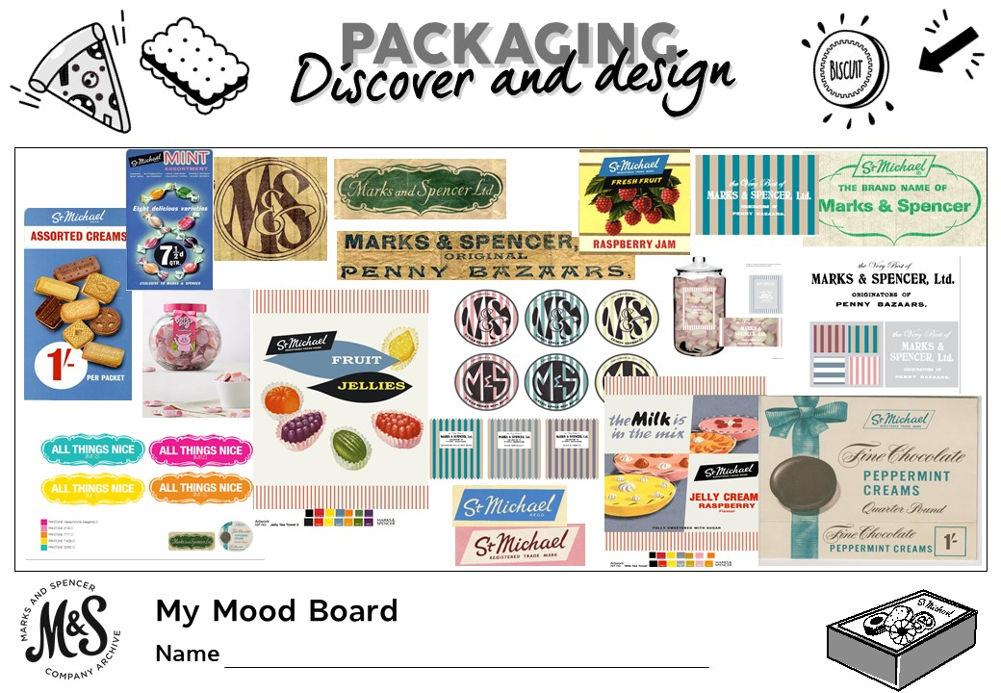
You’re the designer!
Then they use a mood board to collect ideas
Finally they pick the best bits from their mood board to put into their design

Slide 7
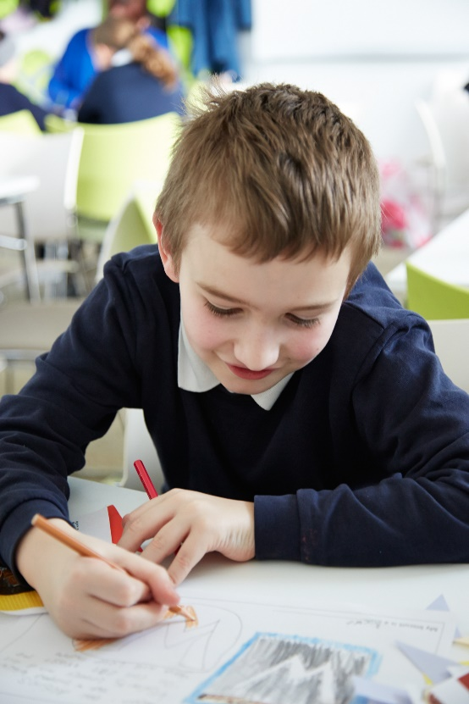
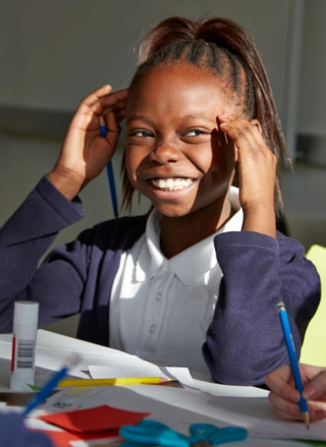
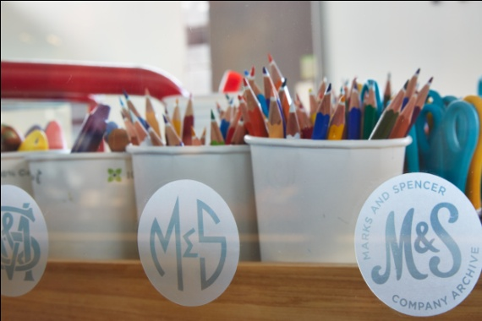
Design your packaging

Slide 8
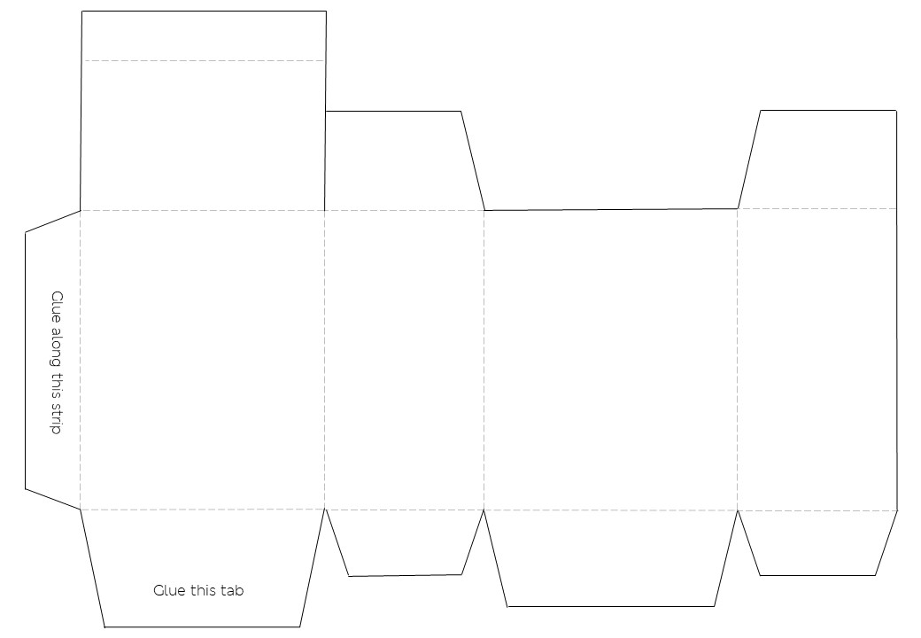
1
2
3
4

Slide 9
Evaluate!
What went well?
What would you do differently next time?
Share your work with your class –
which designs do you like best and why?

