Slide 1
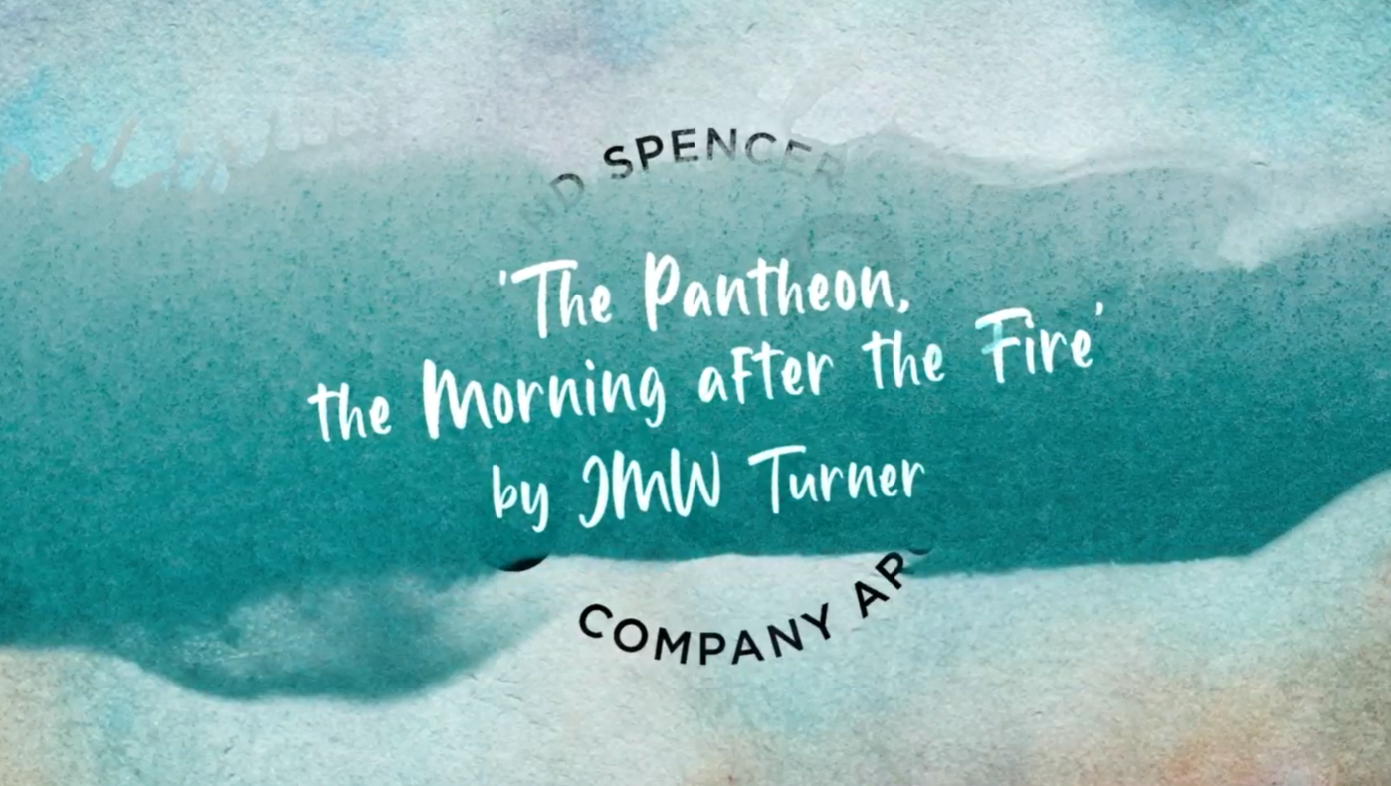
JMW Turner
The Pantheon, the Morning after the Fire

Slide 2
Learning Objectives
Gain knowledge about and analyse JMW Turner’s work.
Understand and use painting and drawing techniques used by JMW Turner.
Use knowledge and understanding of imagery and techniques used by Turner to inform students’ own work.

Slide 4
What can you see?
What can you see?
Why do you think Turner chose to paint this scene?
Can you think of any other artists that record current events with their art? How do they do this?

Slide 5
What can you see?
What materials do you think Turner used to make this picture?
What techniques are used to create the light and dark areas?
There is a lot of depth in this painting, what techniques has Turner used to create such depth?

Slide 6
Watch the film…
Which of the techniques that we’ve discussed did you notice?
How do we capture and record current events now?
How has seeing the painting close-up made you think differently about it?
What surprised you?
Do you have any questions?

Slide 7
En Plein Air
Take your sketchbook outside.
Choose a view or building to sketch.
Mix colours in your sketchbook.
Practice painting a wash using a wet brush and small amounts of paint.
Try painting stronger colours layered over lighter ones.

Slide 8
En Plein Air
Draw your scene again and apply colour using light washes.
Add layers of stronger colours.
Can you sketch the same scene from different angles?
Take your sketches and colour mixes back to your classroom.
Can you make a new painting using your sketches as a starting point?

Slide 9
Light and Shade
Choose an object, observe it in different light conditions.
Try different techniques for creating tone eg
shading
stippling
cross hatching

Slide 10
Light and Shade
Choose one technique to create the different tones seen in your object.
Look at what happens to colours in different light.
Paint your object, paying attention to colour in different light conditions.

Slide 11
Influencers
Choose two artists who have been influenced by Turner, compare their work to Turner’s.
What similarities and differences can you see?
How have they used what they’ve learned from studying Turner in their own work?
What do you like or find most interesting about Turner’s work?
Use what you’ve learned about Turner to create your own art inspired by his work.

Slide 12
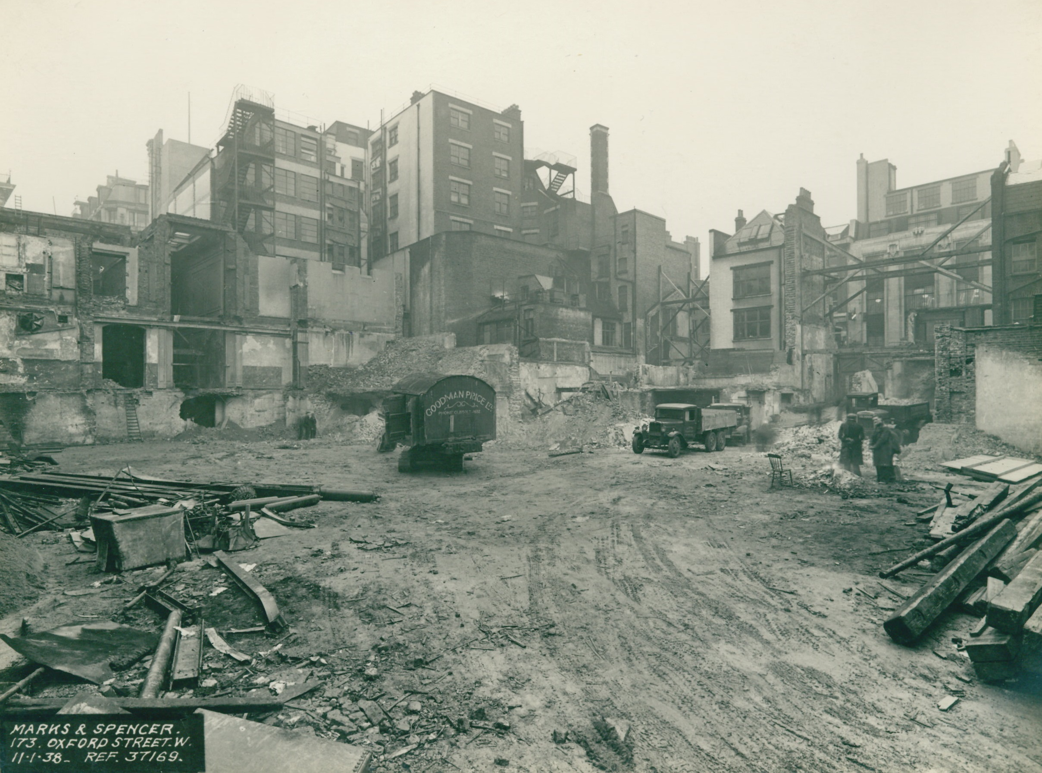
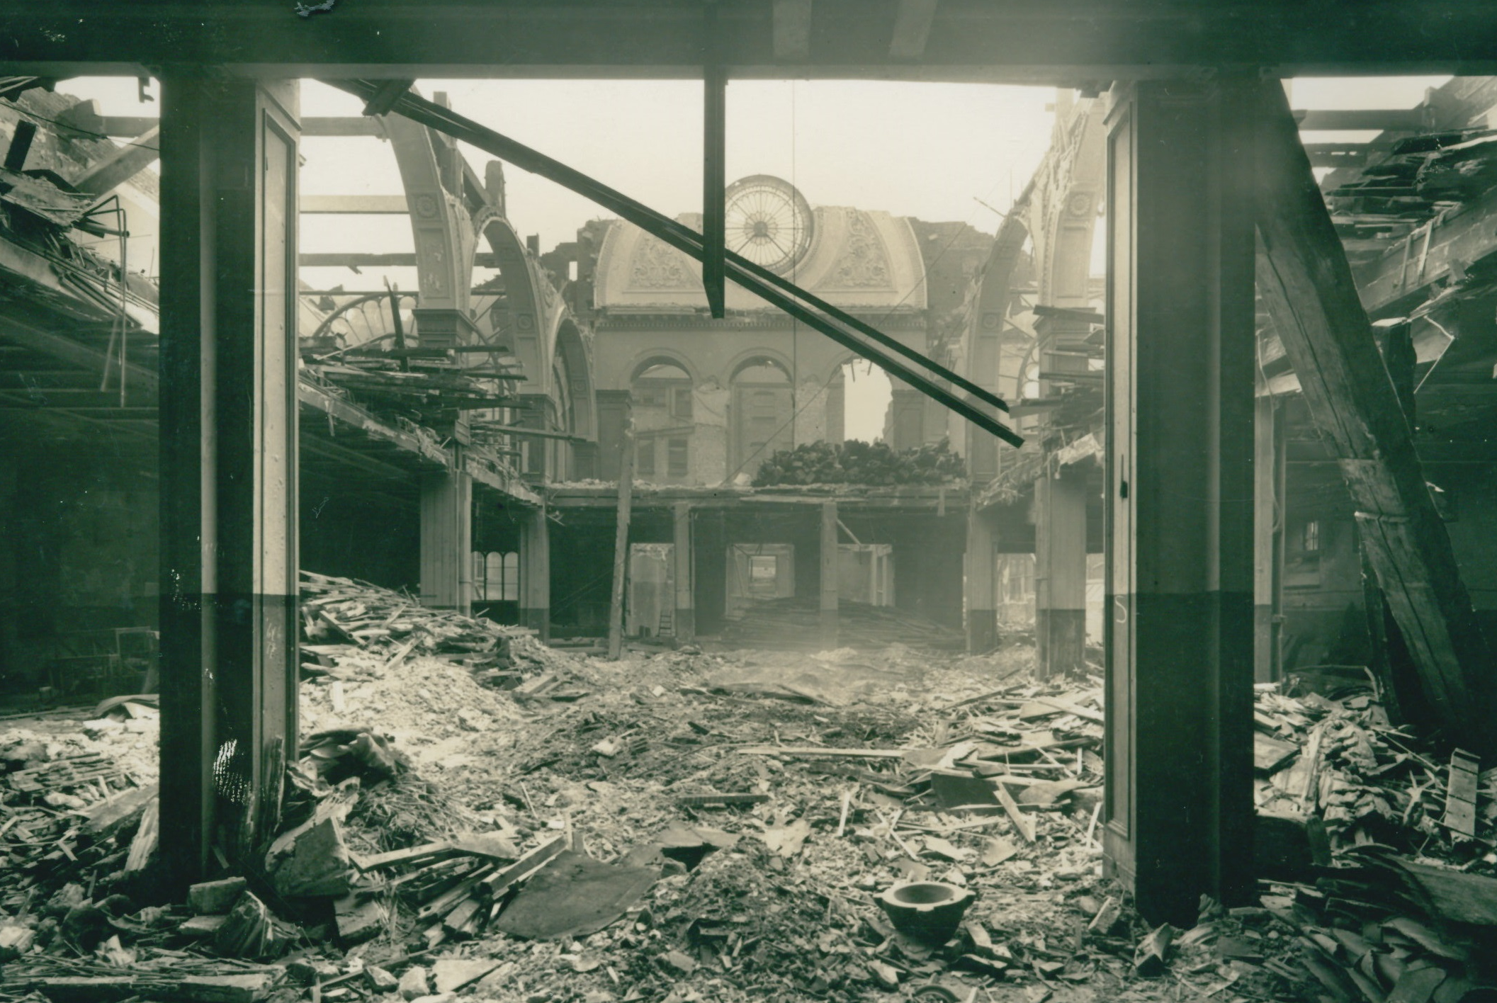
Building a Picture
Can you find parts of the photographs that look like parts of The Pantheon, the Morning after the Fire?
Cut and collage the photographs to make a picture that looks like Turner’s painting.

Slide 13
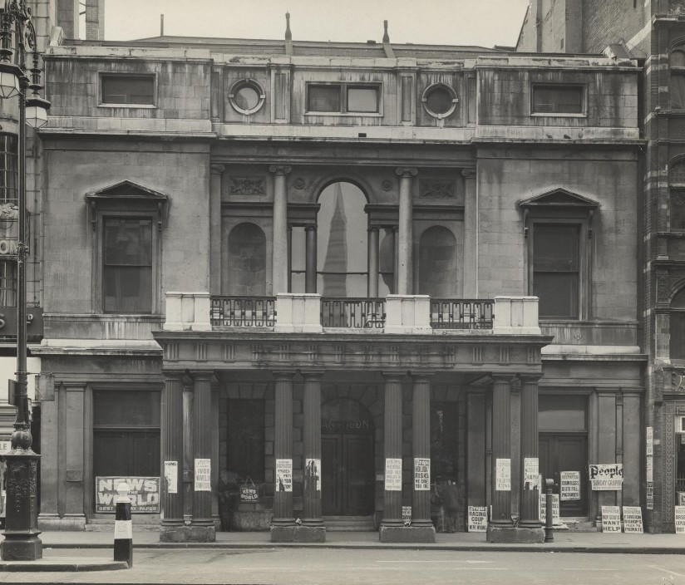
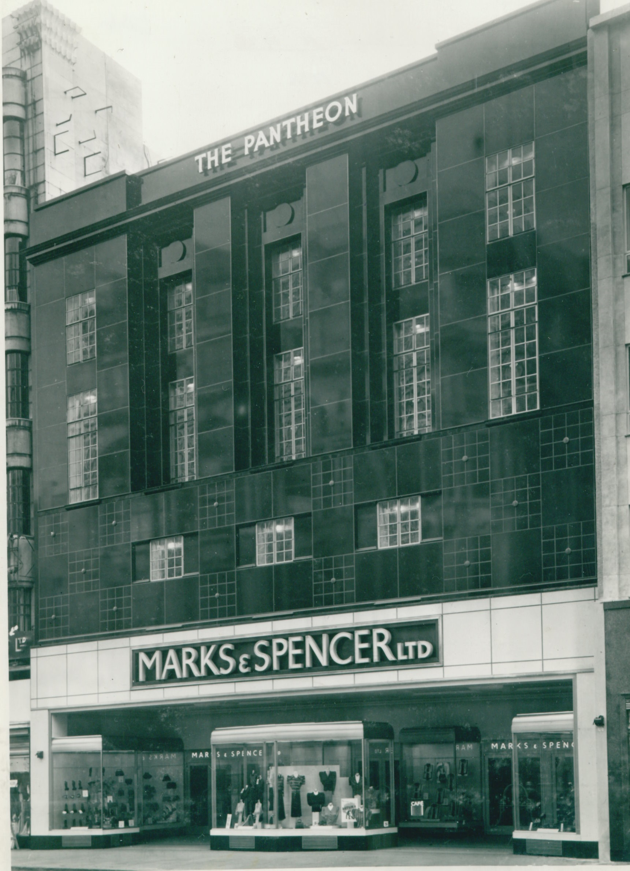
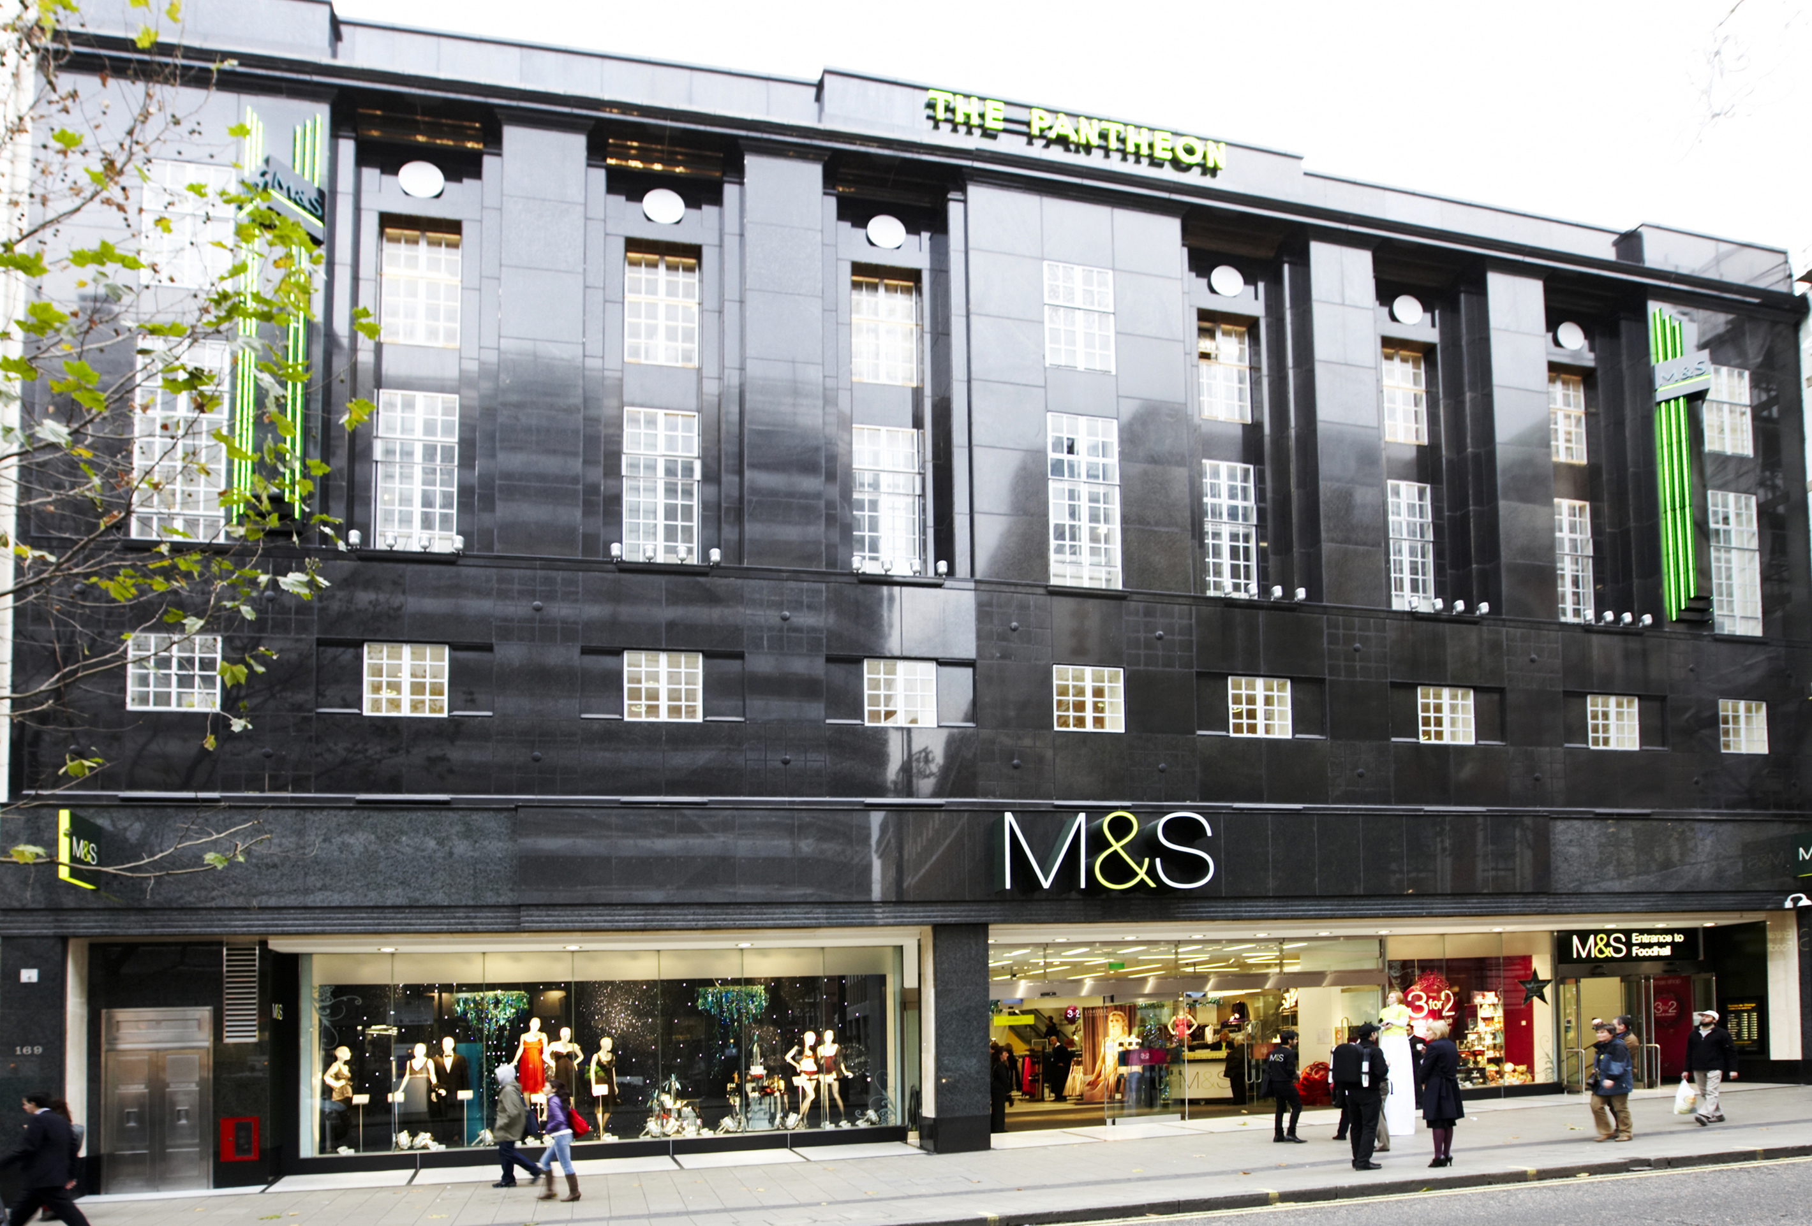
Old and New
How are the old and new building designs similar?
2 The Pantheon c1772
3 M&S Pantheon 1938
4 The Pantheon 1937
5 M&S Pantheon 2008
3 The Pantheon 1937

Slide 14
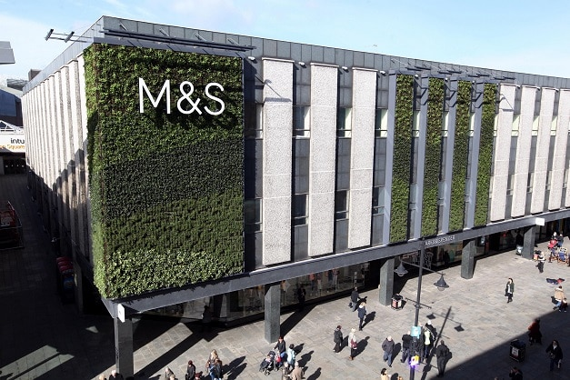
You could include:
Features that mean your building has a positive impact on the environment
Ways that your building could help people in the community to meet/play/shop/recycle
Take inspiration from the history of your local area or historic buildings nearby
Old and New and the Future!
Design a shop or high street building for the future.
Can your building;
Help the environment?
Help people to meet/play/shop/recycle?
Be inspired by historic buildings?
2 The Pantheon c1772
6 M&S Newcastle
3 The Pantheon 1937

Slide 15
Q: Can you write or illustrate one thing you’ve learned using this pack?
Q: If you had the chance to talk to Turner what would you ask him and why?
Talk to Turner
Imagine you had the chance to talk to Turner, what would you ask him and why?
2 The Pantheon c1772
3 The Pantheon 1937

