Slide 1
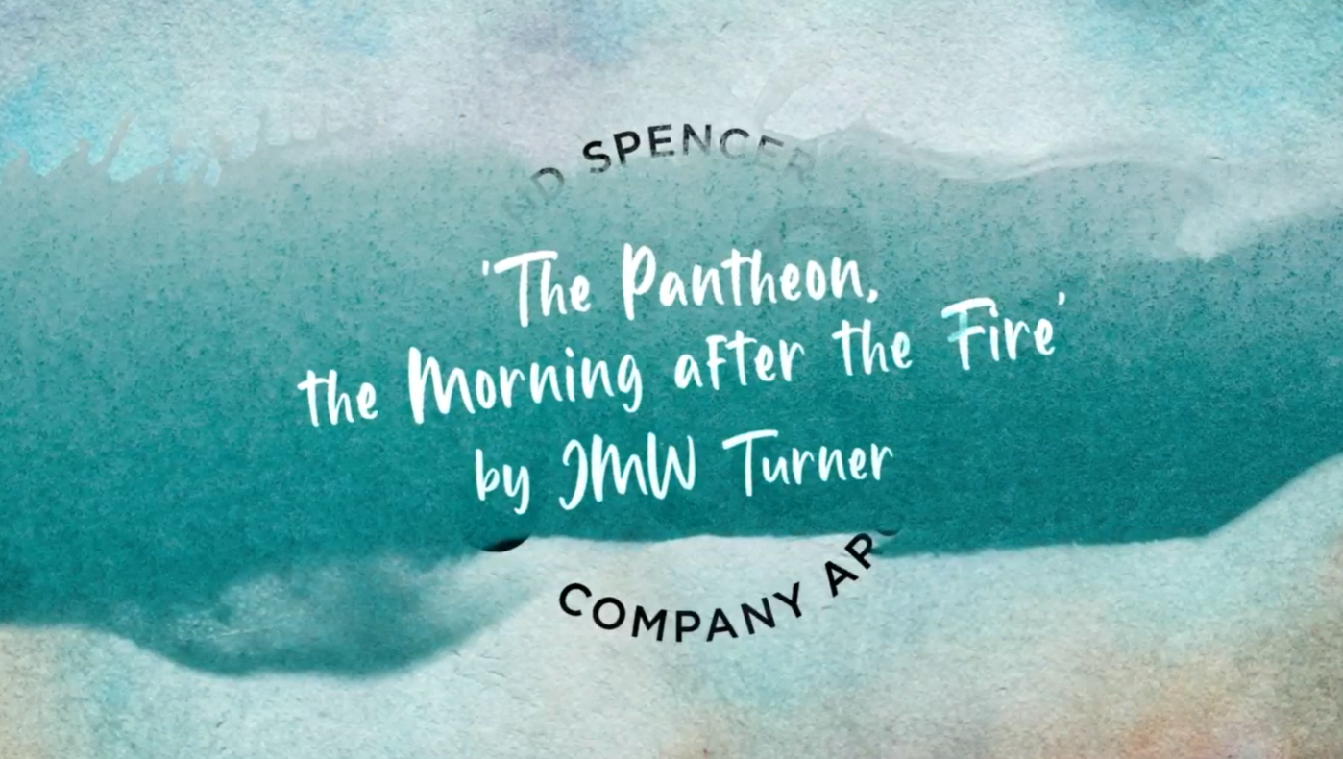

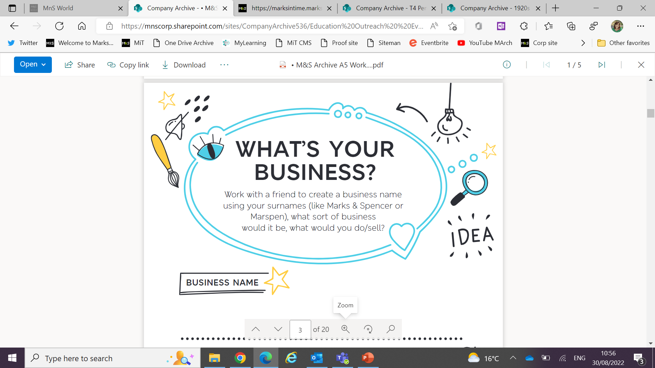
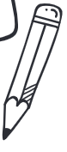

JMW Turner
The Pantheon, the Morning after the Fire

Slide 2

Learning Objectives
Gain knowledge about JMW Turner’s work.
Understand and use painting and drawing techniques used by JMW Turner.
Understand and use some subject terminology such as watercolour, en plein air, washes, sketch, tone.

Slide 3
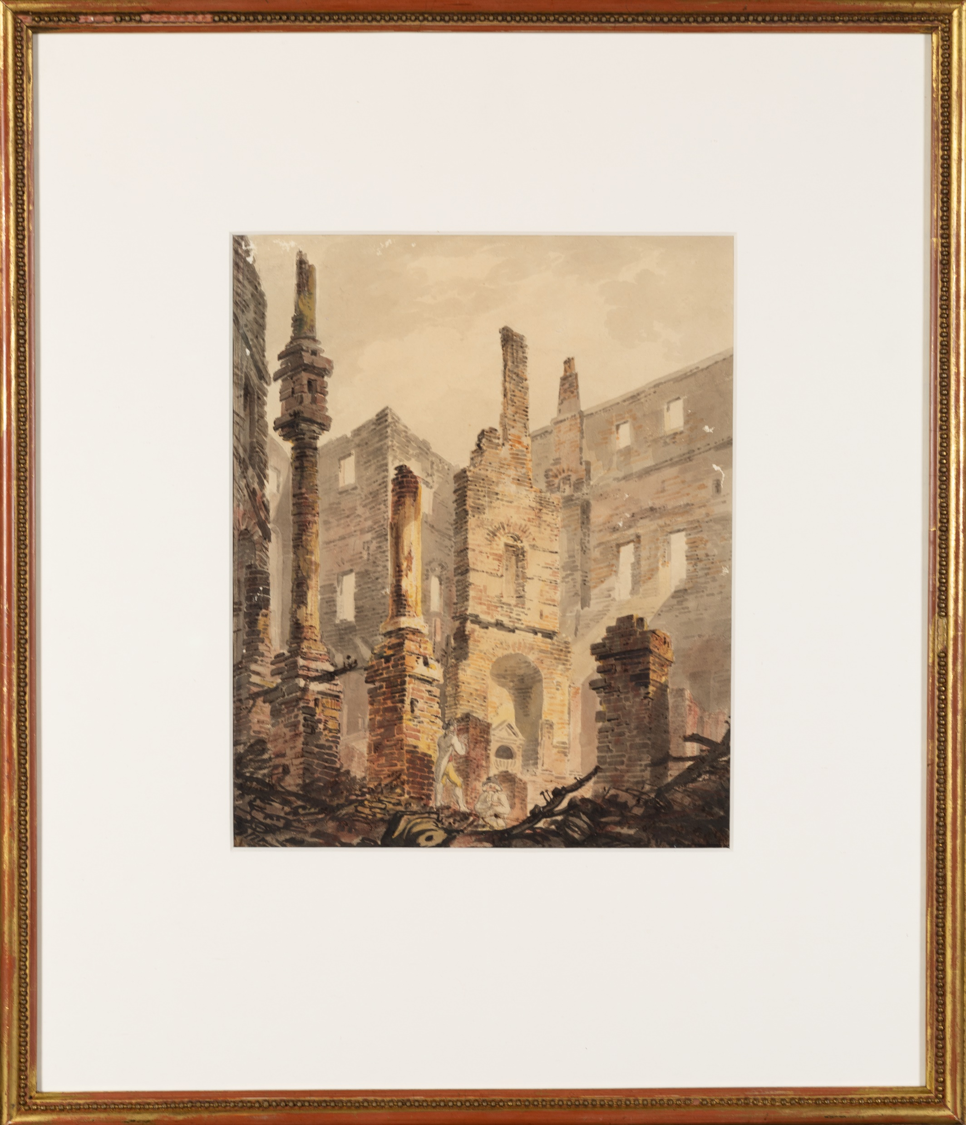

Slide 4
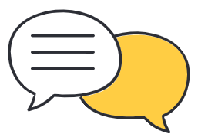
What can you see?
What can you see?
What do you think has happened?
What do you think happened to the building next?

Slide 5
What can you see?
What colours can you see?.
What time of year do you think it is?
What materials do you think Turner used to make this picture?
Where do you think he was when he made it?

Slide 6

What can you see?
Which areas are light and which are dark?
What do you think Turner did differently when he painted the lighter and darker areas?
What are the differences in the way Turner has painted the foreground and the background?

Slide 7
Watch the film…
Which of the techniques that we’ve discussed did you notice?
How has seeing the painting close-up made you think differently about it?
What surprised you?
Do you have any questions?

Slide 8
Create a Scene
Write and illustrate a short story or cartoon that includes your own version of the painting.
You could think about…
  Who are the figures in the painting?
  What happened to Turner on the day he painted the scene?
  How did the fire start?

Slide 9
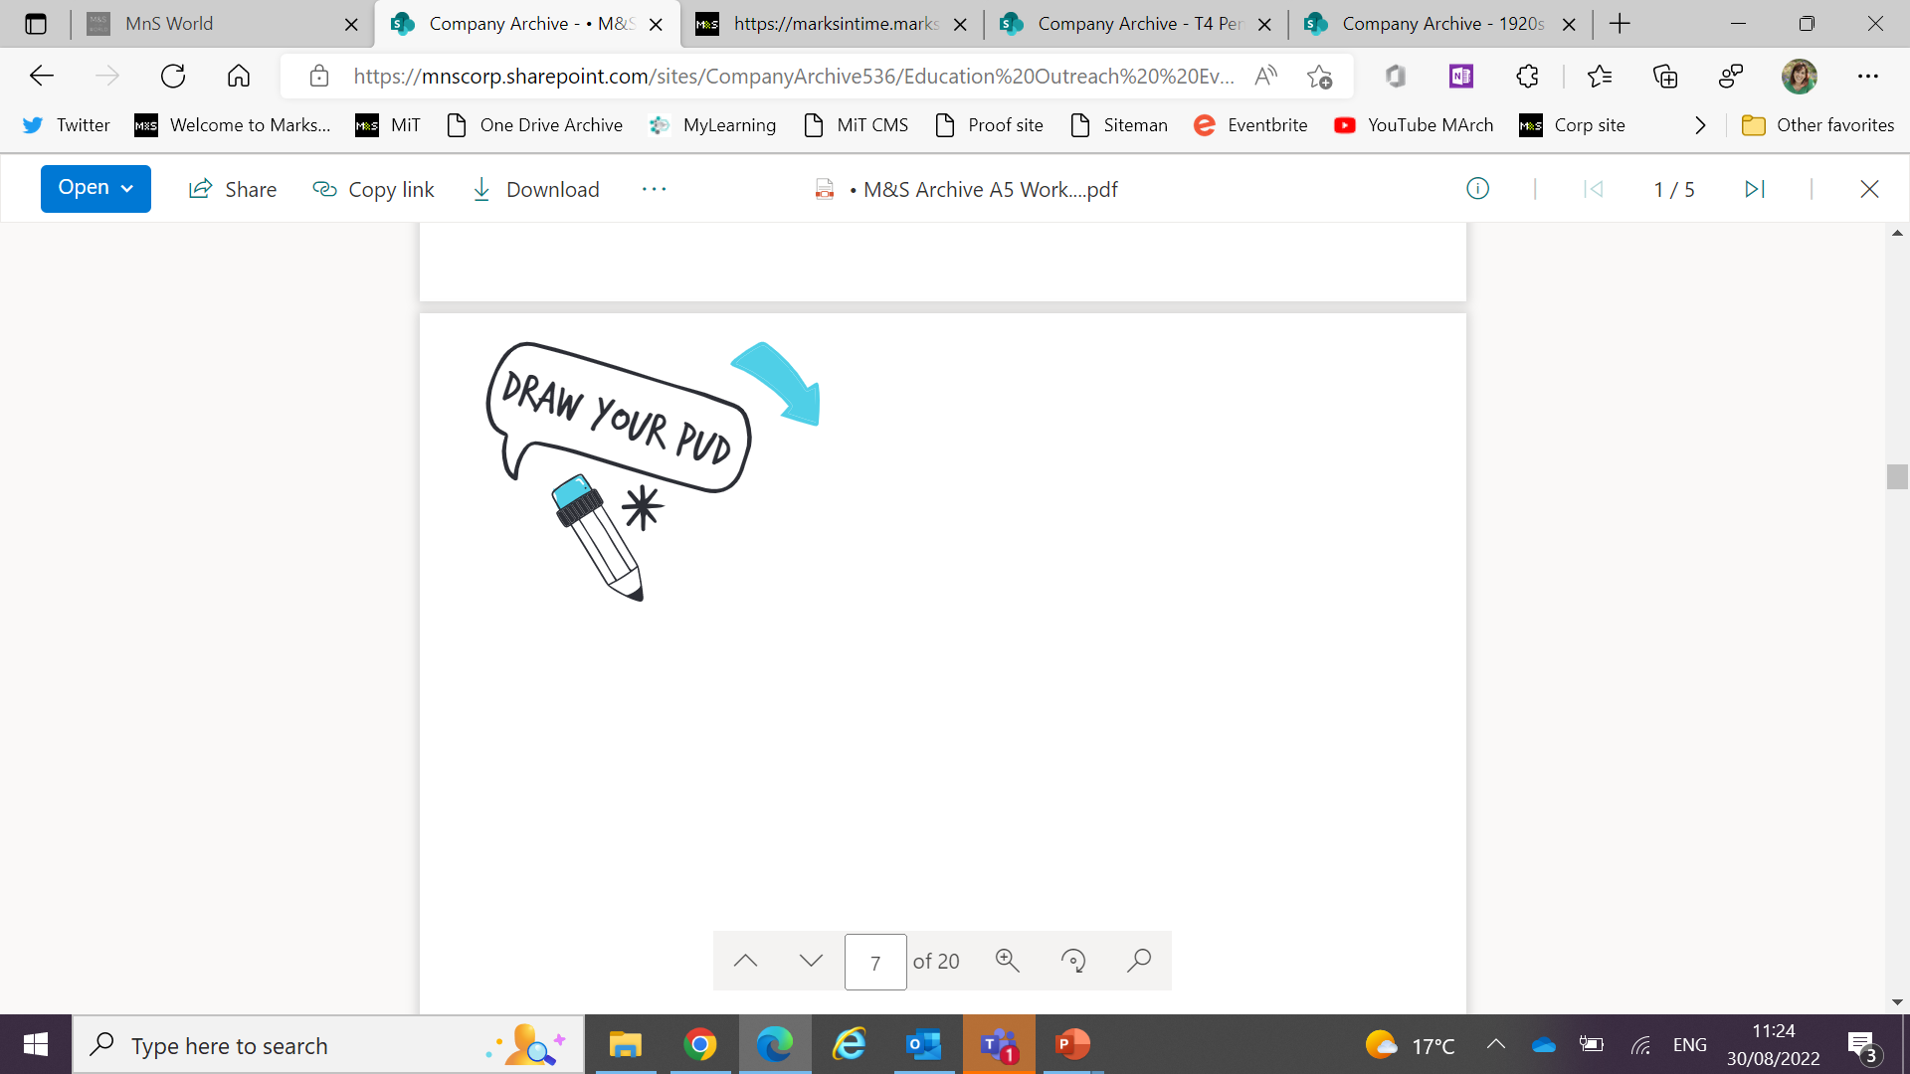
Paint like Turner
Take your sketchbook outside.
Choose a view or building to sketch.
Mix colours in your sketchbook.
Practice painting using a wet brush and small amounts of paint.
Try painting stronger colours layered over lighter ones.

Slide 10
Paint like Turner
Draw your scene again and apply colour using light washes.
Take your sketches and colour mixes back to your classroom.
Add layers of stronger colours.
Can you make a new painting using your sketches as a starting point?

Slide 11
Light and Shade
Look around, can you see areas of bright light and areas of shadow?
Top tip: Squint your eyes to see light and dark areas more clearly
What happens to colours when bright light shines on them, what happens when they’re in shadow?

Slide 12
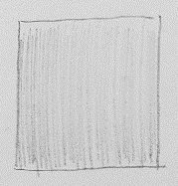


Light and Shade
Using a pencil, draw four squares on your paper and number them 1-4. Your squares should be about 3cm x 3cm.
1. Colour the first square in, pressing very lightly on the paper.
2. For the second square, press slightly harder, and keep shading for longer.
3. Press even harder and colour for even longer on the third square.
What do you notice about how you’ve created the different shades?

Slide 13

Light and Shade
4. Colour lightly on one side of the fourth square.
Move your pencil across, gradually press harder and colour for longer so your square goes from light at one side to dark at the other.

Slide 14
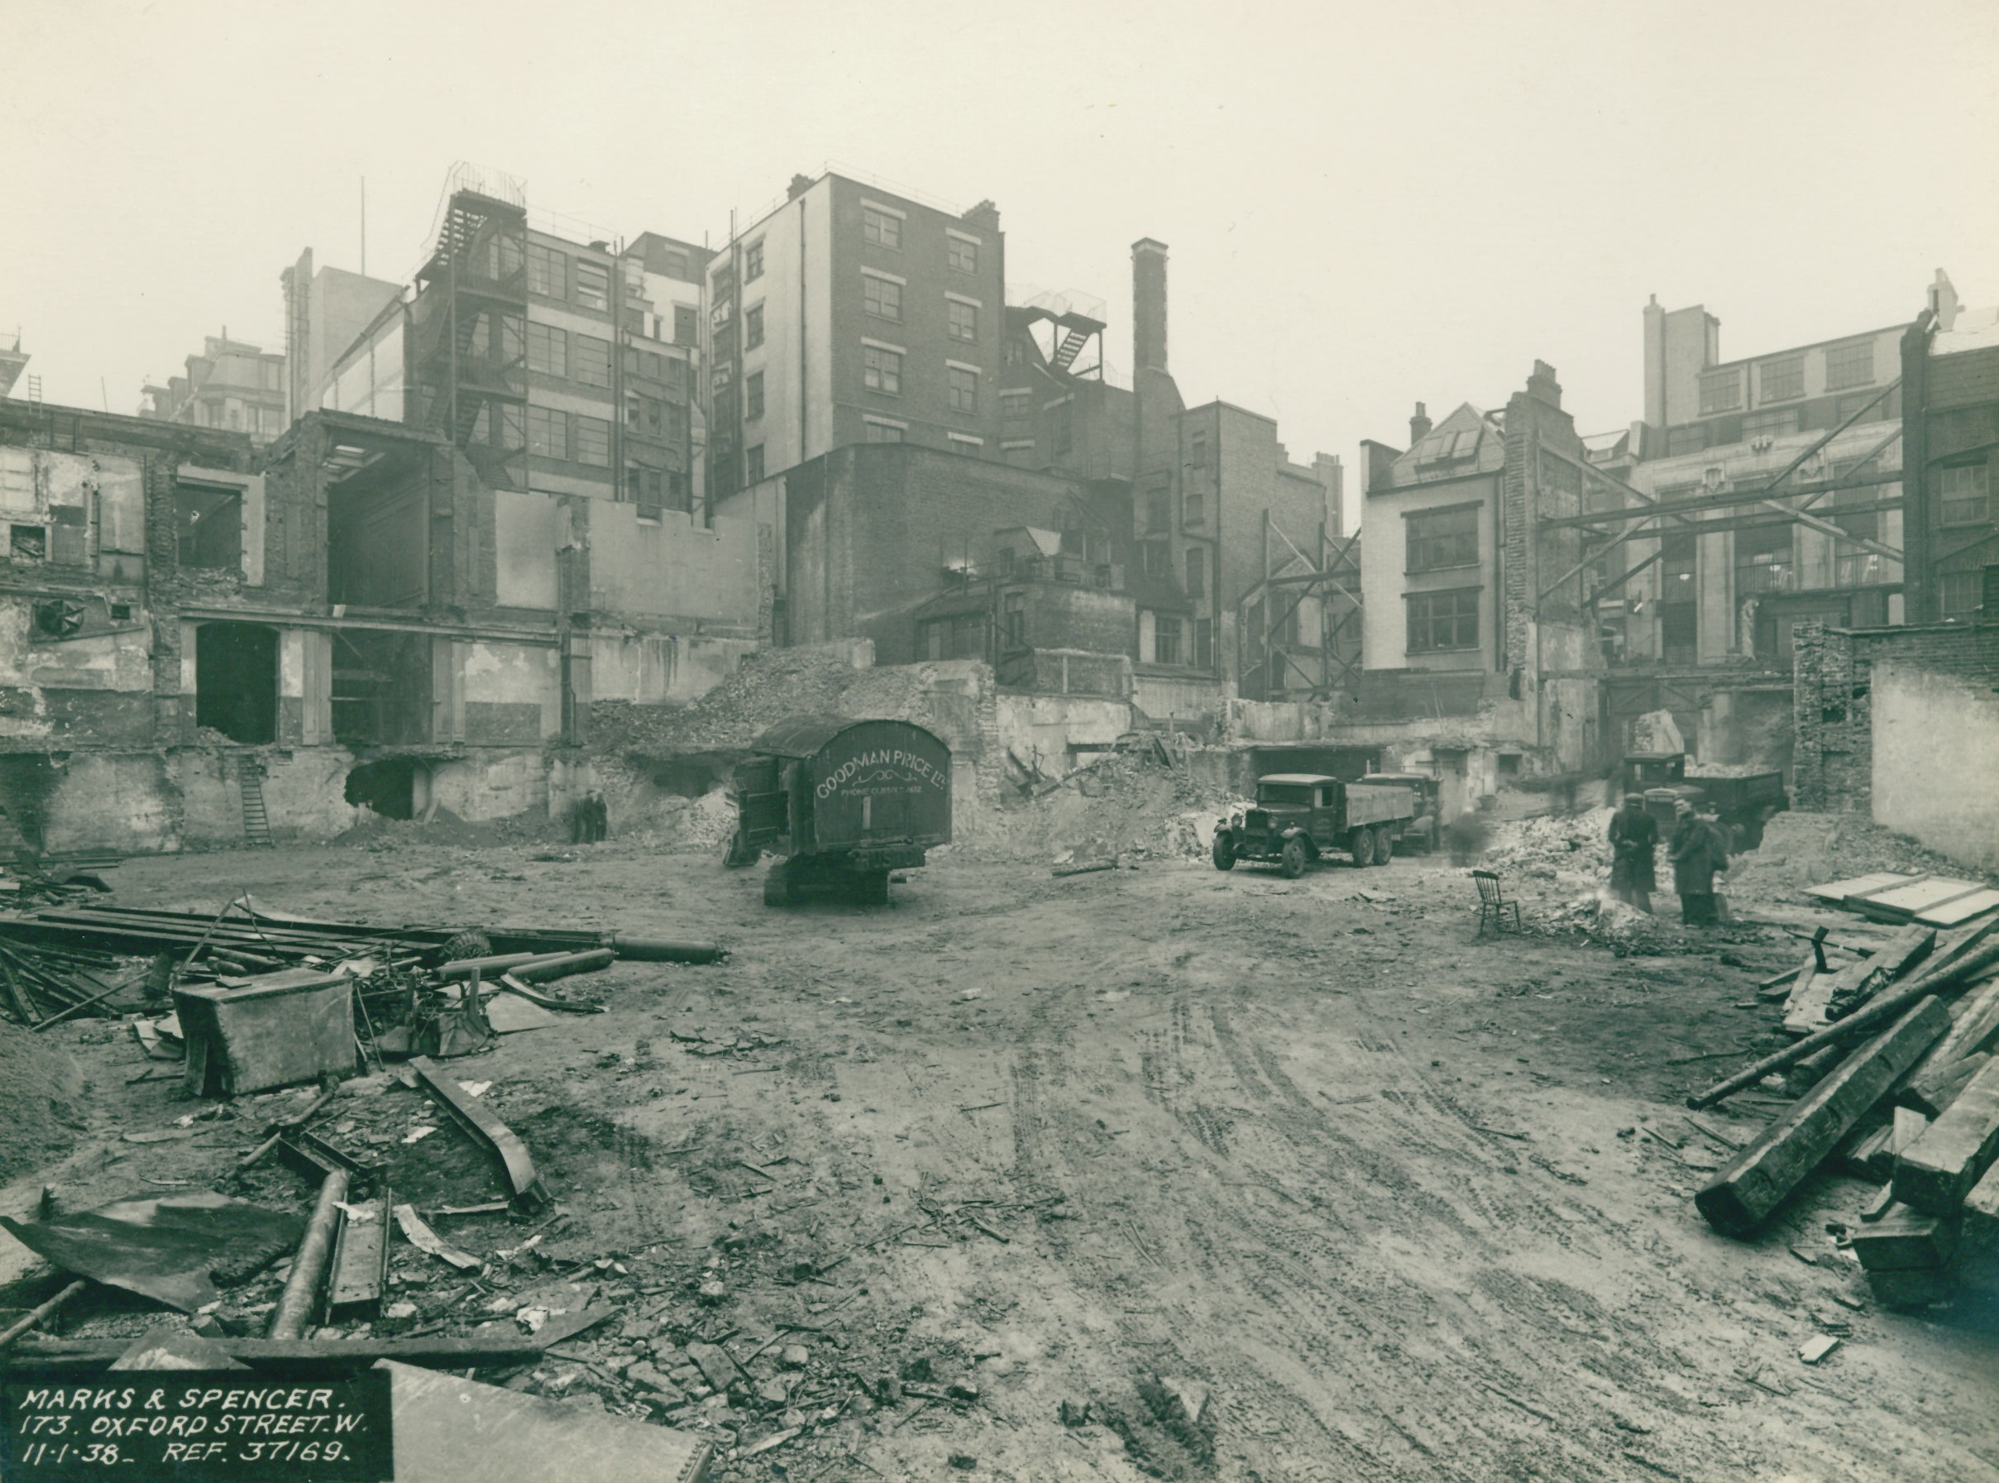
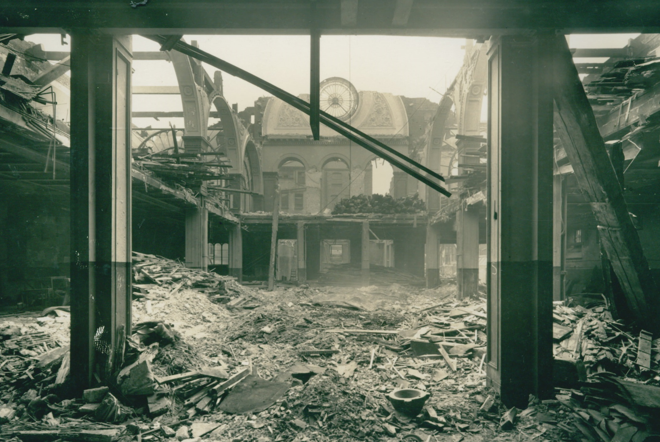
Building a Picture
Can you find parts of the photographs that look like parts of The Pantheon, the Morning after the Fire?
Cut and collage the photographs to make a picture that looks like Turner’s painting.

Slide 15
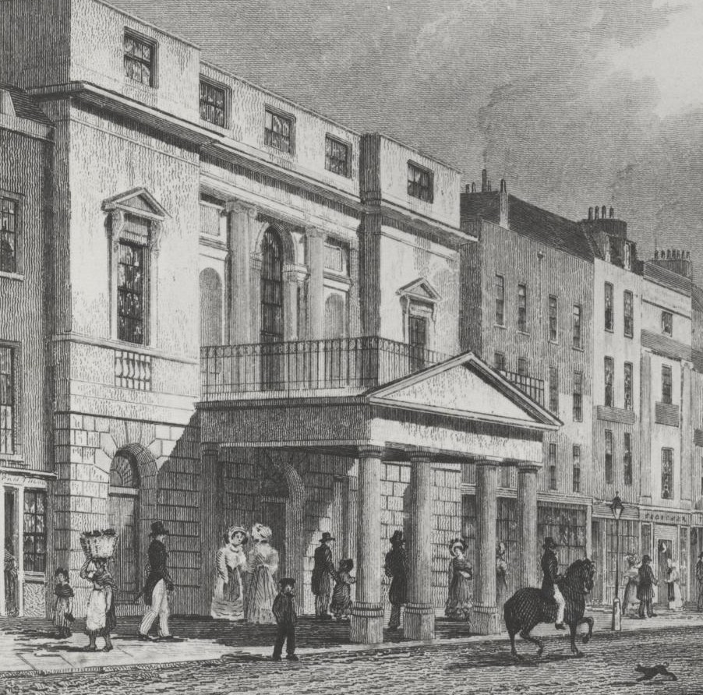
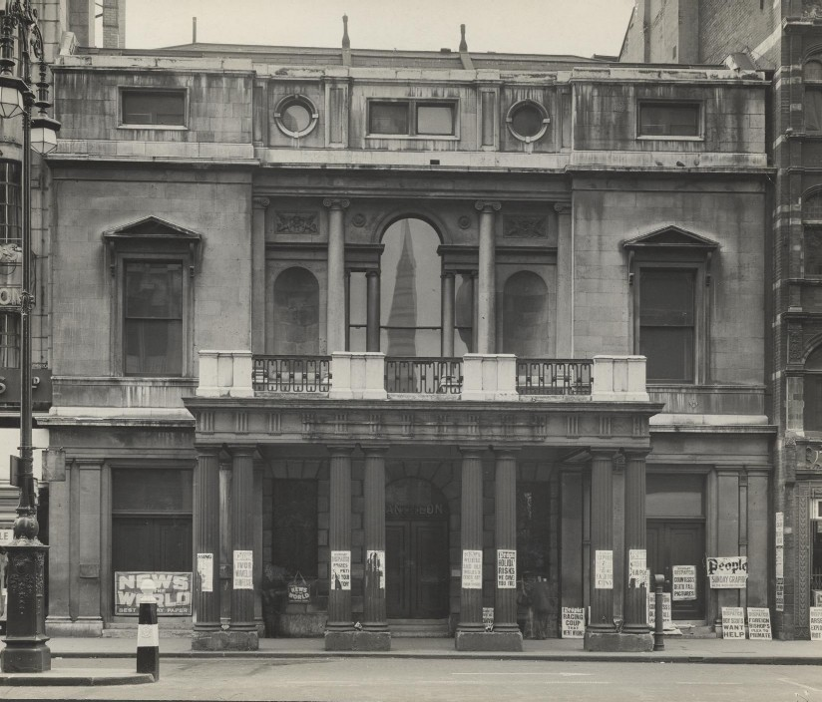
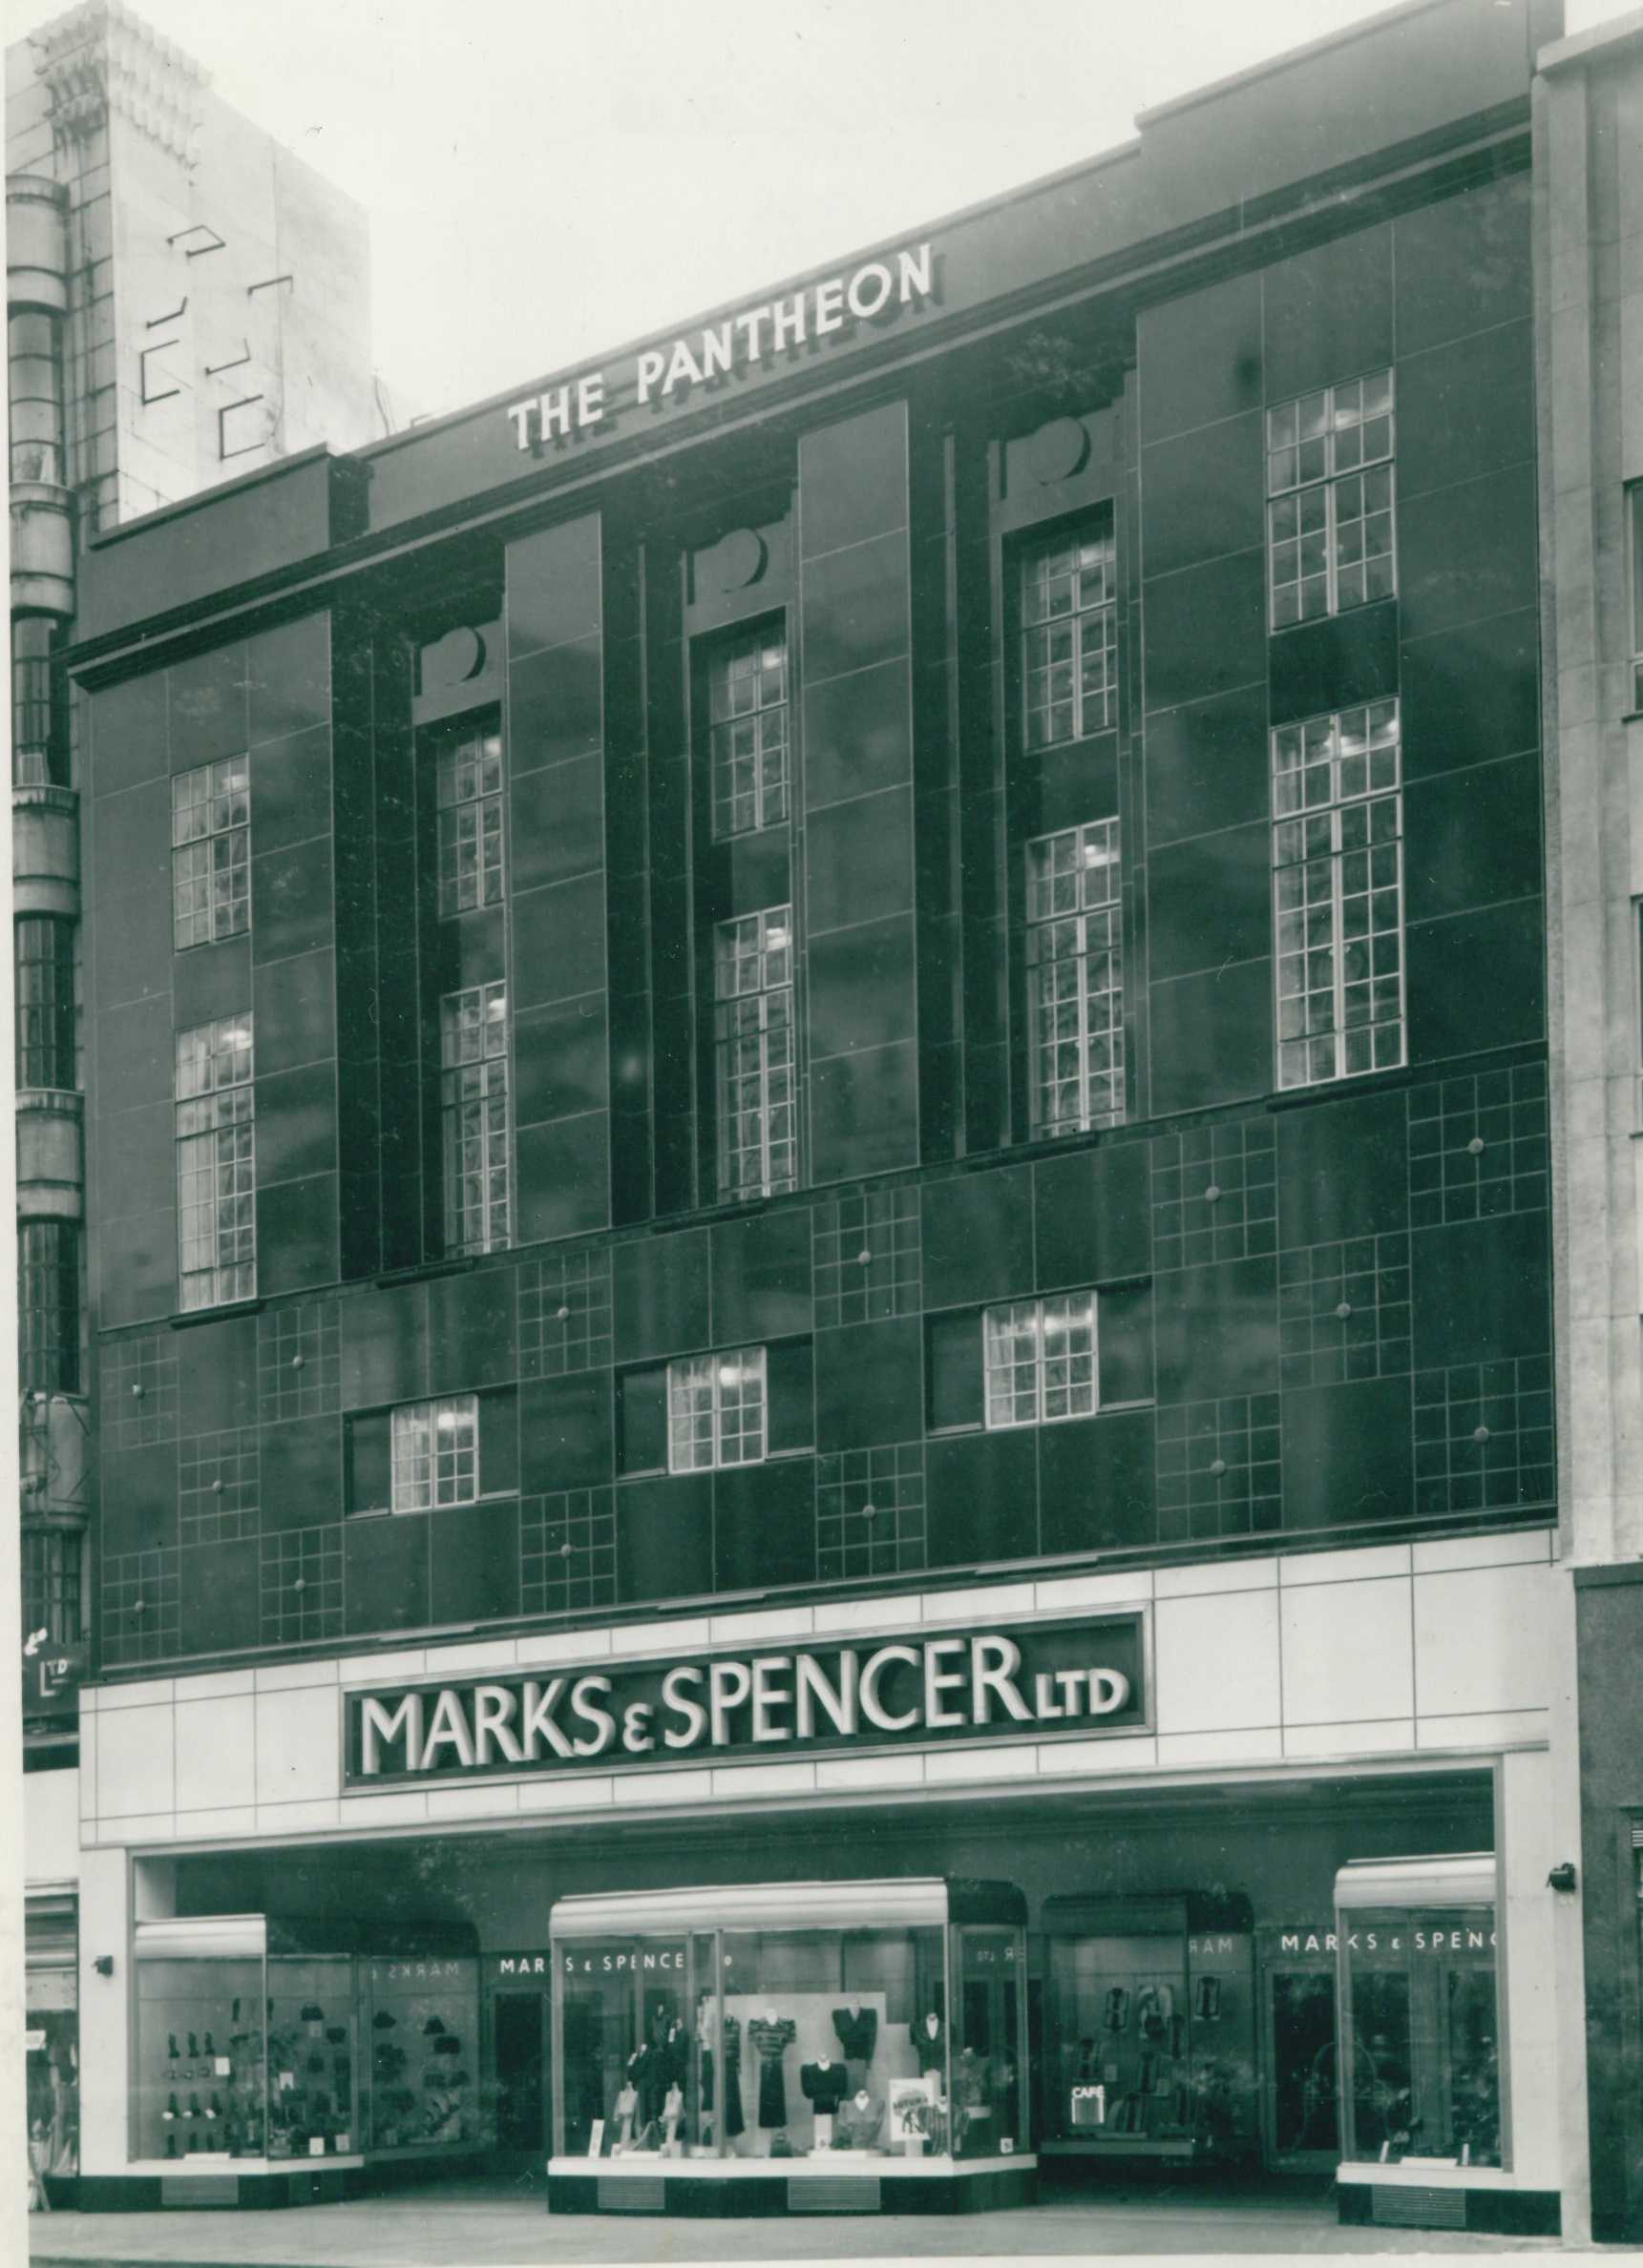
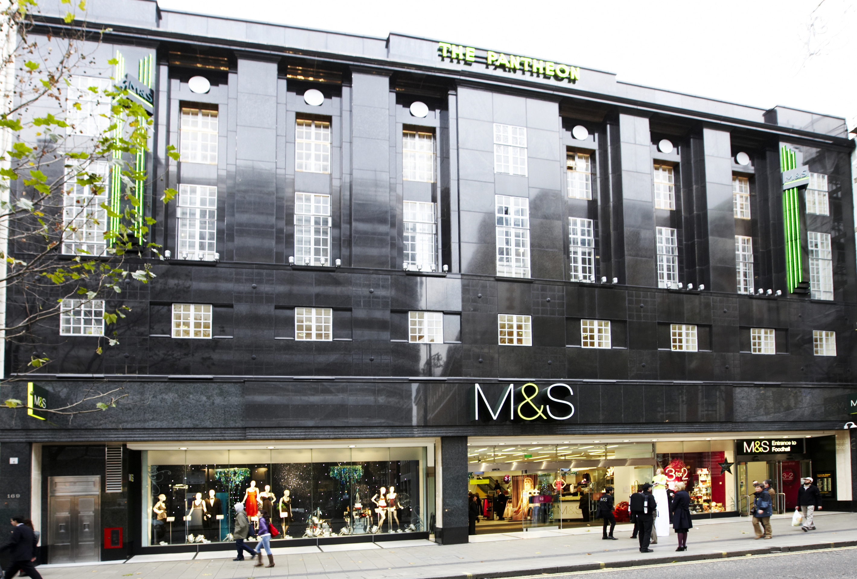
Old and New
How are the old and new building designs similar?
2 The Pantheon c1772
3 M&S Pantheon 1938
4 The Pantheon 1937
5 M&S Pantheon 2008
3 The Pantheon 1937
New
Old

Slide 16
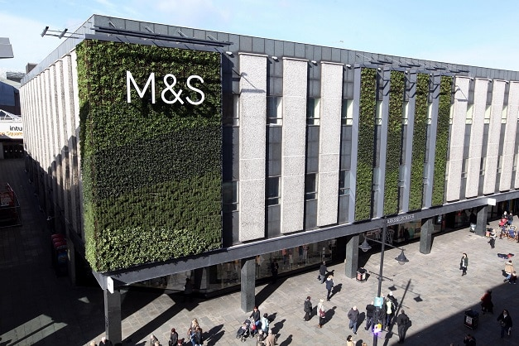
You could include:
Features that mean your building has a positive impact on the environment
Ways that your building could help people in the community to meet/play/shop/recycle
Take inspiration from the history of your local area or historic buildings nearby
Old and New and the Future!
Design a shop or high street building for the future.
How can your building;
Help the environment?
Help people to meet/play/shop/recycle?
Be inspired by the history of your area or historic buildings nearby?
2 The Pantheon c1772
6 M&S Newcastle
3 The Pantheon 1937

Slide 17
Q: Can you write or illustrate one thing you’ve learned using this pack?
Q: If you had the chance to talk to Turner what would you ask him and why?
Talk to Turner
Imagine you had the chance to talk to Turner, what would you ask him and why?
2 The Pantheon c1772
3 The Pantheon 1937

