Slide 1
JMW Turner: The Pantheon, the Morning After the Fire 1792
Image 1

Slide 2
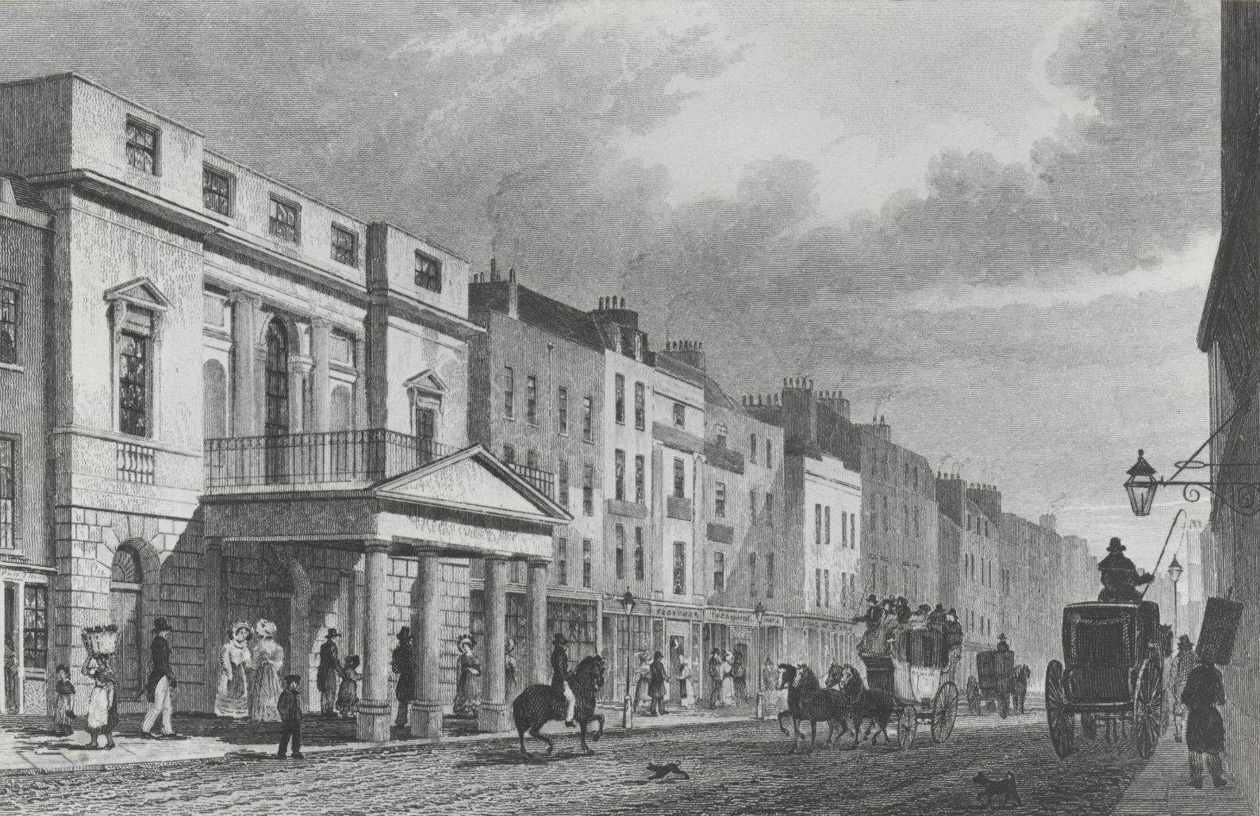
Image 2
The Pantheon c1772

Slide 3
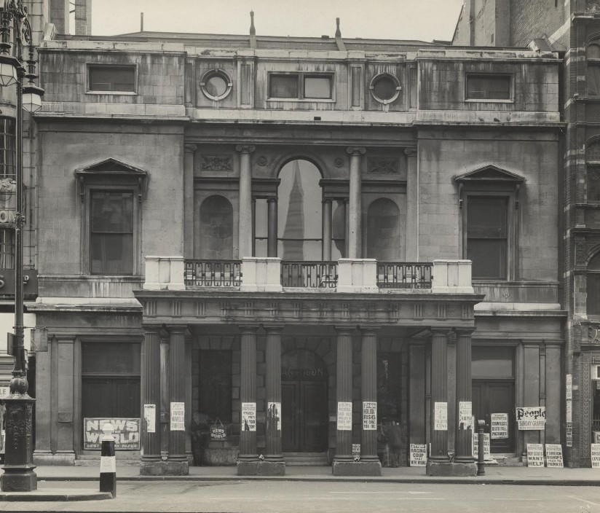
Image 3
The Pantheon 1937

Slide 4
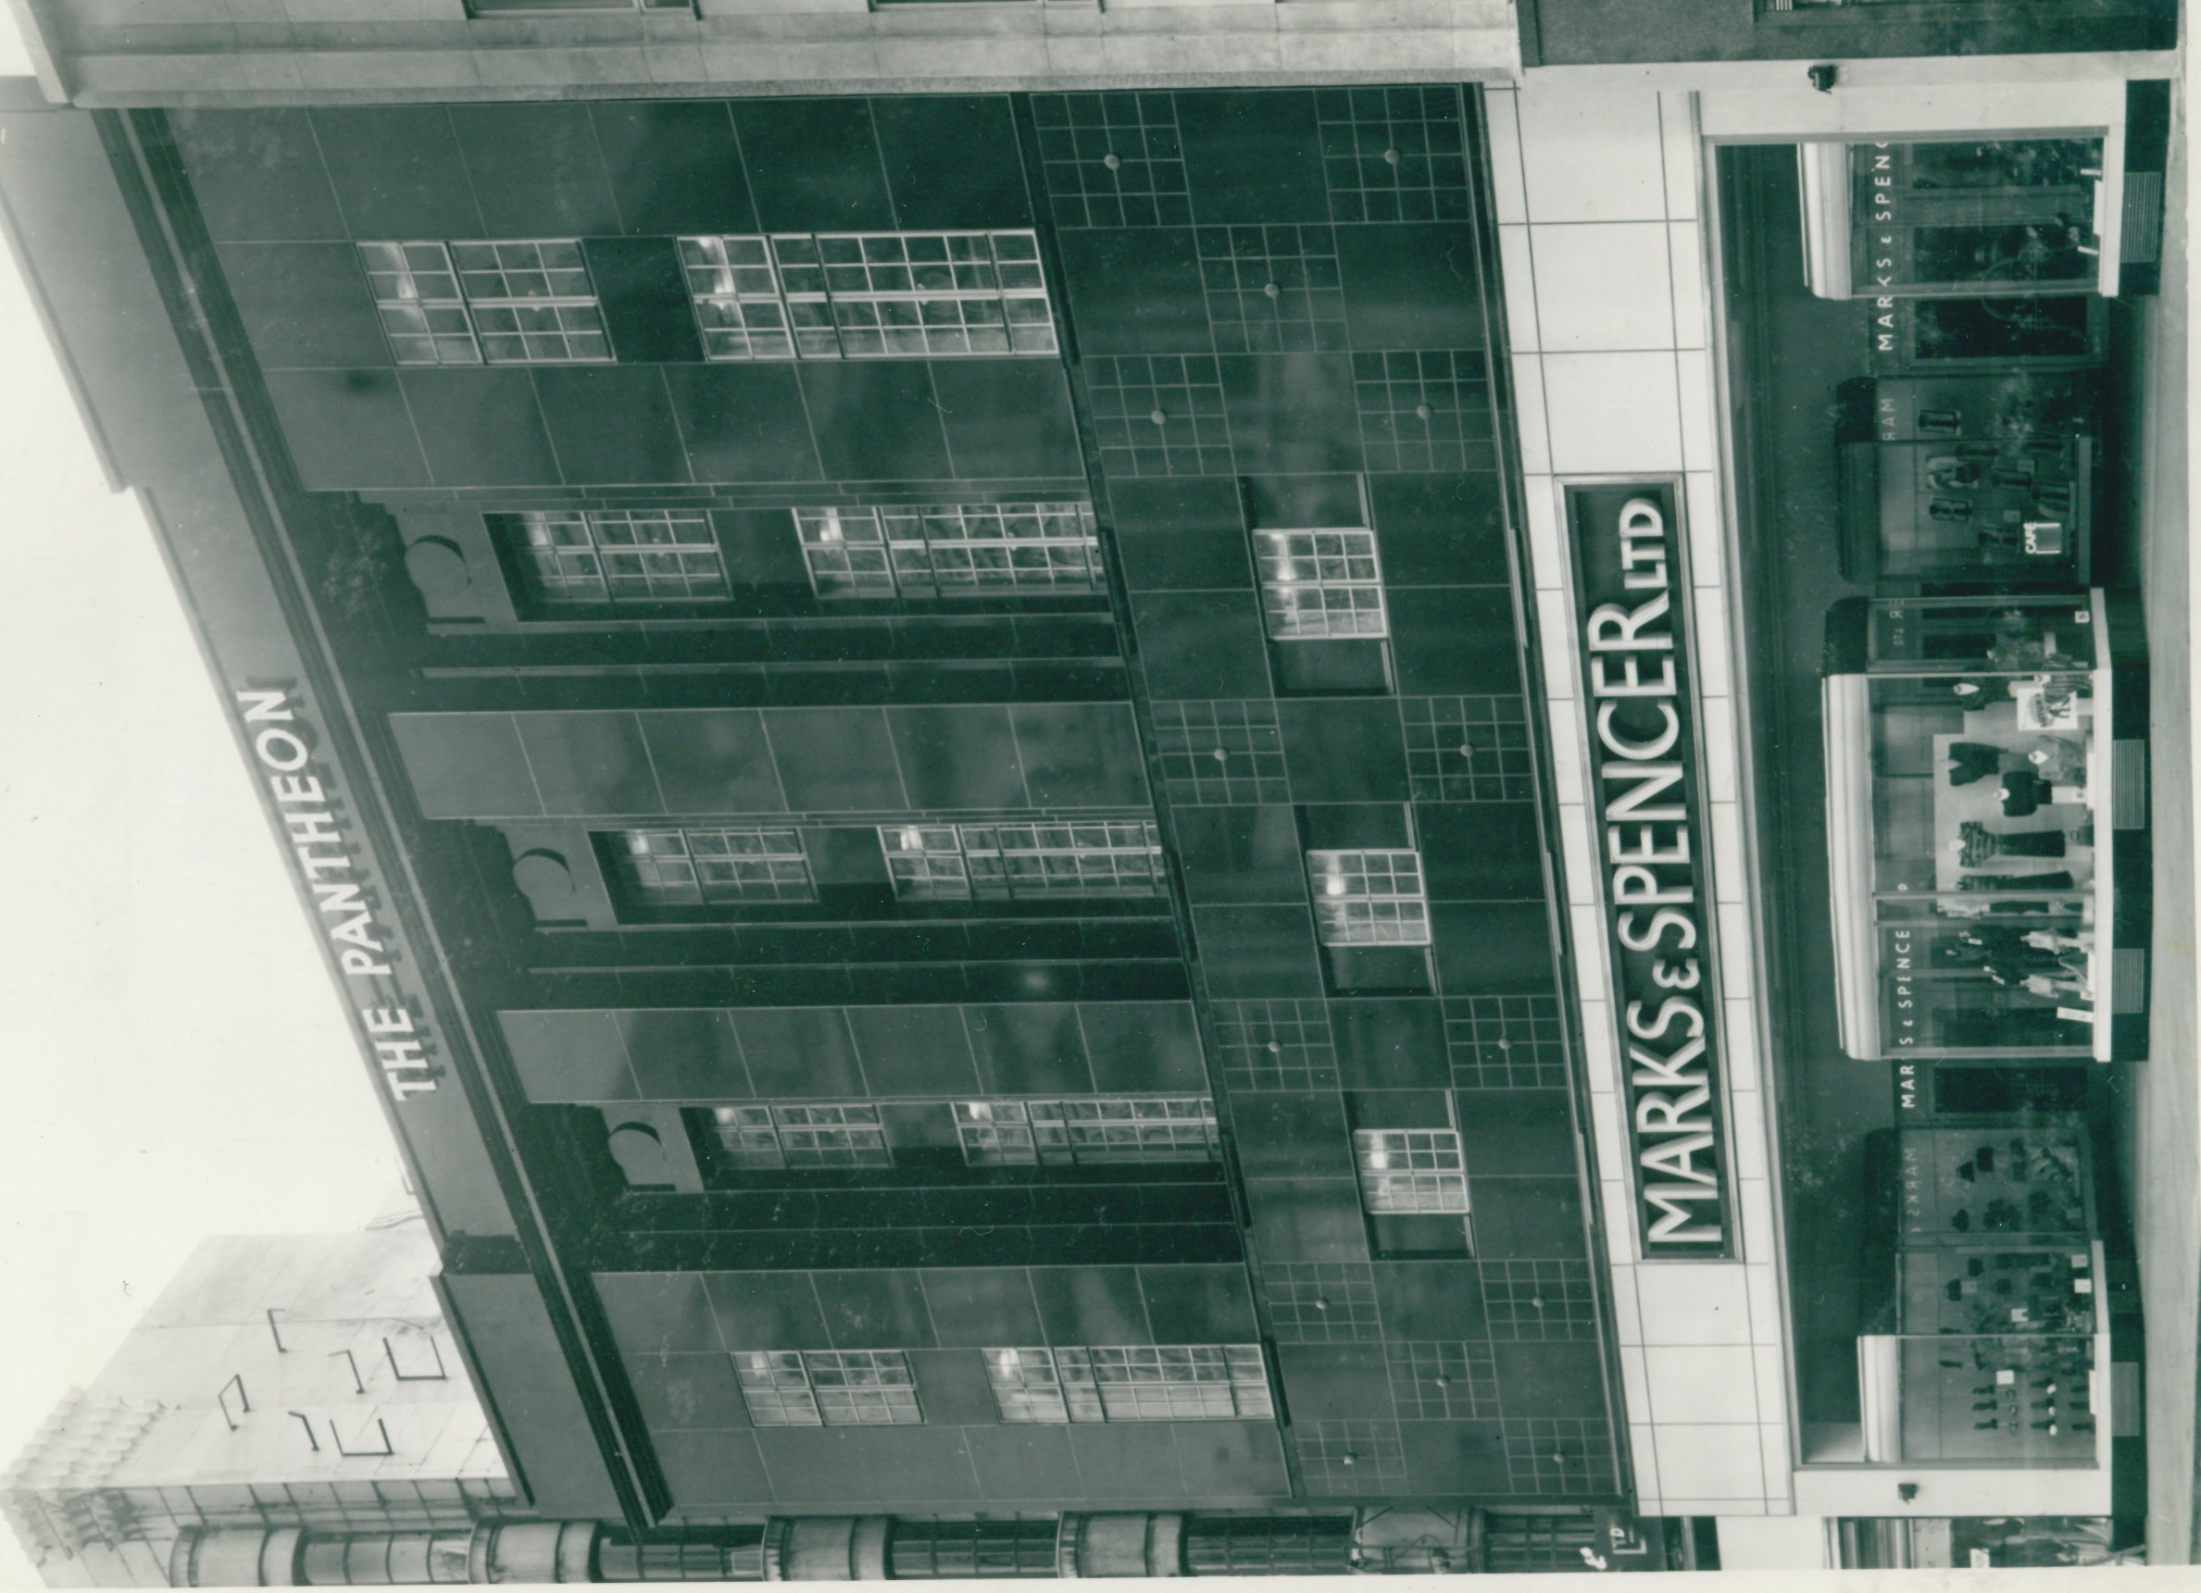
M&S Pantheon 1938
Image 4

Slide 5
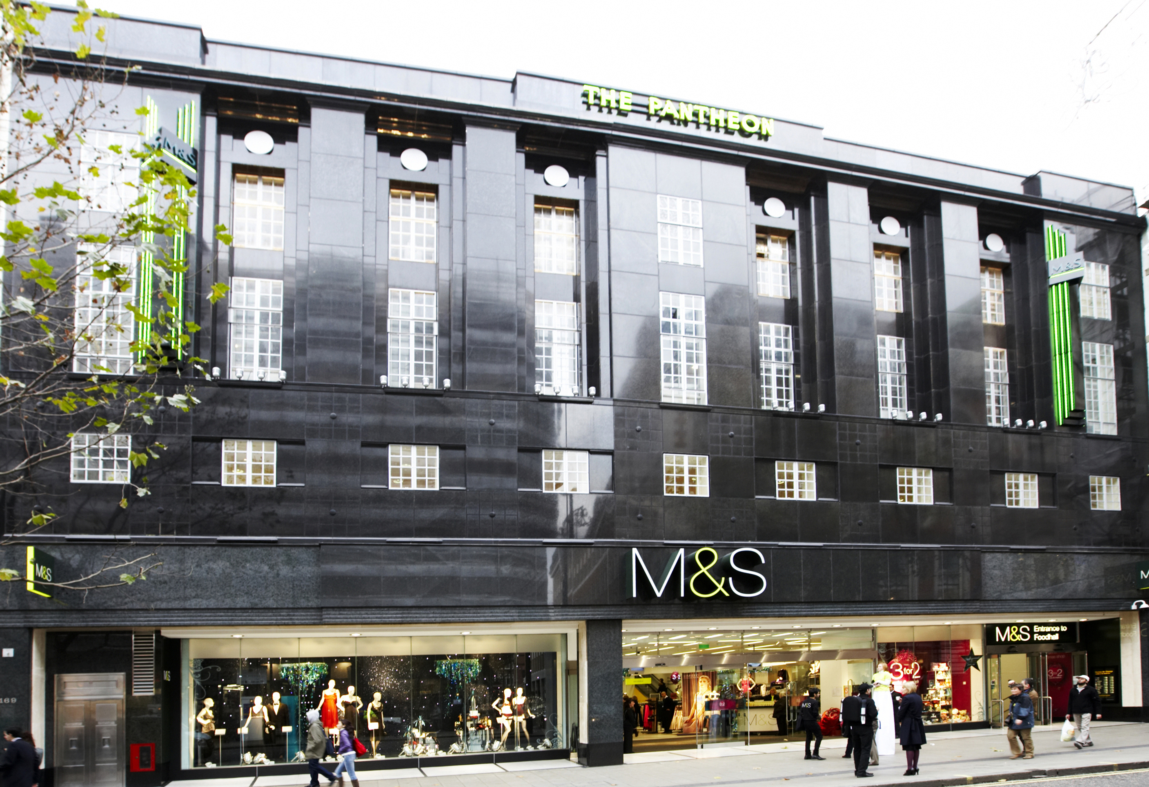
Image 5
M&S Pantheon 2008

Slide 6
Image 6
M&S Newcastle

Slide 7
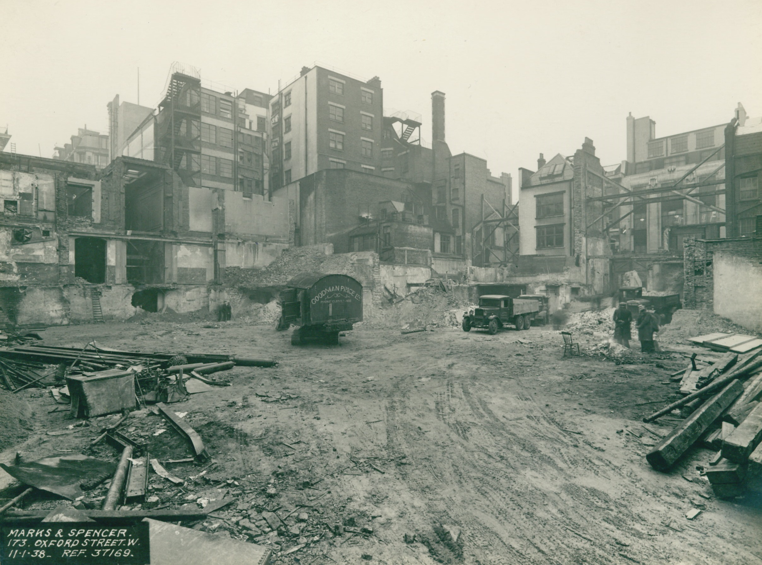
Image 7
M&S Pantheon construction site 1938

Slide 8
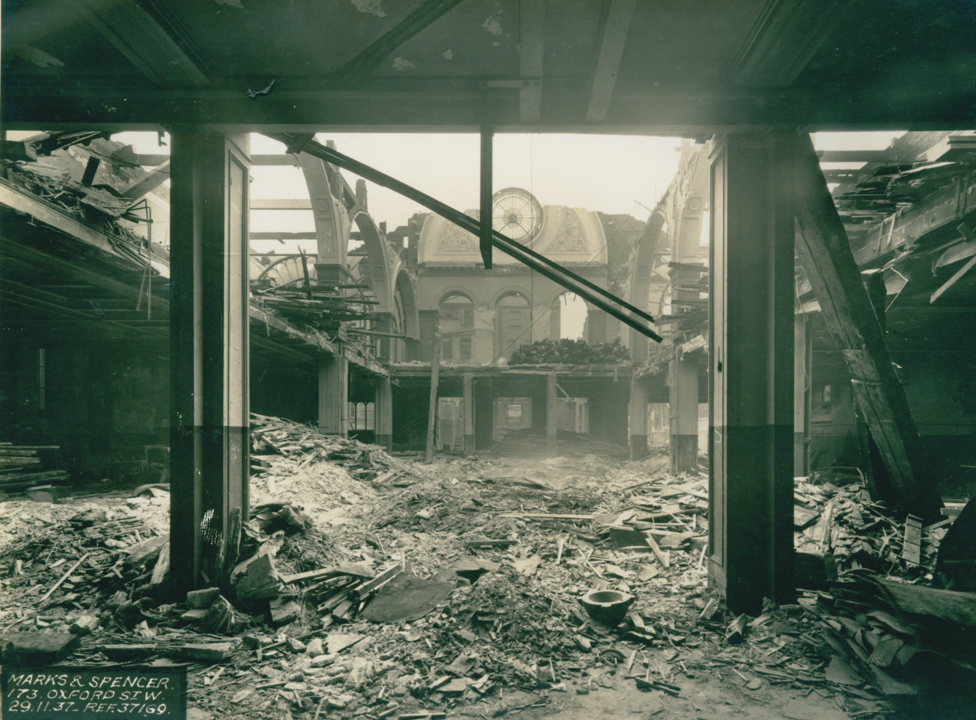
Image 8
The Pantheon demolition 1937

