Slide 1
Birth of a Brand

Slide 2
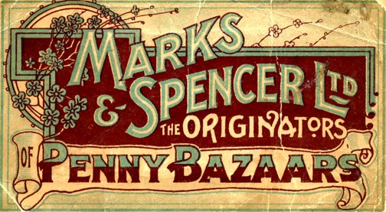
What is a brand?

Slide 3
What visual design elements make up a brand?
How do those elements convey messages about the brand to customers?

Slide 4
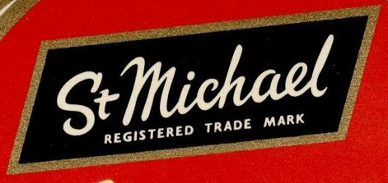
What does M&S branding convey at different times?
1940s
1950s

Slide 5
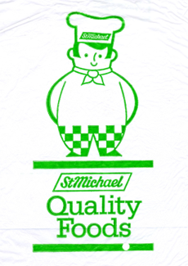
What does M&S branding convey at different times?
1980s
2010s

Slide 6
What do you notice when comparing the examples?
Why do you think those changes were made?

Slide 7
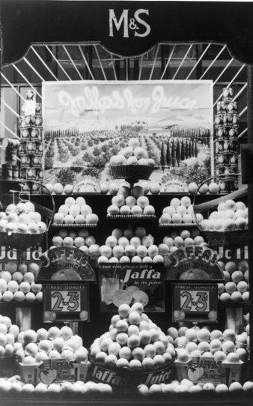
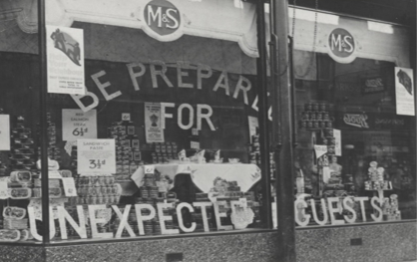
Why did M&S create such elaborate window displays in the 1930s?

Slide 8
Why was M&S advertising in cinemas?
Click the image to play

Slide 9
What do you notice about the advert in comparison to today’s TV or online advertising?

Slide 10
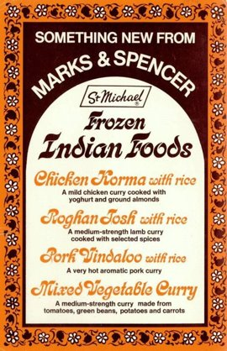
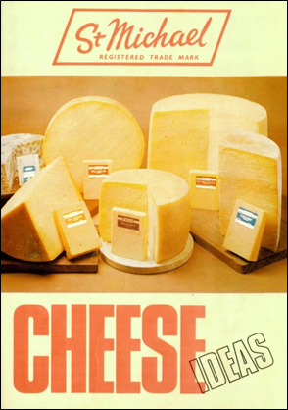
Which 1970s image is most like current advertising, and which is the least?

Slide 11
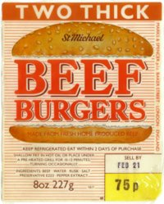
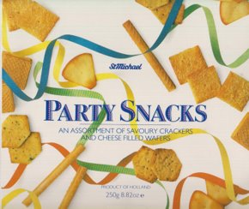
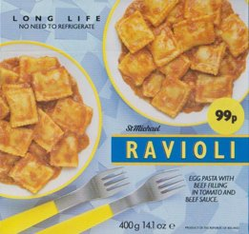
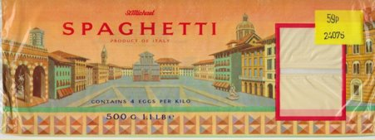
What graphic design techniques can you identify in these 1980s examples?

Slide 12
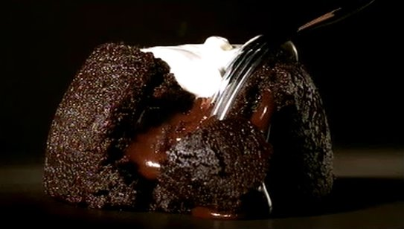
Why was the ‘This is not just food… This is M&S Food’ TV campaign so successful?
Click the image to play

Slide 13
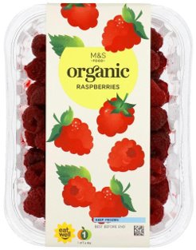
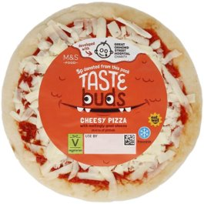
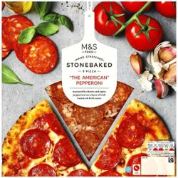
Which design elements do you notice first? List all the elements you notice in order.

Slide 14
What does this tell you about how visual hierarchy is being used?
Consider; colour, composition, contrast, size, symmetry, repetition, proximity, texture, white space.

Slide 15
Can you find these design elements in the Food Packaging and Advertising image pack? Make a note of any other details you notice.

Slide 16
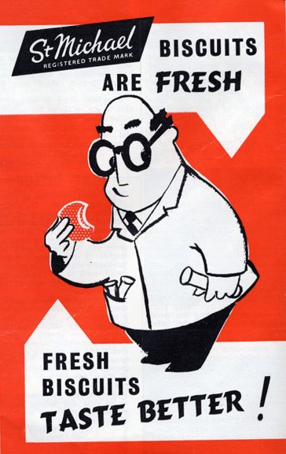

Slide 17
