Slide 1
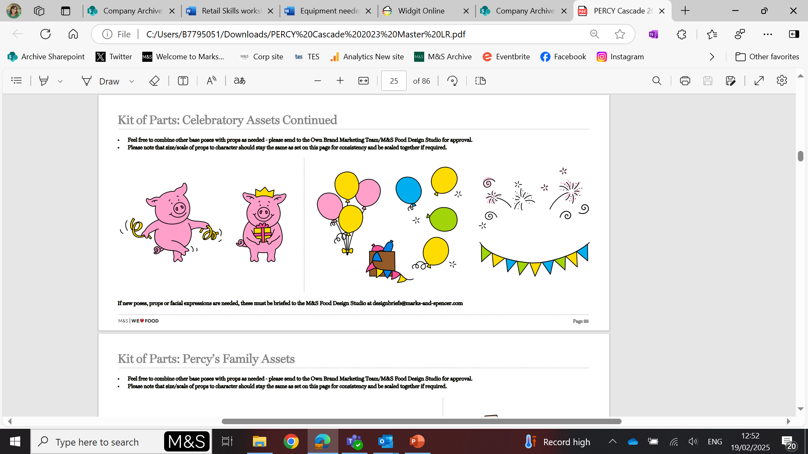


CONGRATULATIONS!
For completing M&S Archive Retail Skills activities!

